Slide 1
Tick Testing:
Passive Surveillance and Community Engagement
Stephen M. Rich
Professor of Microbiology
Director of the Laboratory of Medical Zoology
University of Massachusetts, Amherst

Slide 2
Objectives
Discuss the importance of Lyme Borrelia and other emerging tick-borne co-infections to public health
Recognize the significance of Tick Testing as it pertains to clinical and public health concerns
Evaluate the utility of Passive Surveillance to identify areas and times of risk of tick-borne diseases.

Slide 3



Slide 4
Where did Lyme disease come from?
Evolutionary
Ecological
Epidemiological

Slide 5
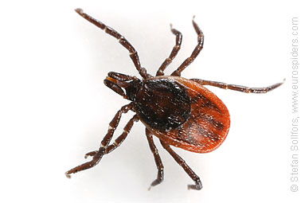
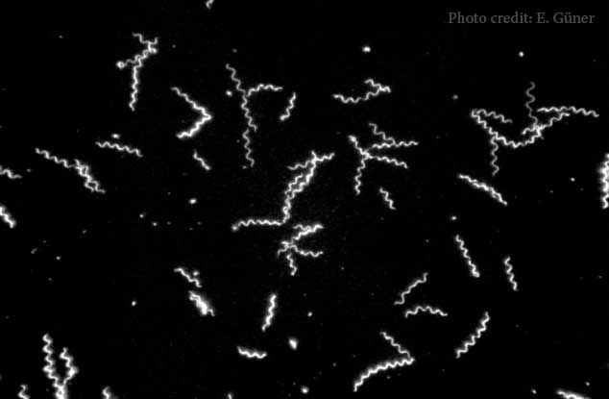
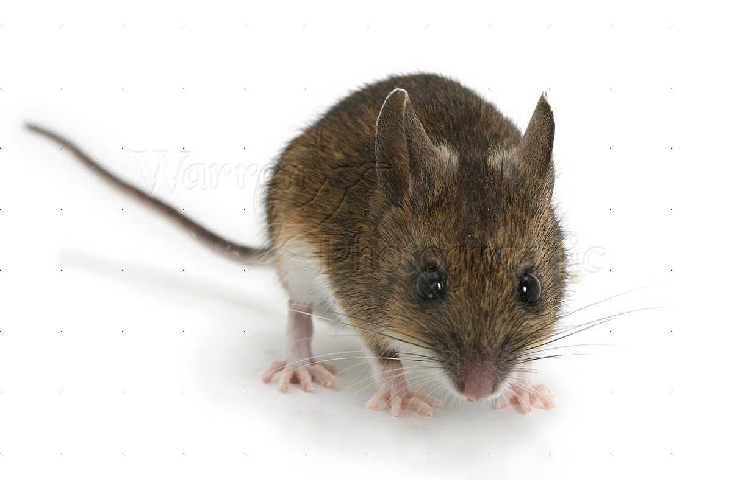
EVOLUTION:
Borrelia are ancient and abundant
VECTOR
HOST
B. afzelii
Hard tick
Mammal
B. garinii
Hard tick
Mammal
B. bissetti
Hard tick
Mammal
B. burgdorferi
Hard tick
Mammal
B. anserina
Soft tick
Bird
B. coriaceae
Soft tick
Mammal
B. hersmii
Soft tick
Mammal
B. parkeri
Soft tick
Mammal
B. turicatae
Soft tick
Mammal
B. miyamotoi
Hard tick
Mammal
B. crocidurae
Soft tick
Mammal
B. recurrentis
Louse
Mammal
Spain
Soft tick
Mammal

Slide 6
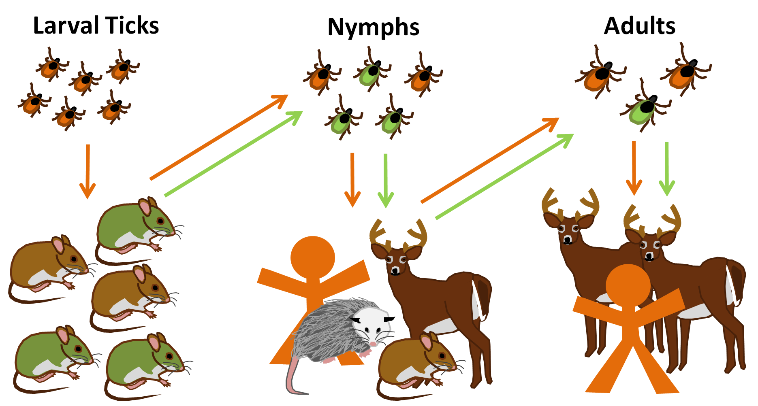
Lyme disease is an ecological phenomenon

Slide 7
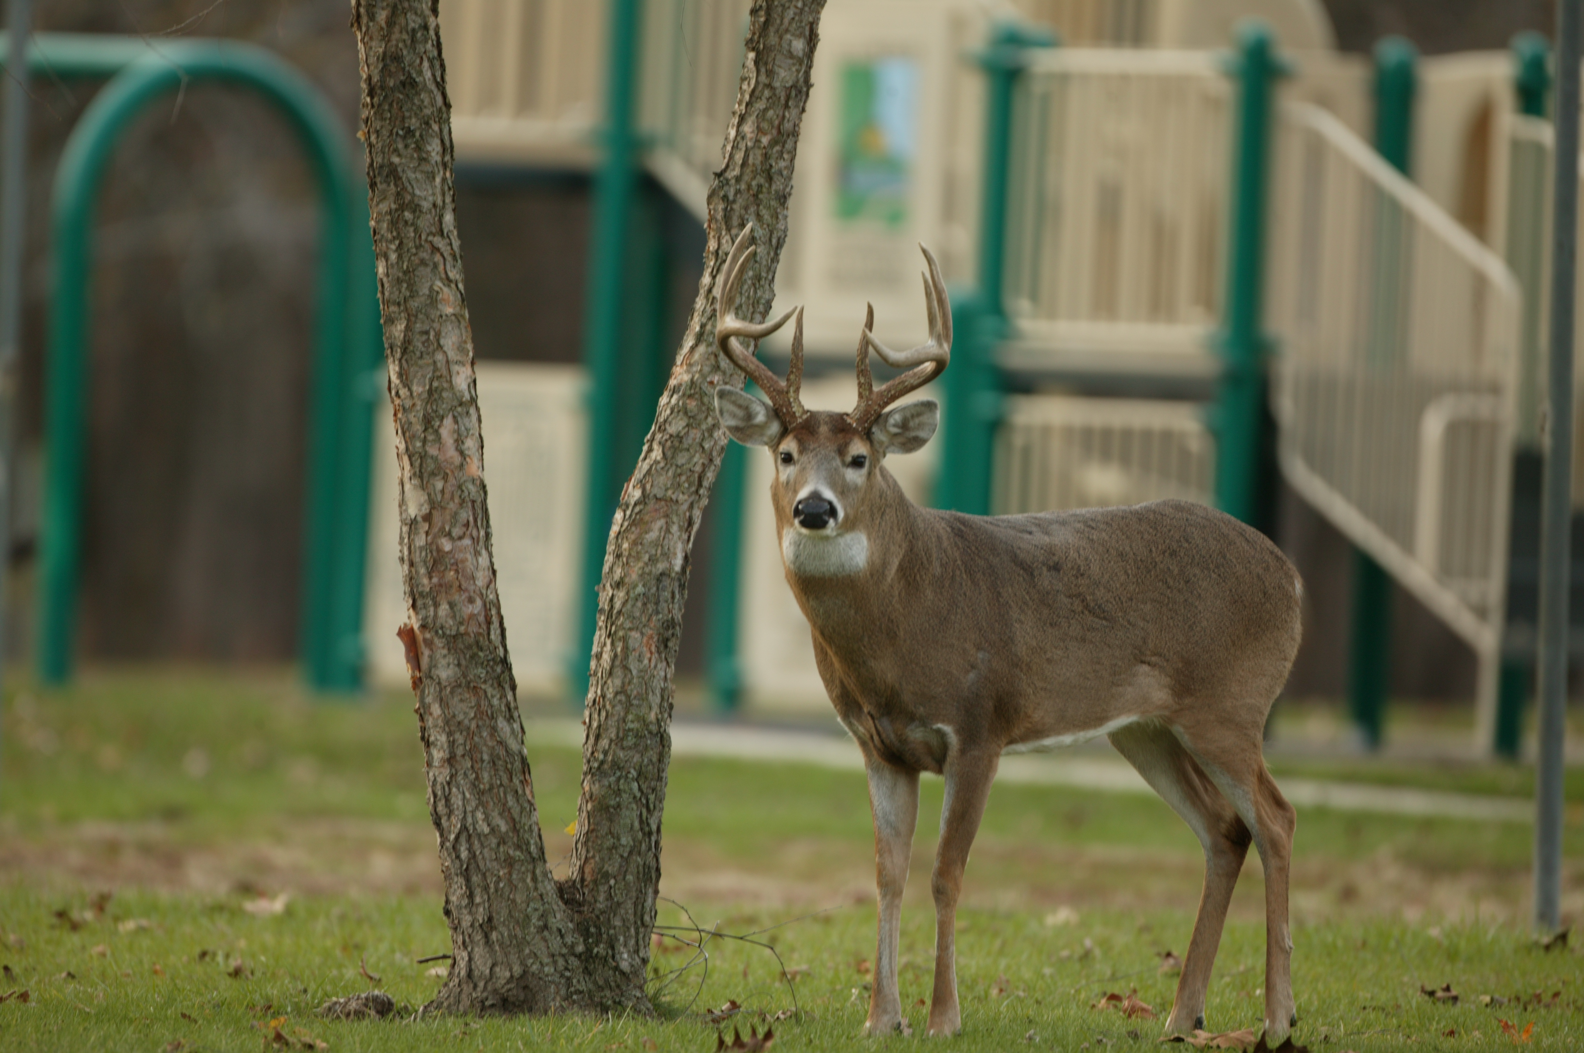
ECOLOGY:
“more ticks in more places”
Changing landscapes, suburban sprawl have led to unprecedented increase in deer habitat
Deer are the principal breeding host for deer ticks
Diversity of ecological communities

Slide 8
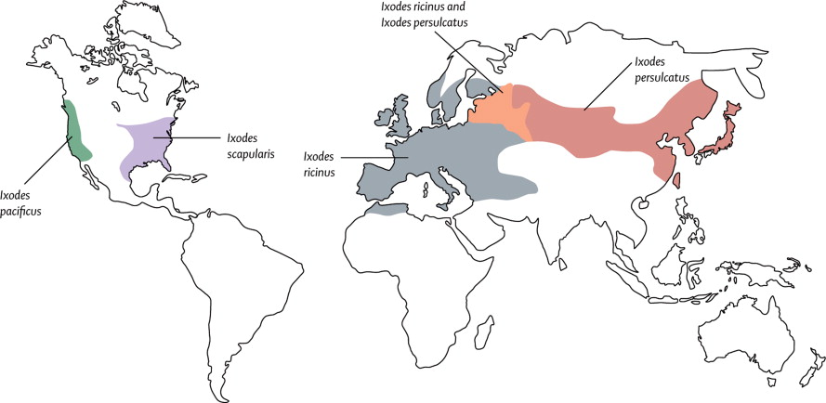
Global distribution of the vectors ( Ixodes ricinus species complex) of Lyme borrelia
The Lancet, Volume 379, Issue 9814, 2012, 461 - 473
http://dx.doi.org/10.1016/S0140-6736(11)60103-7

Slide 9
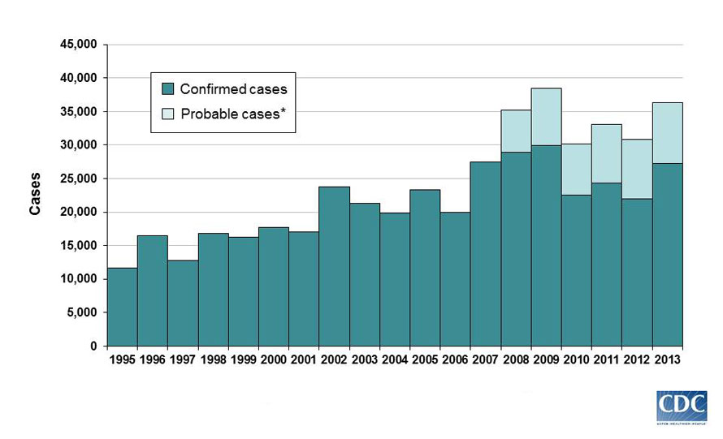
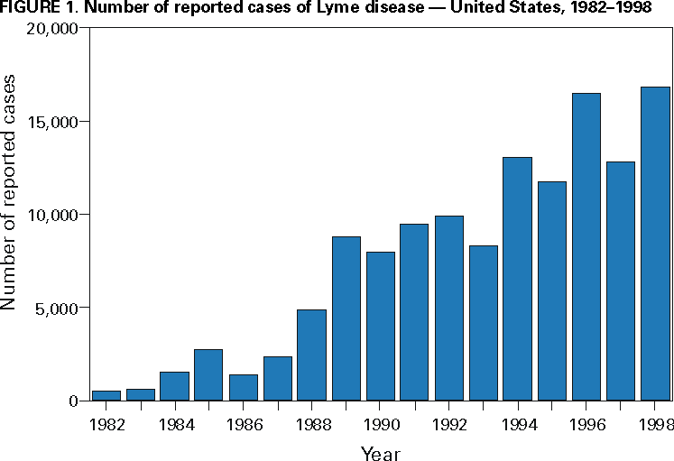
EPIDEMIOLOGY

Slide 10
Epidemiological ‘Tyme’ Line
Juvenile arthritis (Old Lyme CT)
Tick bite etiology
Deer tick (Ixodes dammini)
Spirochete (Borrelia burgdorferi)
Reservoirs (deer and mice)
Lyme Disease
1975
1979
1982
1985

Slide 11
Passive Surveillance for
Tick-borne Disease
Properly assessing risk of exposure to Lyme disease
Evaluating the extent of lesser know or newly emerged co-infections (Anaplasma, Babesia, B. miyamotoi, Powassan, etc.).
Anticipating the next tick-borne disease

Slide 12
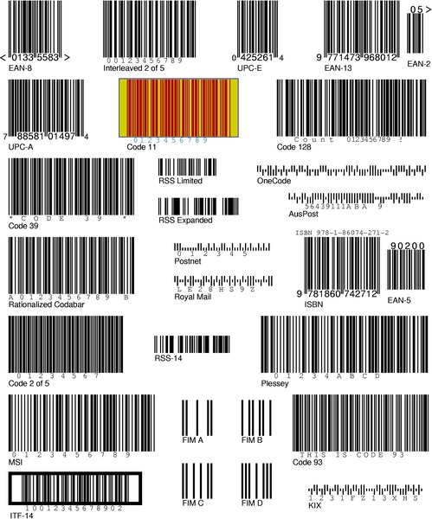
Tick Testing Service
Molecular detection of Lyme disease agent and other pathogens in ticks (PCR)
Fee-for-service ($50/tick)
  2006 - Started in Fall
  2010 - Added more pathogen tests
  2014 - Over 5000 of ticks/year from 40 states (~70% from Massachusetts)

Slide 13
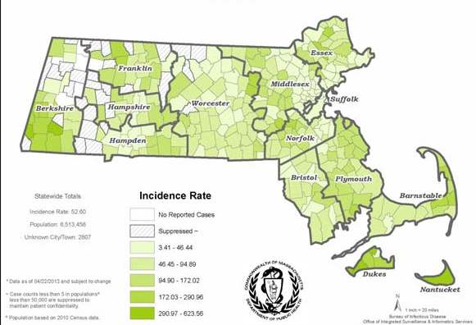
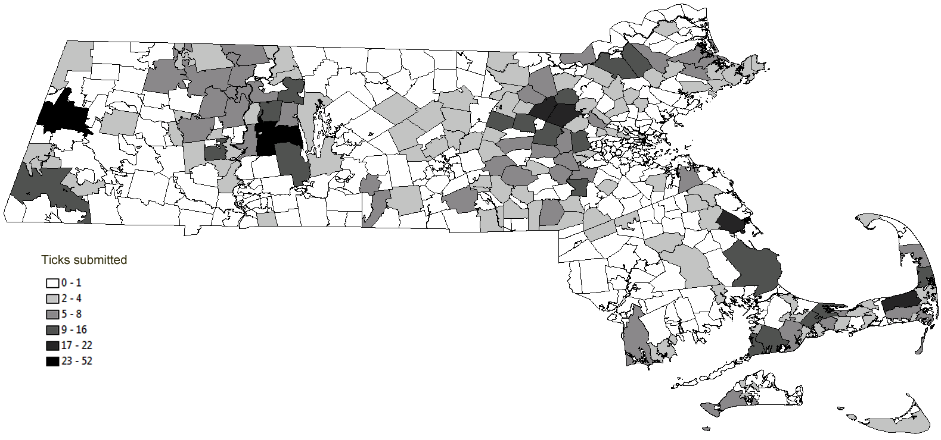
Tick submissions 2006-2012

Slide 14
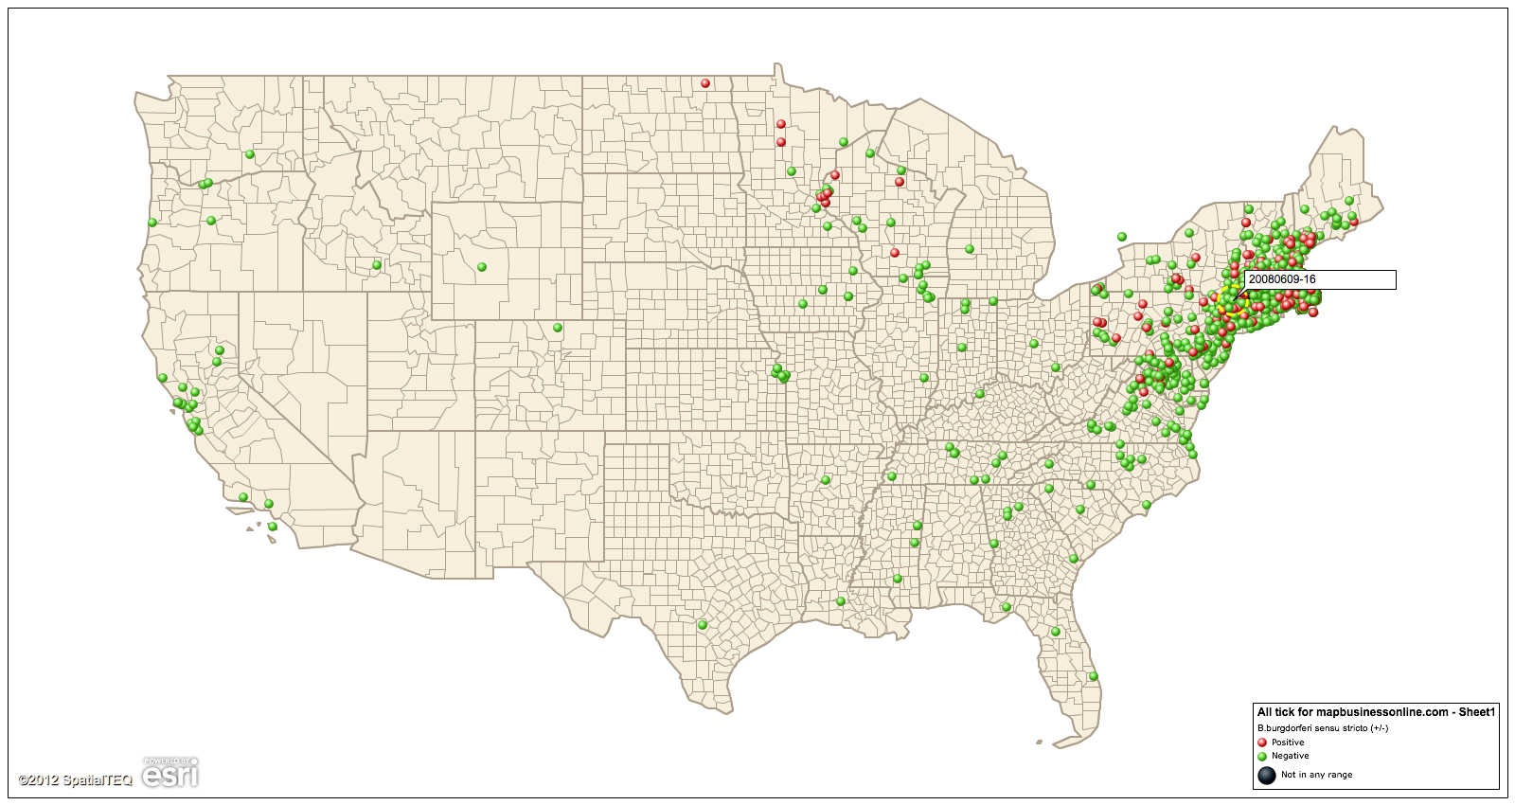
Ticks tested 2006-2012

Slide 15
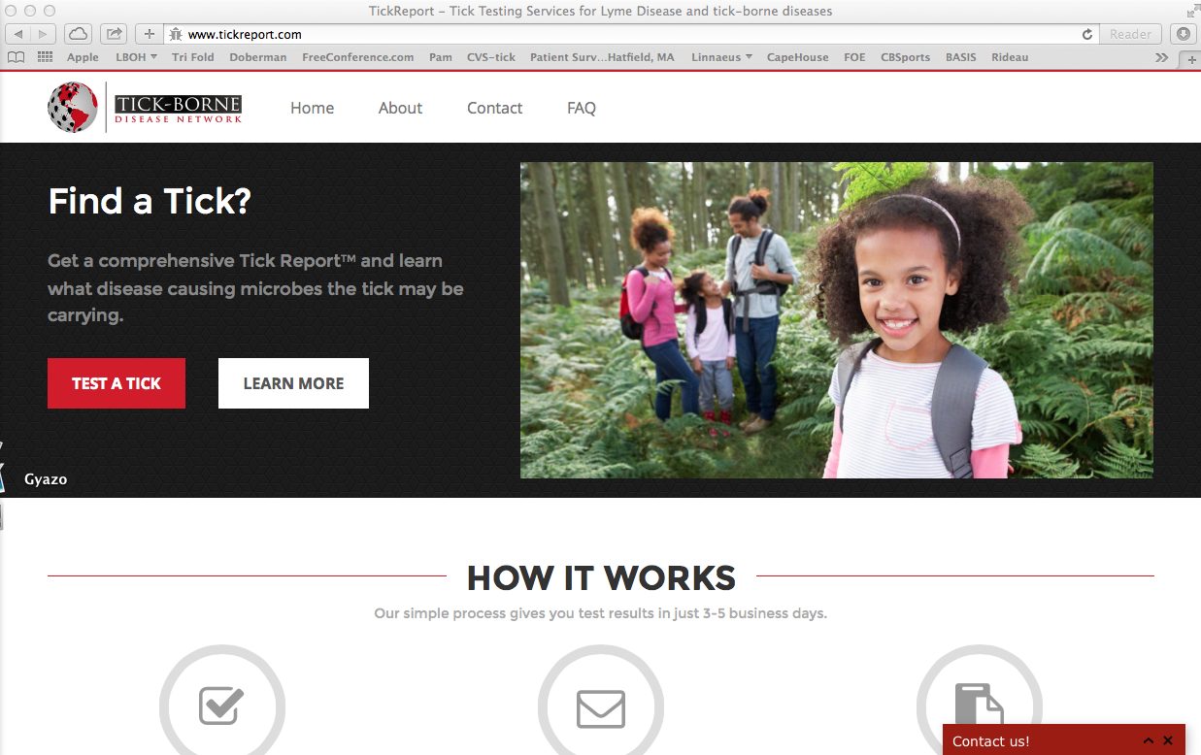

Slide 16
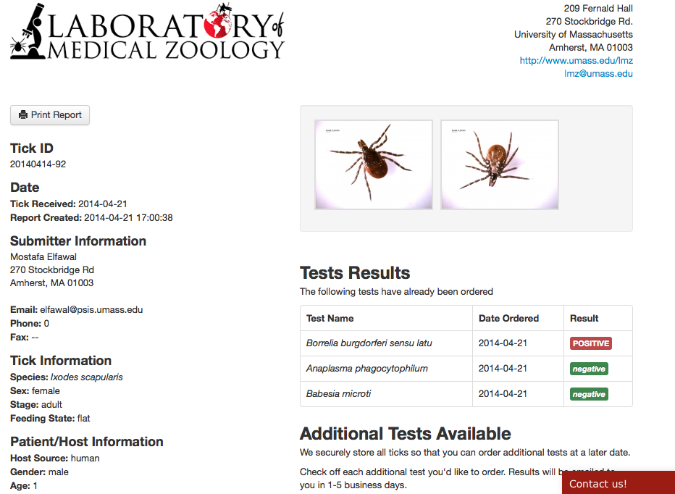

Slide 17
Tick Borne Pathogen tests (2010)
Borrelia burgorferi
Borrelia miyamotoi
Borrelia lonestari
Anaplasma phagocytophilum
Babesia microti
Babesia divergens Francisella tularensis
Ehrlichia chaffeensis
Ehrlichia canis
Bartonella henselae
Rickettsia rickettsii
Rickettsia spp.

Slide 18
70 of 90 (77.8%) Anasplasma positives come from Cape Cod/Islands
32 of 36 (88.9%) Babesia positives come from Cape Cod/Islands

Slide 19
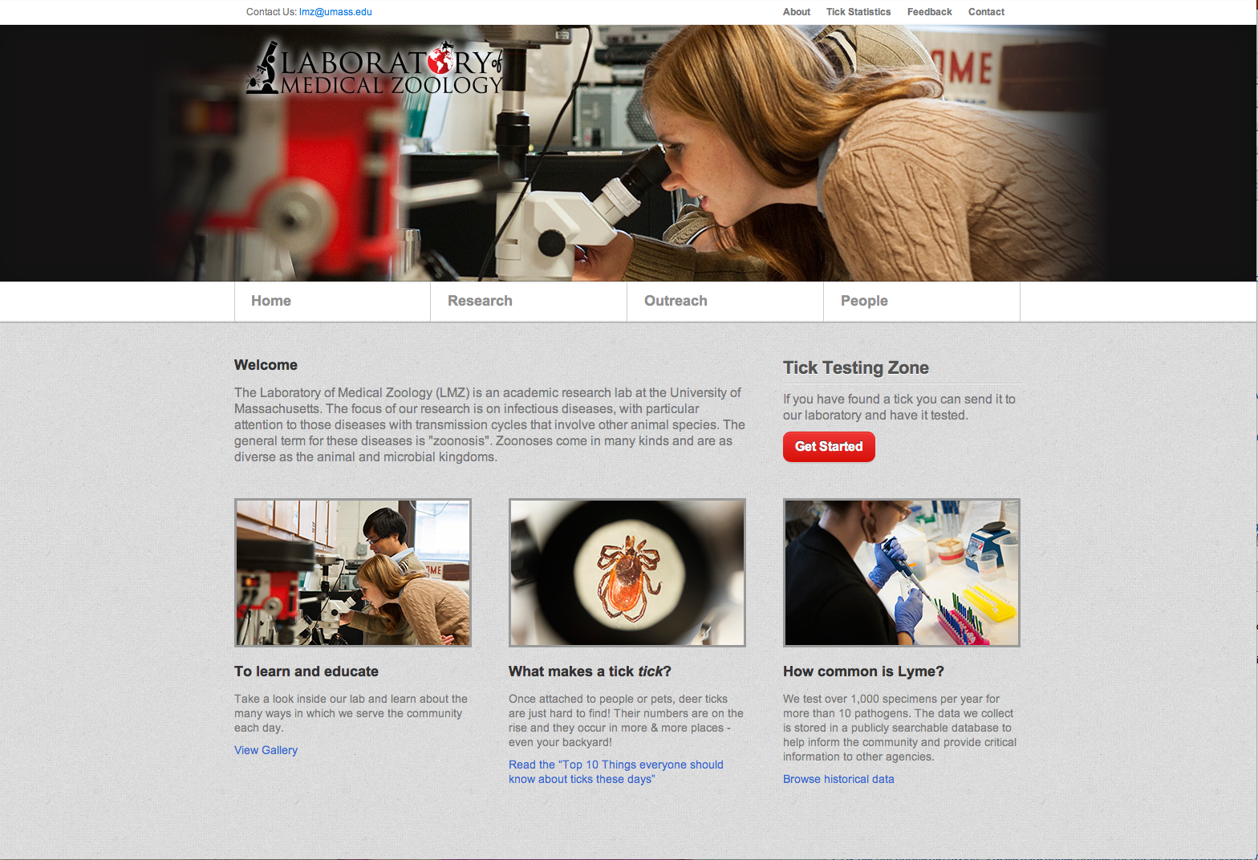
Submit a Tick

Slide 20
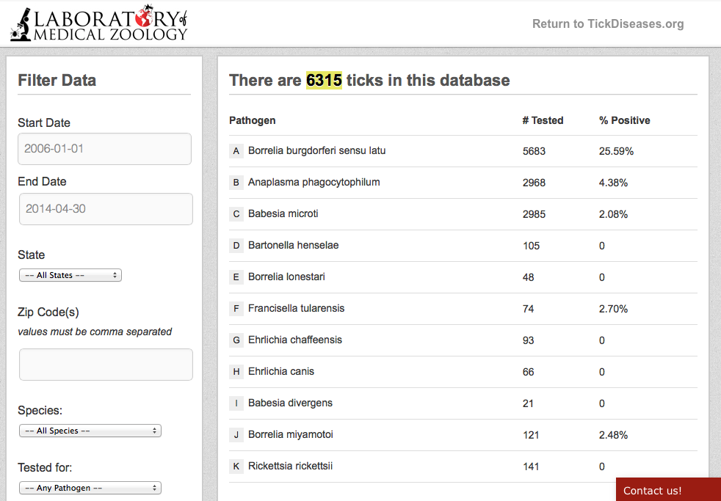
stats.TickDiseases.org

Slide 21
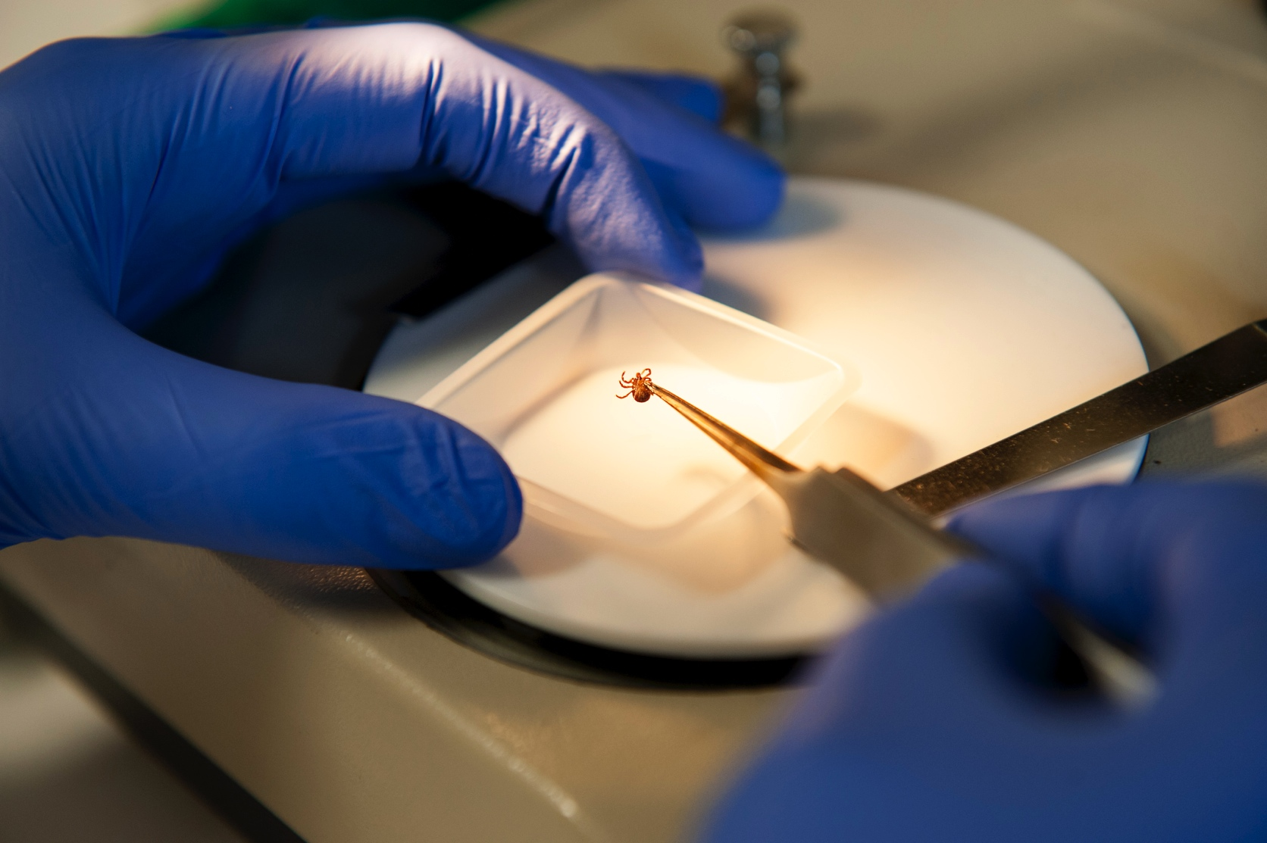
Assessing Risk using TickReport.com
Identification of tick species
    Is it known to transmit pathogens?
Assessment of feeding
    Did it feed long enough?
Is the tick infected with pathogen?
    Results based on highly accurate DNA test.

Slide 22
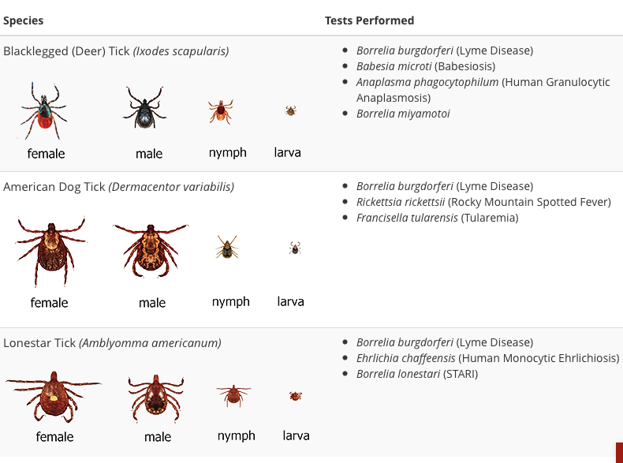
TickReport menu

Slide 23
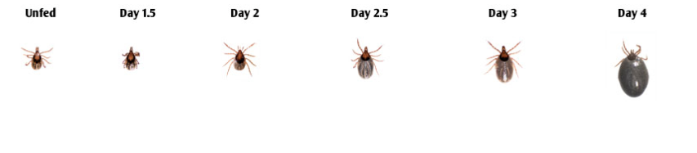
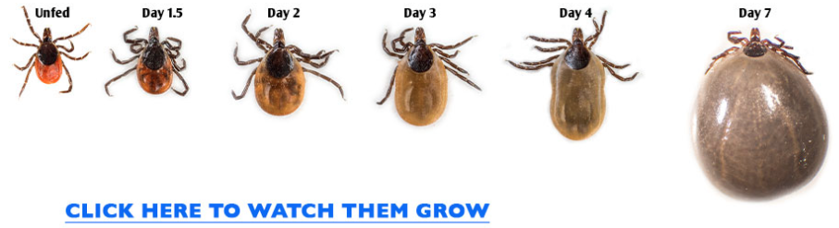
Risk increases with feeding (time of attachment)

Slide 25


INDIVIDUAL benefits
+
-

Slide 26
Tick Testing for pathogens
(not disease)
Host
Disease
Pathogen
Environment

Slide 27





SURVEILLANCE benefits
+
+
-
-
-
-
+
-

Slide 28
PUBLIC HEALTH benefits
E
N
K
T
R
W
O
!

Slide 29
Passive Surveillance
Tick testing is not intended to diagnose of human disease.
Tick testing is a research tool to aid epidemiological and zoonotic research, and can be particularly useful to:
    Provide temporal and geographic data of tick species, associated pathogens, and levels of human biting activity
    Assess individual levels of exposure risk
    Raise awareness of ticks and TBD

Slide 30
Surveilling Risk
Tick encounter rate
Infection rates among ticks
Duration of tick exposure

Slide 31
Surveilling Risk
 | Flag/Drag sampling
Tick encounter rate | Indirect
Infection rates among ticks | Direct
Duration of tick exposure | -

Slide 32
Surveilling Risk
 | Flag/Drag sampling | Case Reports/ Serosurveys
Tick encounter rate | Indirect | -
Infection rates among ticks | Direct | Indirect
Duration of tick exposure | - | -

Slide 33
Surveilling Risk
 | Flag/Drag sampling | Case Reports/ Serosurveys | Passive surveillance of tick bite
Tick encounter rate | Indirect | - | Direct
Infection rates among ticks | Direct | Indirect | Direct
Duration of tick exposure | - | - | Direct

Slide 34
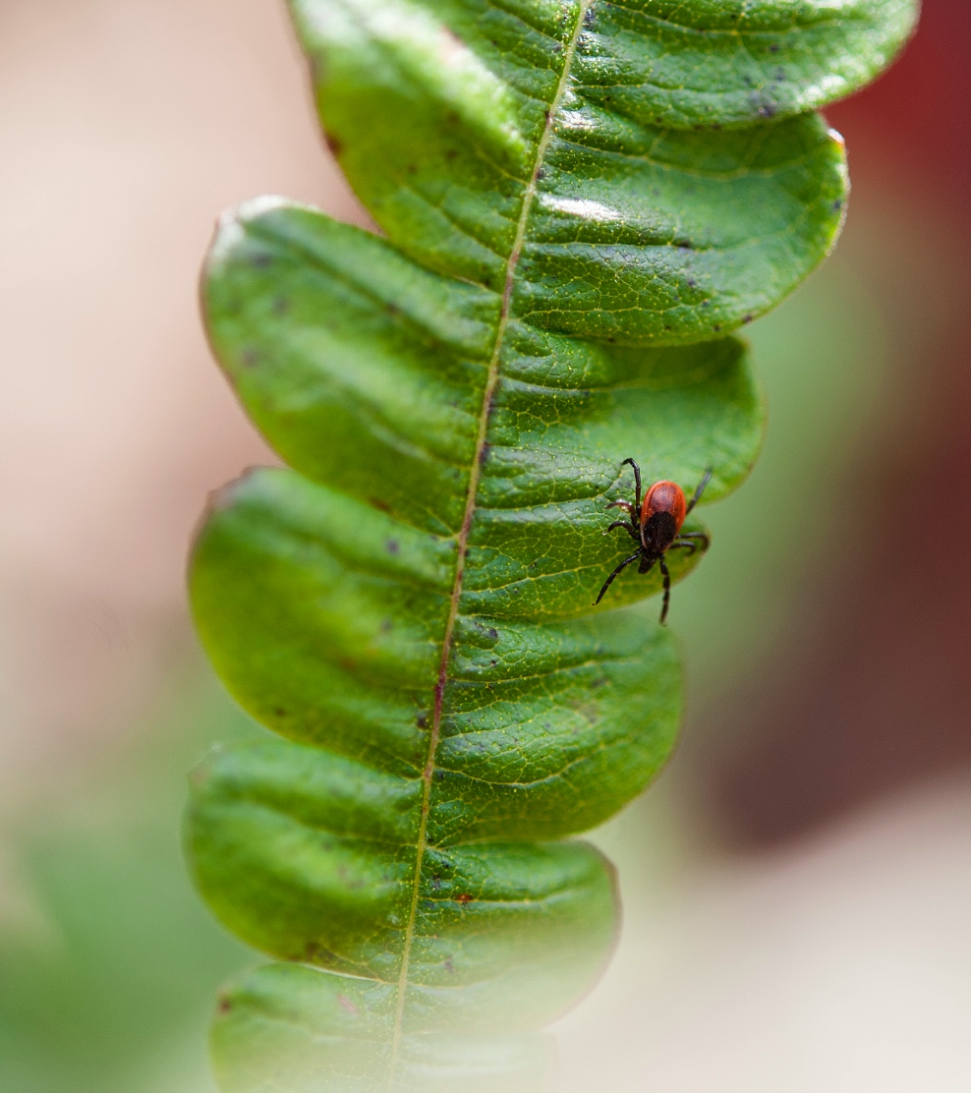
Passive Surveillance provides novel Public Health insights
Who is getting bit by ticks?
When are they getting bit?
Where are these bites occurring?
What disease causing pathogens are involved?

Slide 35


Slide 36
Passive Surveillance funding
  Little federal or state $$ available
  Crowd-sourcing/funding
  Search for “Tick angels”
  SOLUTION: Realize favorable economies of scale by joining local public health agencies into a PASSIVE SURVEILLANCE network

Slide 37
TICKTOWN, USA - INFECTION SUMMARY
Pathogen | Ixodes | Dermocentor | Amblyomma
B. burgdorfer + | 45% (130) | 0% (76) | 0% (43)
A.phagocytophilum + | 11% (130) | 0% (0) | 0% (0)
B. microti + | 4% (130) | 0% (0) | 0% (0)
B. miyamotoi + | 15% (130) | 0% (0) | 0% (0)
B. lonestari + | 0% (0) | 0% (0) | 8% (43)
E. chaffeensis + | 0% (0) | 0% (0) | 2% (43)
R. rickettsii + | 0% (0) | 2% (76) | 0% (0)
F. tularensis + | 0% (0) | 0% (76) | 0% (0)
B. henselae + | 0% (18) | 0% (0) | 0% (0)

Slide 38
No-TICKTOWN, USA - INFECTION SUMMARY
Pathogen | Ixodes | Dermocentor | Amblyomma
B. burgdorfer + | 0% (0) | 0% (0) | 0% (0)
A.phagocytophilum + | 0% (0) | 0% (0) | 0% (0)
B. microti + | 0% (0) | 0% (0) | 0% (0)
B. miyamotoi + | 0% (0) | 0% (0) | 0% (0)
B. lonestari + | 0% (0) | 0% (0) | 0% (0)
E. chaffeensis + | 0% (0) | 0% (0) | 0% (0)
R. rickettsii + | 0% (0) | 0% (0) | 0% (0)
F. tularensis + | 0% (0) | 0% (0) | 0% (0)
B. henselae + | 0% (0) | 0% (0) | 0% (0)

Slide 39
Community Innovation Challenge 2014 (Bedford)
32 Towns in 4 counties (Barnstable, Franklin, Middlesex, Nantucket)
Pre-paid tick testing for 100 residents from each participating town
    $3K/town, $30/tick, test for most common pathogens
Establish a Tick-Borne Disease Network

Slide 40
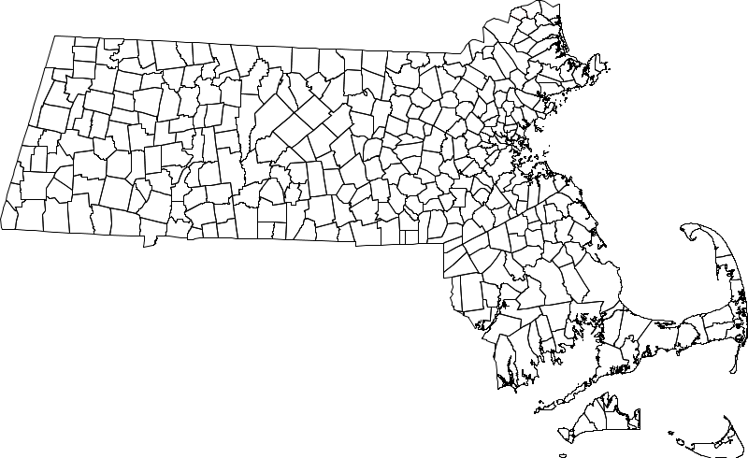
Tick-borne Disease Network
Community Innovation Challenge
32 towns, 100 ticks/town, $3k/town

Slide 41
Passive Surveillance:
  Tick Testing
    Who is getting bit by ticks?
    When are they getting bit?
    Where are these bites occurring?
    What disease causing pathogens are involved?
  Develop protocol for assessing PUBLIC HEALTH RISK

Slide 42
Who is getting bit?

Slide 43
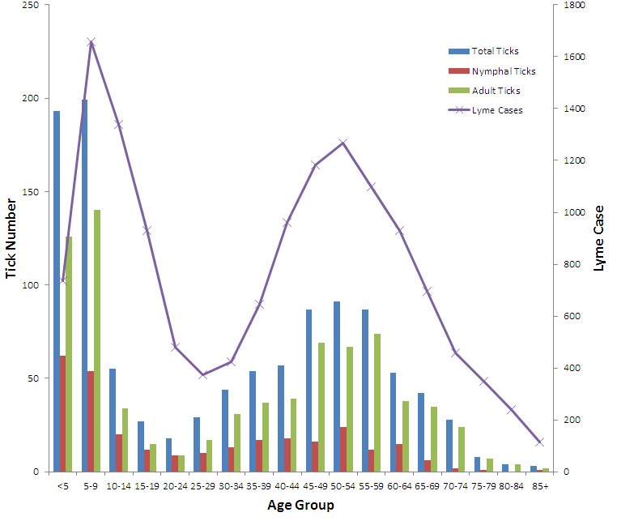
Age distribution of tick attacks

Slide 44
When are people/pets getting bit?

Slide 45
Seasonal Distribution of Tick submissions

Slide 46
Where are these bites occurring?
31 of 32 towns with tick bites
Three tick species in each county

Slide 47
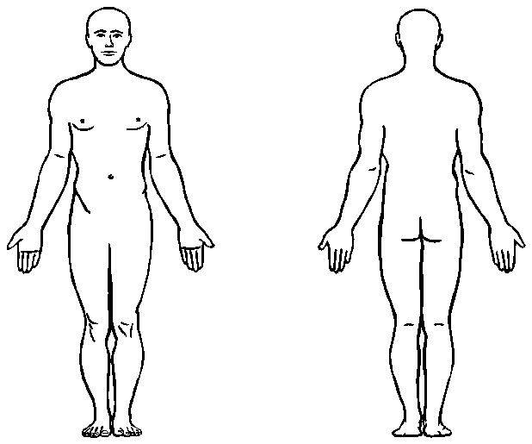
Tick Bite Distribution
2185 tick bite
submissions (2014)
13%
11%
18%

Slide 48
What pathogens are involved in these tick encounters?

Slide 49
Deer Tick Infection rates
(3 pathogens)
County | stage | count | B.burgdorferi | A.phagocytophilum | B.microti
Barnstable | Nymph | 208 | 15.9% | 3.8% | 9.1%
 | Adult | 708 | 37.9% | 6.1% | 9.3%
Franklin | Nymph | 52 | 17.3% | 0.0% | 0.0%
 | Adult | 225 | 39.1% | 4.9% | 1.8%
Middlesex | Nymph | 118 | 27.1% | 1.7% | 8.5%
 | Adult | 499 | 44.3% | 4.8% | 5.6%
Nantucket | Nymph | 48 | 31.3% | 8.3% | 22.9%
 | Adult | 14 | 42.9% | 7.1% | 7.1%

Slide 50
CIC co-infection rates
 | count | Anaplasma(+) | Babesia(+)
Chatham | 36 | 0.0% | 16.7%
Falmouth | 118 | 5.9% | 13.6%
Eastham | 41 | 7.3% | 12.2%
Brewster | 81 | 9.9% | 11.1%
Wellfleet | 37 | 5.4% | 10.8%
Yarmouth | 28 | 3.6% | 10.7%
Carlisle | 152 | 7.9% | 9.9%
Sandwich | 65 | 12.3% | 9.2%
Harwich | 44 | 0.0% | 6.8%
Dennis | 31 | 12.9% | 6.5%
Mashpee | 47 | 2.1% | 6.4%
Concord | 138 | 4.3% | 5.1%
Orleans | 40 | 5.0% | 5.0%
Lincoln | 63 | 1.6% | 4.8%
Barnstable | 86 | 4.7% | 4.7%
Truro | 25 | 8.0% | 4.0%
Acton | 54 | 5.6% | 3.7%
Bedford | 77 | 2.6% | 1.3%
Winchester | 32 | 0.0% | 0.0%

Slide 51
CIC co-infection rates
 | count | Anaplasma(+) | Babesia(+)
Dennis | 31 | 12.9% | 6.5%
Sandwich | 65 | 12.3% | 9.2%
Brewster | 81 | 9.9% | 11.1%
Truro | 25 | 8.0% | 4.0%
Carlisle | 152 | 7.9% | 9.9%
Eastham | 41 | 7.3% | 12.2%
Falmouth | 118 | 5.9% | 13.6%
Acton | 54 | 5.6% | 3.7%
Wellfleet | 37 | 5.4% | 10.8%
Orleans | 40 | 5.0% | 5.0%
Barnstable | 86 | 4.7% | 4.7%
Concord | 138 | 4.3% | 5.1%
Yarmouth | 28 | 3.6% | 10.7%
Bedford | 77 | 2.6% | 1.3%
Mashpee | 47 | 2.1% | 6.4%
Lincoln | 63 | 1.6% | 4.8%
Harwich | 44 | 0.0% | 6.8%
Chatham | 36 | 0.0% | 16.7%
Winchester | 32 | 0.0% | 0.0%

Slide 52
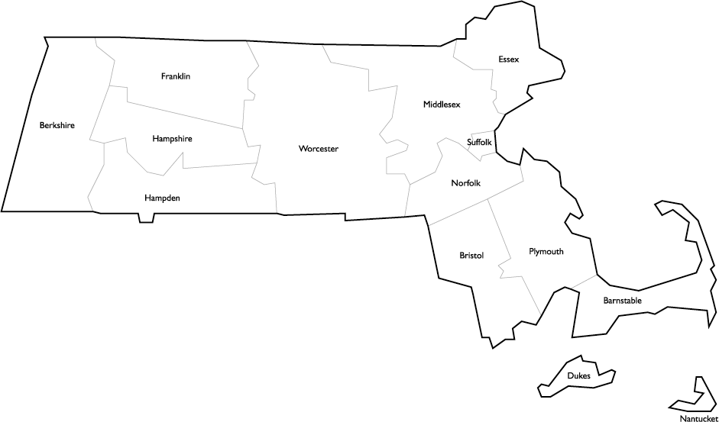
Tick Submissions 2014
Unfed ticks (no risk)
Fed ticks (high risk)

Slide 53
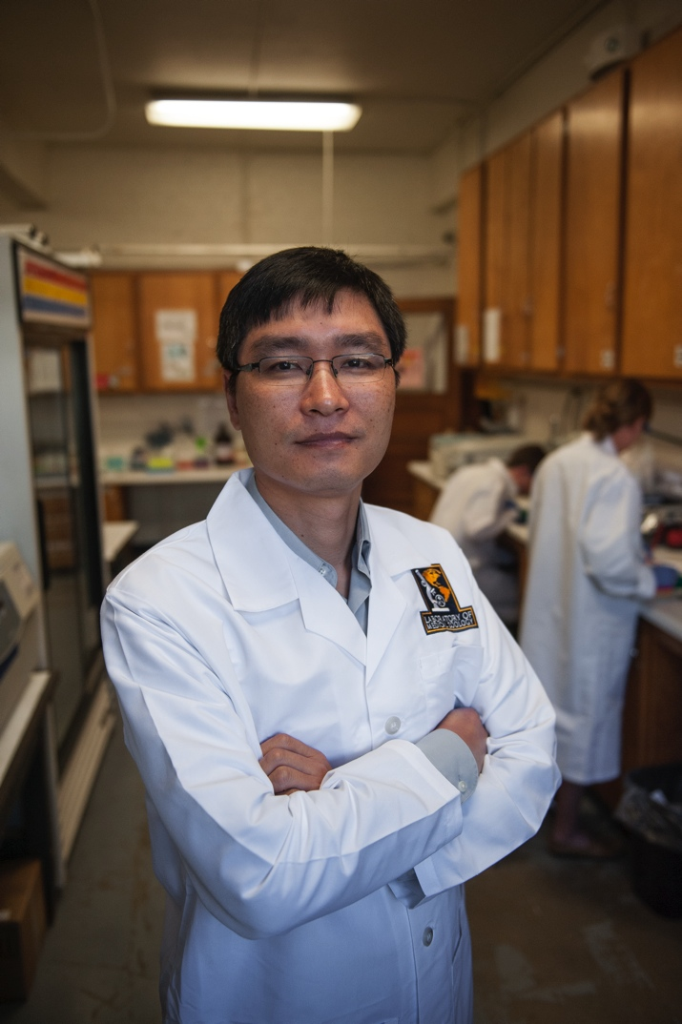
Engagement and Outreach
Guiding Risk Avoidance
TickEncounter.org

Slide 54
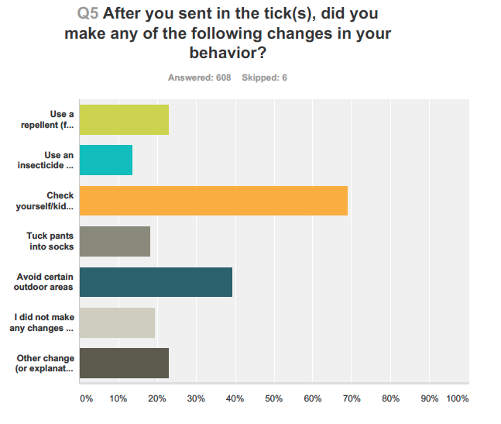

Slide 55


Slide 56
Passive Surveillance Summary
TickReport.com offers a tick testing service of value with both individual and greater public health benefits
    With increased sampling, data becomes a more powerful surveillance and research tool.
Locally, public-funded efforts in cooperation with a state lab at Umass, can provide a sustainable model for maintaining this network.

Slide 57
Conclusions
Distribution of deer ticks is expanding and with that expansion emerging disease phenomenon will continue
  Lyme, Anaplasmosis, Babesiosis….
Increasing awareness is key component of prevention
Passive Surveillance via testing of human biting ticks allows us to track disease and engage public individuals and agencies seeking to reduce risk

Slide 58
Acknowledgements
Heidi Porter (Bedford)
Susan Rask (Concord)
Phoebe Walker (Franklin Co.)
Larry Dapsis (Barnstable Co.)
Richard Ray (Nanucket)
Lisa White (Franklin Co.)
Dr. Guang Xu
Will Mohn, Elisheva Neffinger, Lora Miller, Michayla Marcil
College of Natural Science (Umass)
Community
Innovation
Challenge
Laboratory
of Medical
Zoology
Visit WWW.TickREPORT.COM

