Slide 1
MAPHN Leadership Matters: The Future of Public Health Nursing
Caroline Kinsella, BSN, RN, RS
Angela Kramer, MS, RN
Jessica Tracy, MSN, RN
Taylor West, BSN, RN
Tiffany Zike, MPH, BSN, RN

Slide 2
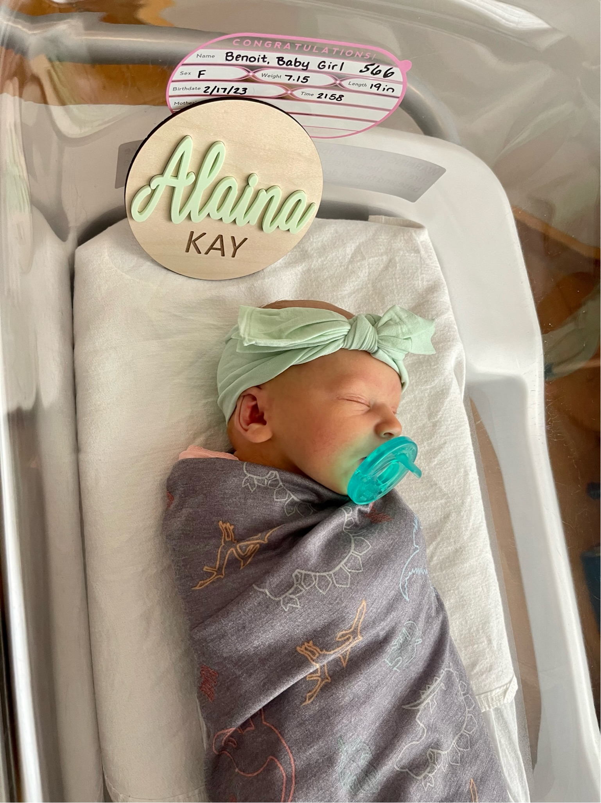

Slide 3
Purpose of this Presentation
Better understand the MAPHN Leadership Team role attending the Leadership Matters Program which was conducted by the Public Sector Consortium a National Non-Profit dedicated to training public leaders.
Better understand the Vision Statement & Innovations Project which is in progress
Engage you in the vision and execution of the plan.
Introduce the action steps we are already undertaking and major barriers we will be working on.
Identify MAPHN members willing to participate in leadership training for sustainability and advocacy for the profession.
Review how we prepared ourself to obtain the skillsets needed to create our Shared Vision
Facilitate an exit survey on tables.
Q & A

Slide 4
Vision Statement for our Innovations Project
Public health nurses are among the strategic public health professionals in all the Massachusetts cities and towns.
Public Health Nurses are responsible for keeping the residents of each town or city healthy and safe through public health regulations.
Municipal Public Health Nurses are responsible for the development and implementation of local public health programs in compliance with federal state and local laws and regulations.
Notes:
A Shared Vision is creating a picture of a desired future stated and written in present tense as though we achieved it. It's used to focus our decisions and investments to assure outcomes are aligned with our vision of the future.

Slide 5
Action Steps Underway
5 MAPHN Members received 64 hours of Leadership Training Fall/Winter 2022
Share and enroll MAPHN Members and other key stakeholders in our Vision Statement
Generated a lists of legislators with contact information throughout the Commonwealth.
Plan the training for a 1-day training retreat to teach the skills, knowledge and confidence that committed public health nurses can use to enroll their municipalities and their elected officials in the regulatory standards needed to achieve our vision statement.

Slide 6
MAPHN Leadership Matters: Measures of Success & Indicators for our Shared Vision
Every town in Massachusetts has at a minimum one full time public health nurse for every 5000 residents for each city or town or there would be a shared public nurse for 5000 residents across smaller cities and towns.*
The health of the community is improved and continues to improve due to regulations, services offered in public health, education, public health programs and monitoring.
Structurally and operationally public health nurses are among the public health officials at the strategic decision-making table in all their communities.
*Association of Public Health Nurses (APHN) national population-based recommendation of 1 PHN to every 5,000 in a 2008 document titled the Report on a Public Health Nurse to Population Ratio (ASTDN, 2008).

Slide 7
“Reform can be accomplished only when attitudes are changed.”
Lillian Wald 1867–1940ed.

Slide 8
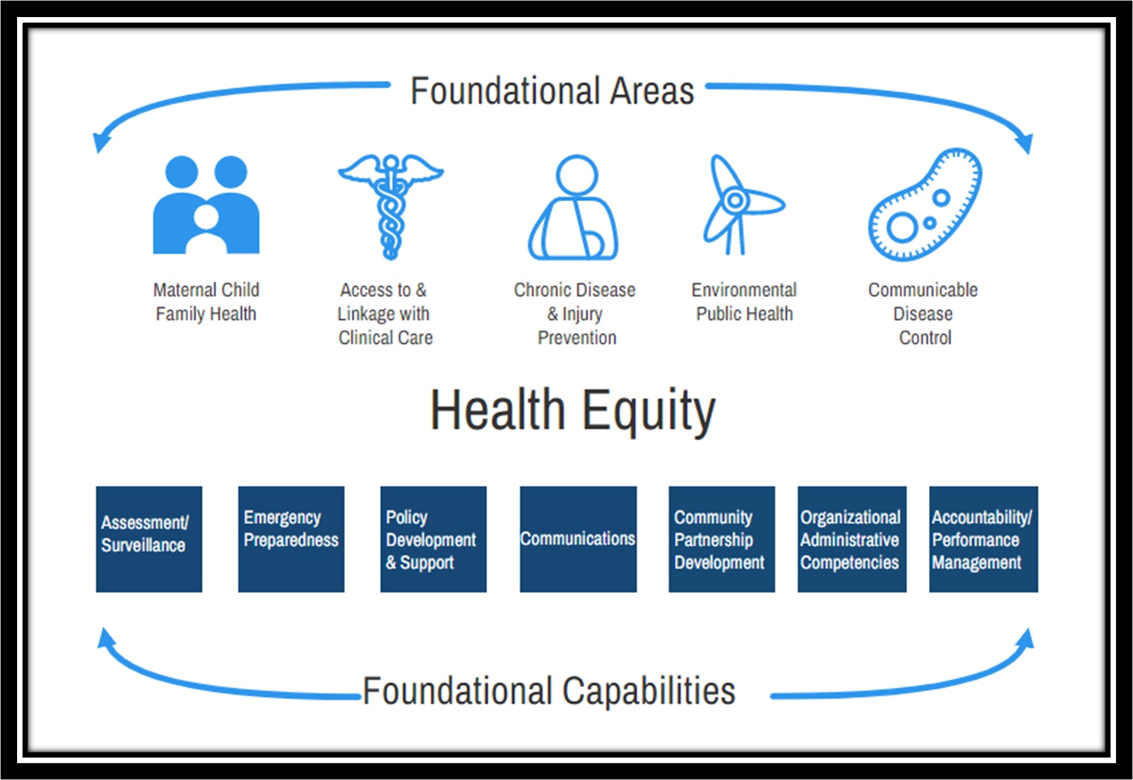
Special Commission Blueprint: Offers specific recommendations and frameworks to improve our local public health systems effectiveness to achieve health equity across the state.
The Foundational Public Health Services (FPHS) minimum set of skills, program planning and activities are what health departments must have to invest in health equity.
Source: (Special Commission Blueprint, 2019

Slide 9
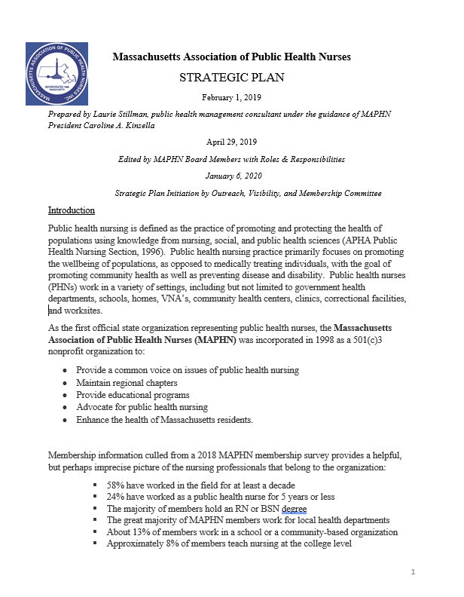
The MAPHN Strategic Plan serves as a roadmap to advocate for change. It outlines goals, objectives and key strategies to achieve outcomes.
The MAPHN White Paper identifies systemic issues related to the profession of MA public health nursing and identifies opportunities to address them.

Slide 10
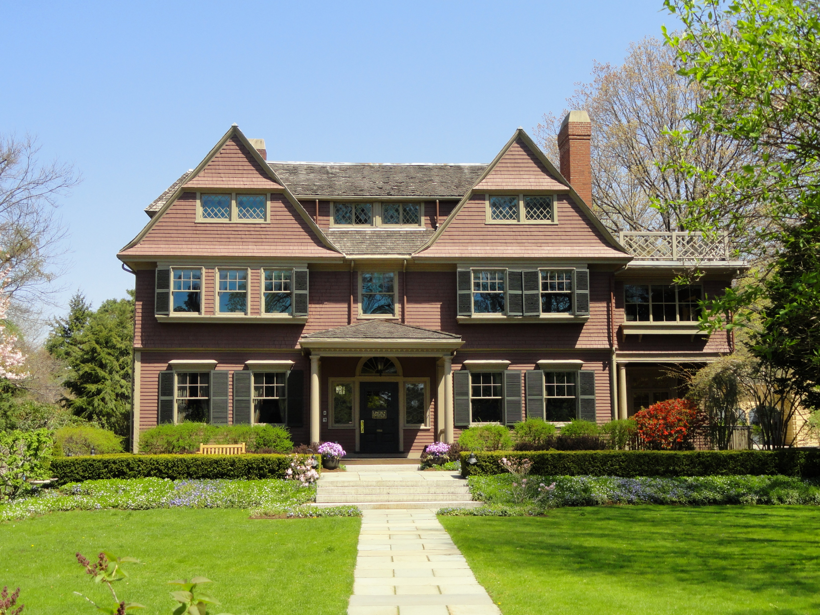
Notes:
We knew we needed new skill sets to better prepare ourselves in the leadership skills needed to address our barriers to change and reach our vision statement.

Slide 11
Leadership Matters Training Program
For Public Leaders
Phase 1: Eight days of classroom training (course descriptions to follow)
Phase 2: Execution of an Innovations Project which could be a continuation of this project in year two.
Phase 3: Share outcomes, best practices and what we would do differently with colleagues and alumni of this program.
“If your actions inspire others to dream more, learn more, do more and become more, you are a leader.” -John Quincy Adam

Slide 12
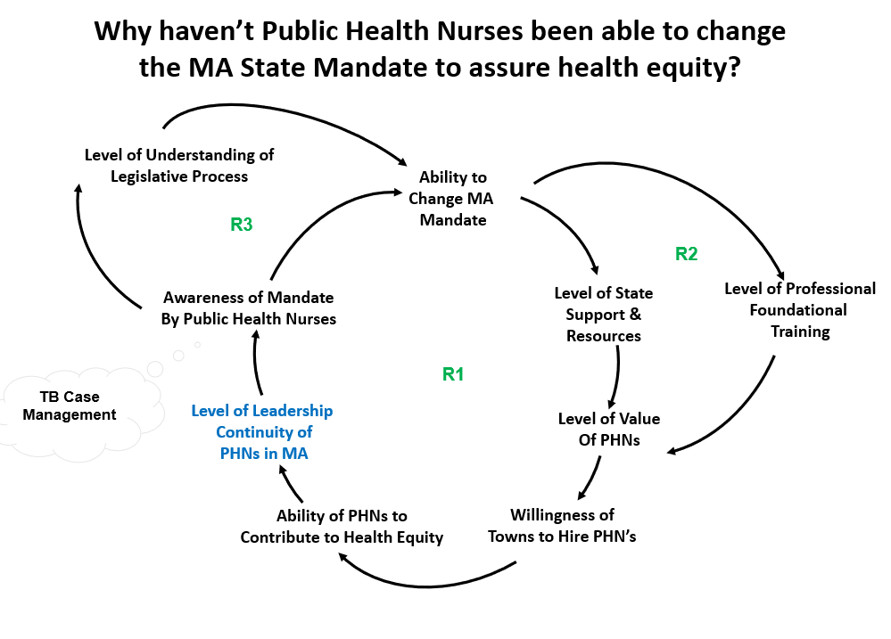
MAPHN Leadership Matters:
How We Prepared ourselves for this Work
Phase I: The Classroom
Facilitation Practices for Public Leaders September 16-17, 2022
Systems Thinking for Public Leaders October 14-15, 2022
Negotiation Strategies for Public Leaders November 4-5, 2022
Strategic Alignment for High Performance January 20-21, 2023

Slide 13
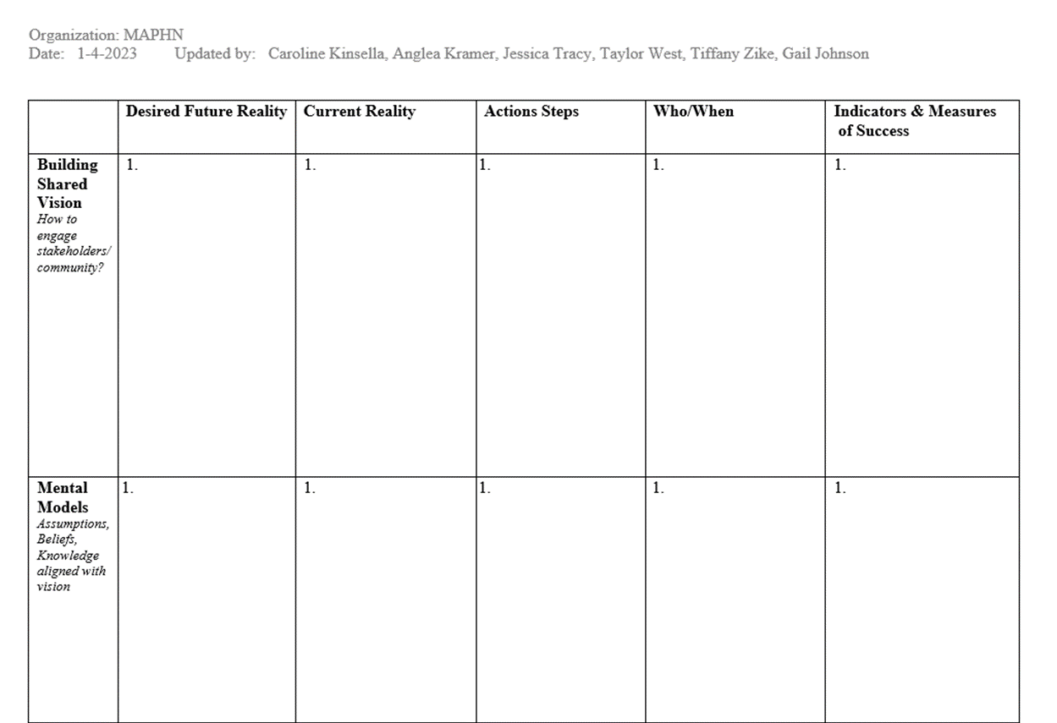
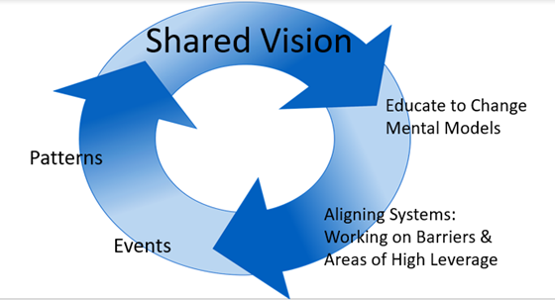
MAPHN Leadership Matters: Innovations Project
Notes:
Phase II of Leadership Matters Program The Vision Deployment Matrix identifies our desired future state with our current reality through vision, mental models, structures, patterns, and events.
The Vision Deployment Matrix aligns strategies to our shared vision to make change.

Slide 14
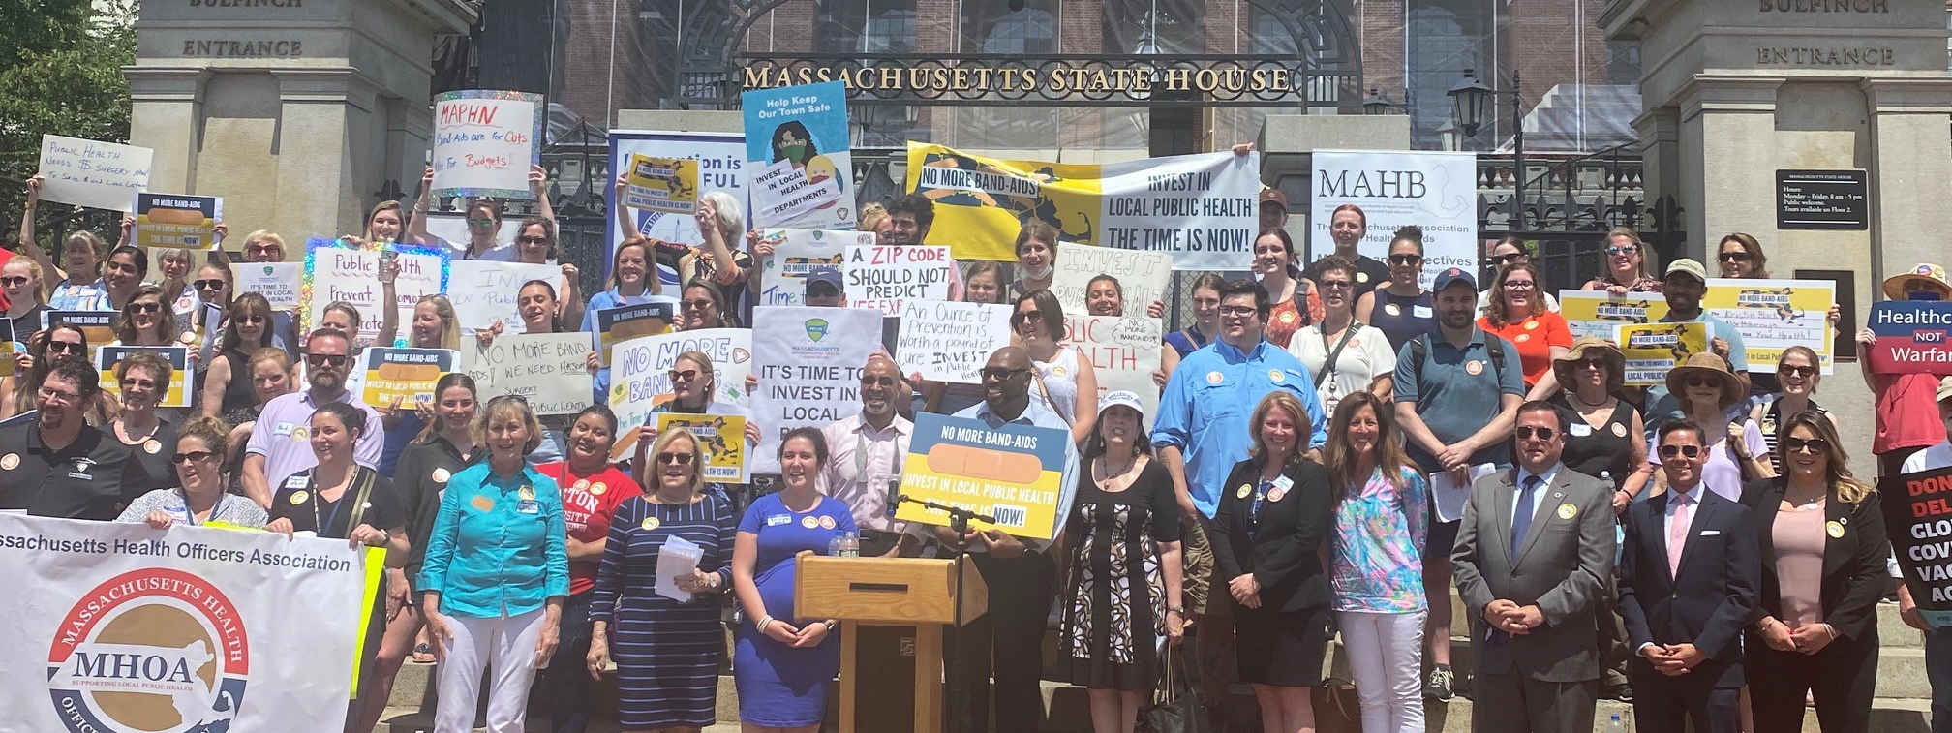
June 9, 2021, more than 130 local public health professionals, 10 State Legislative Officials & offices and more than 5 major news outlets rallied in front of the Boston State House to advocate for the use of the federal dollars from the American Rescue Plan Act (ARPA of 2021) to invest in local public health systems.

Slide 15
MAPHN Leadership Matters: What we Need From MAPHN Members
Support for the Vision Statement and help with implementation of this Innovations Project.
Willingness to attend a one-day training and conduct meetings with town managers, mayors, members of the legislators and other key stakeholders.
Willingness to volunteer on a subcommittee to identify regulatory standards that support the Public Health Nurse Profession.
Willingness to help us gather data on the cost savings to our healthcare systems, towns and insurance through preventative public health programs or public health nursing services in state/municipalities.

Slide 16
MAPHN Leadership Matters: 3 Key Barriers
MAPHN Members need to enroll the following stakeholders in our Shared Vision:
Members of Coalition for Local Public Health: MAPHN, MHOA, MAHB, MPHA, WMPHA, MEHA
Massachusetts Department of Public Health: ORLPH
Legislators
Mental Models: MAPHN Members need to enroll the stakeholders in municipalities in our Shared Vision and the cost savings to our healthcare systems, towns and insurance through preventative public health programs or public health nursing services in municipalities.
Structures & Systems: Need to add regulations that support Public Health Nurses at the municipal level to practice at full scope and standards of practice to support Foundational Public Health Services for health equity.

Slide 17
MAPHN Leadership Matters: Approach
Facilitative Strategies Training
Stakeholder Engagement
Skills and competencies learned will provide the knowledge, skills and confidence for engaging stakeholders
Commitment to engaging multiple stakeholders across the Commonwealth to our Shared Vision for improved PHN Standards for the public good. Meet with Members of the State Legislature
Recruit 25 PHNs to participate in a 1-Day Retreat to learn
Facilitative Practice for Public Leaders
Notes:
Willingness to work on a new MA mandate.
Willingness to help us gather data on the cost savings to our
healthcare systems, towns and insurance through preventative public
health programs or public health nursing services in municipalities

Slide 18
MAPHN Leadership Matters: Approach
Regulation Subcommittee
Financial Opportunities Subcommittee
TB Regulation vs Mandates
Volunteer on a subcommittee to identify regulations/ polices that support the Public Health Nurse Profession
Help us gather data on the cost savings to our healthcare systems, towns and insurance through preventative public health programs or public health nursing services in municipalities
Notes:
• Overcoming belief systems about the added costs without understanding the cost savings
• Reviewing the regulation or mandate which defines how public health nurses should function

Slide 19
EXIT SURVEY
Please appoint 1 person at each table to collect competed surveys
Each person take 5 mins to complete the exit survey on table.
Question and Answer Session to follow, please avoid distractions/side chatter until the surveys have been completed.
This information will be collected by the MAPHN Leadership Matters Team and volunteers will be contacted by email for next steps.
Notes:
Interest form not commitment

Slide 20
“If at first the idea is not absurd than there is no hope for it.” –Albert Einstein
QUESTIONS?

