Slide 1
LOCAL PUBLIC HEALTH NURSE
&
MEDICAL RESERVE CORPS
VOLUNTEER MANAGEMENT
Roberta Ho
Middlefolk MRC (formerly Region 4A)

Slide 2
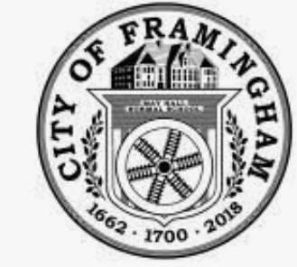
History of Framingham
June 25, 1700
Incorporated as Town
January 1, 2018
Incorporated as City
Town Manager
Selectman
County Middlesex
Population 4252 (1850)
Inhabitants: Indigenous
Nipmuc & Europeans
Mayor
City Council
County Middlesex
Population 72,362 (2020)
Inhabitants: Very Diverse (Multicultural/Multiracial)

Slide 3
History of MRC in Framingham
Region 4A was comprised of 31 communities. In 2019, Region 4A was divided into North and South Districts. A North and South Volunteer Coordinator worked with their respective District. This had allowed for each community to be better served.
North District: Littleton, Carlisle, Bedford, Woburn, Boxborough, Acton,
Concord, Lincoln, Lexington, Winchester, Stow, Maynard,
Waltham, Hudson, Wayland, Sudbury, Weston, and
Marlborough
South District: Southborough, Framingham, Natick, Ashland, Sherborn,
Dover, Hopkinton, Holliston, Medfield, Millis, Norfolk,
Sharon, and Wrentham
History of MRC in Framingham

Slide 4
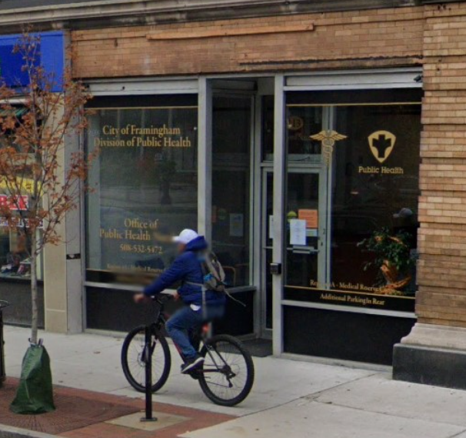
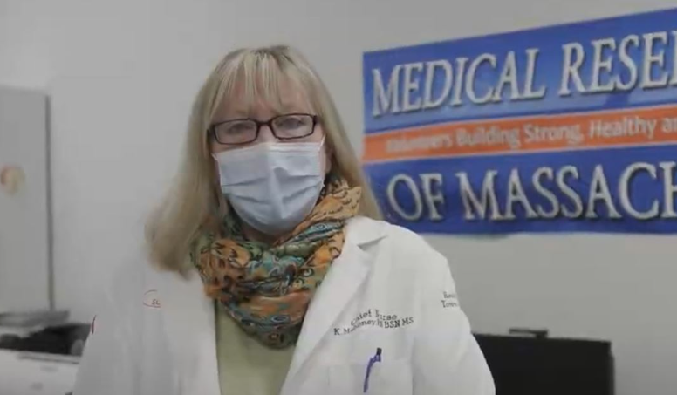
History of MRC in Framingham
Kitty Mahoney, RN, BSN, MS
Chief Public Health Nurse
2004-2022
Framingham Nursing Clinic
First Office of Public Health Nursing in Massachusetts.
Public Health Clinic serving MetroWest area
Opened on August 20, 2019
Office of Region 4A 2019-2021

Slide 5
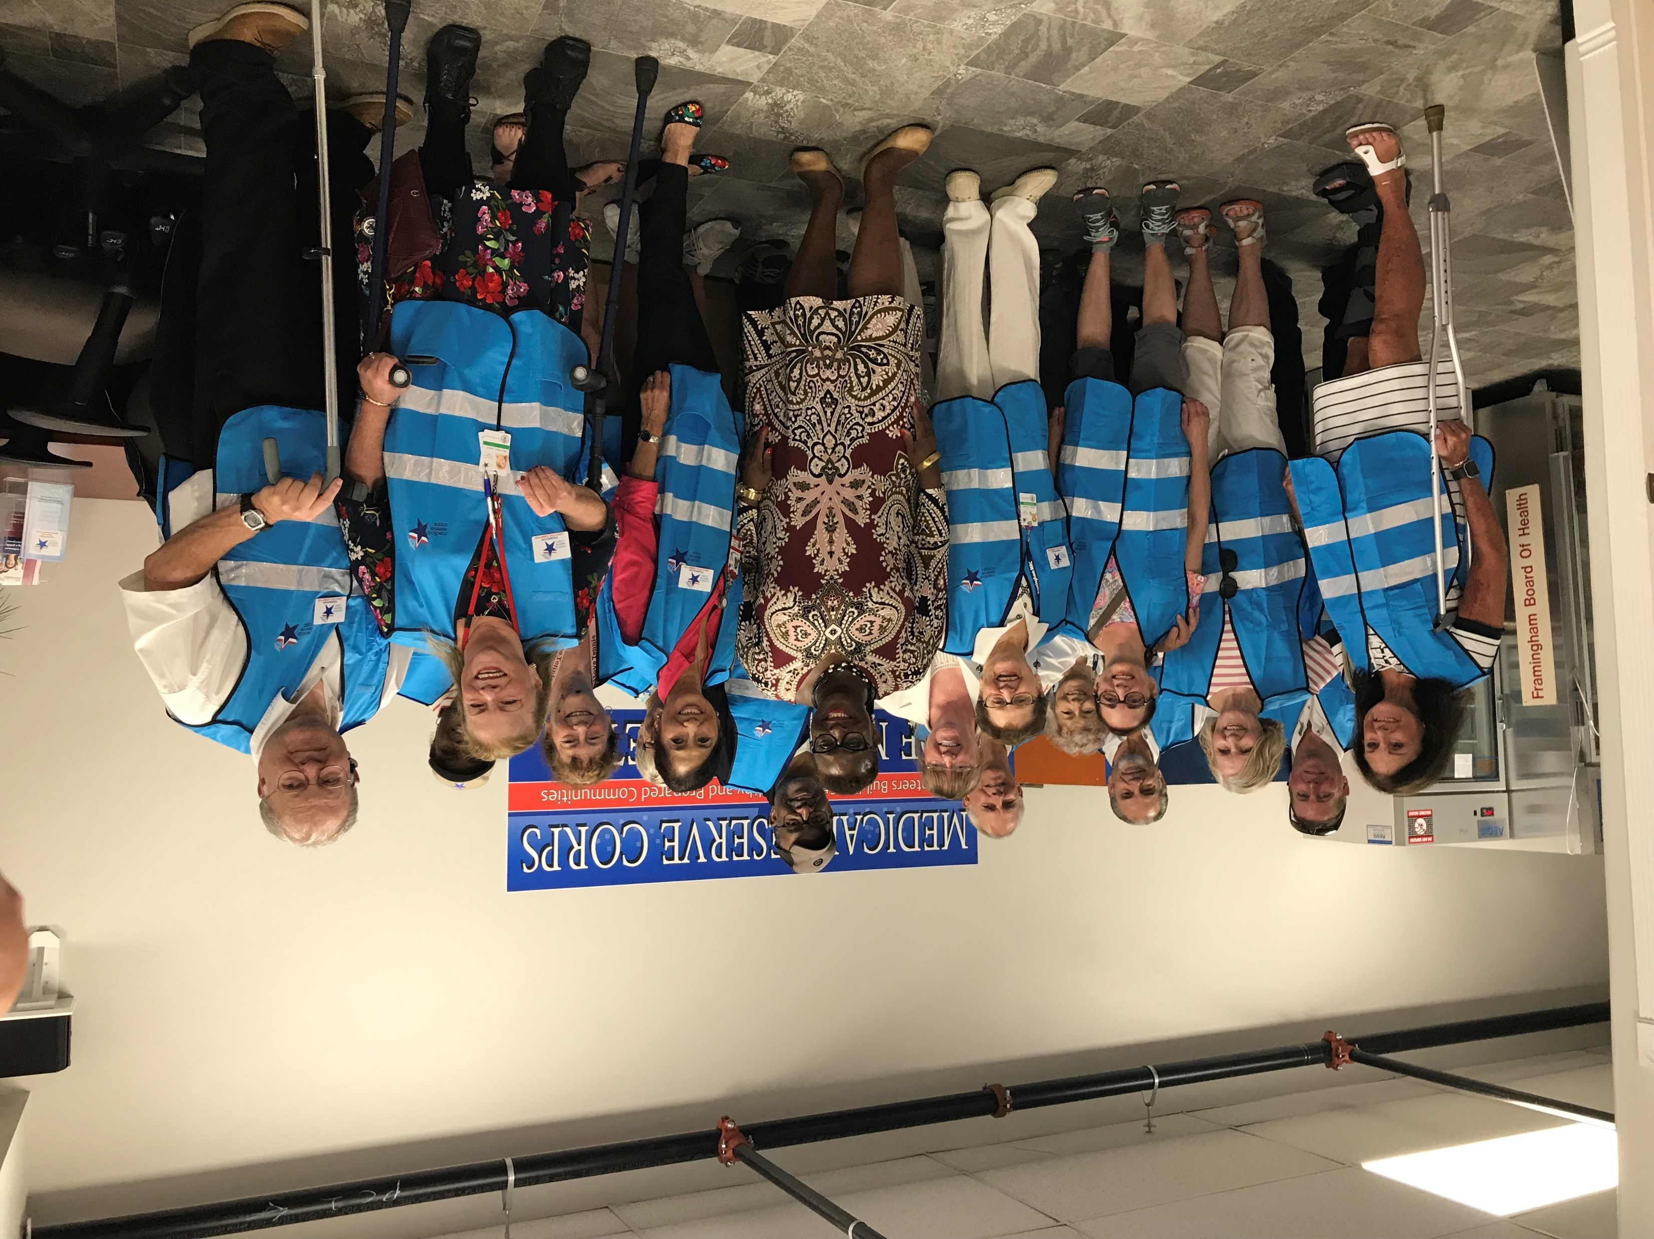
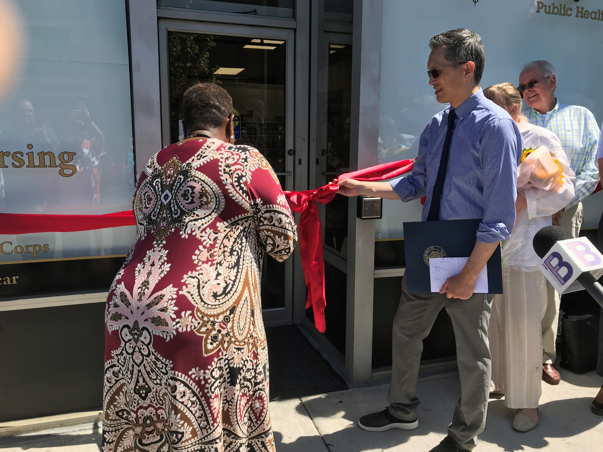
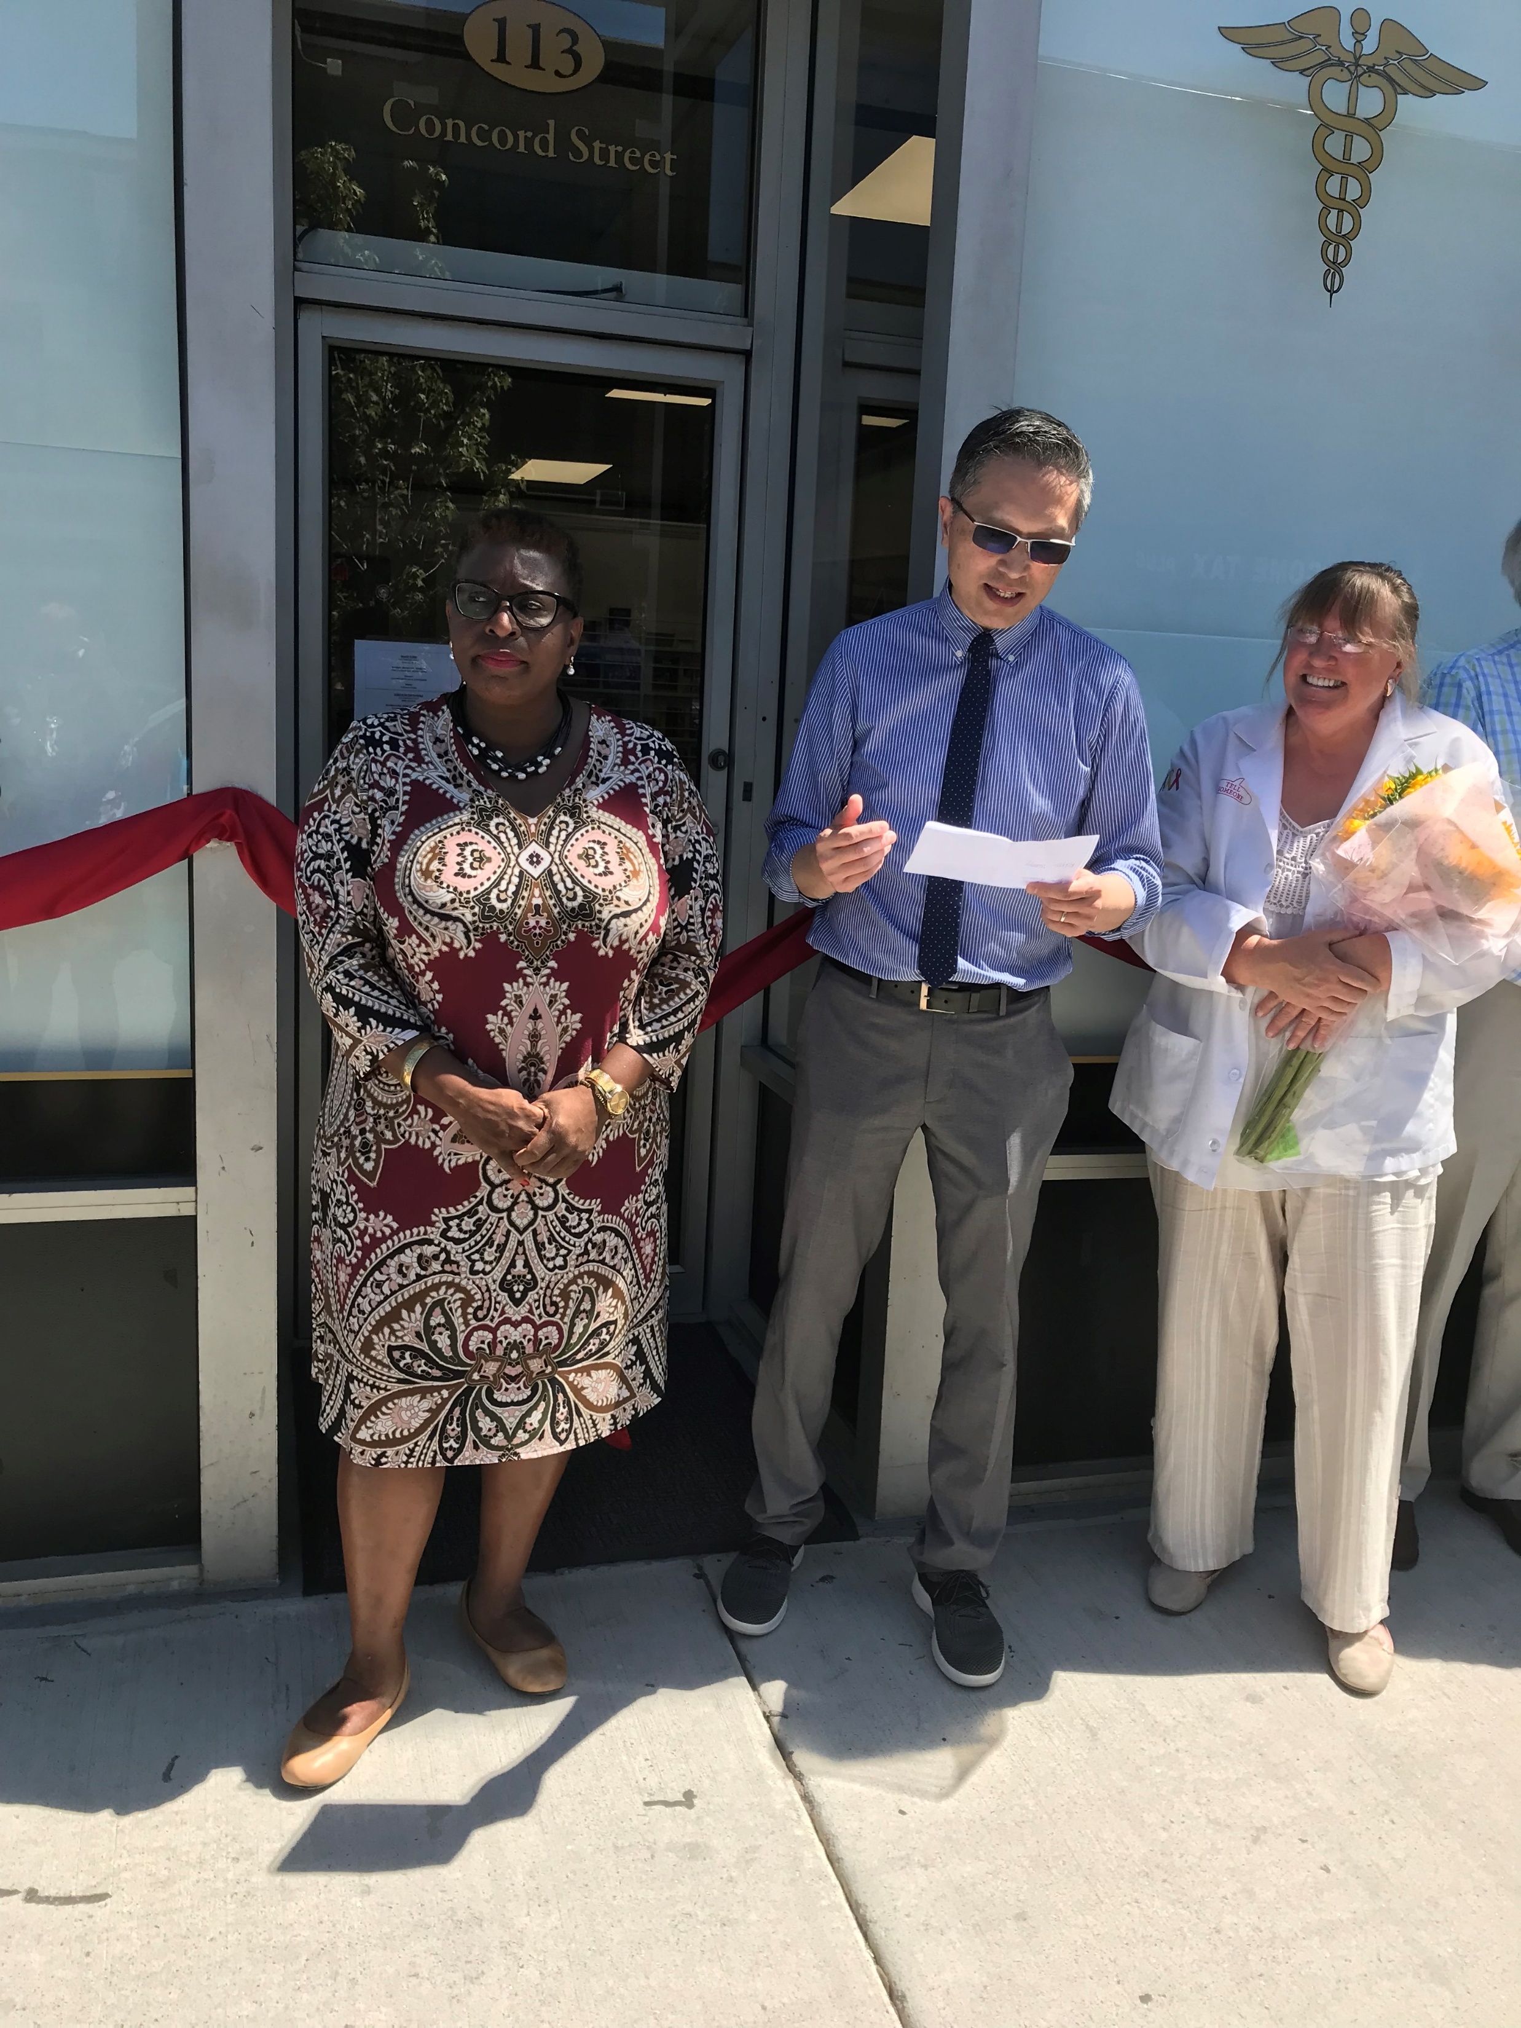
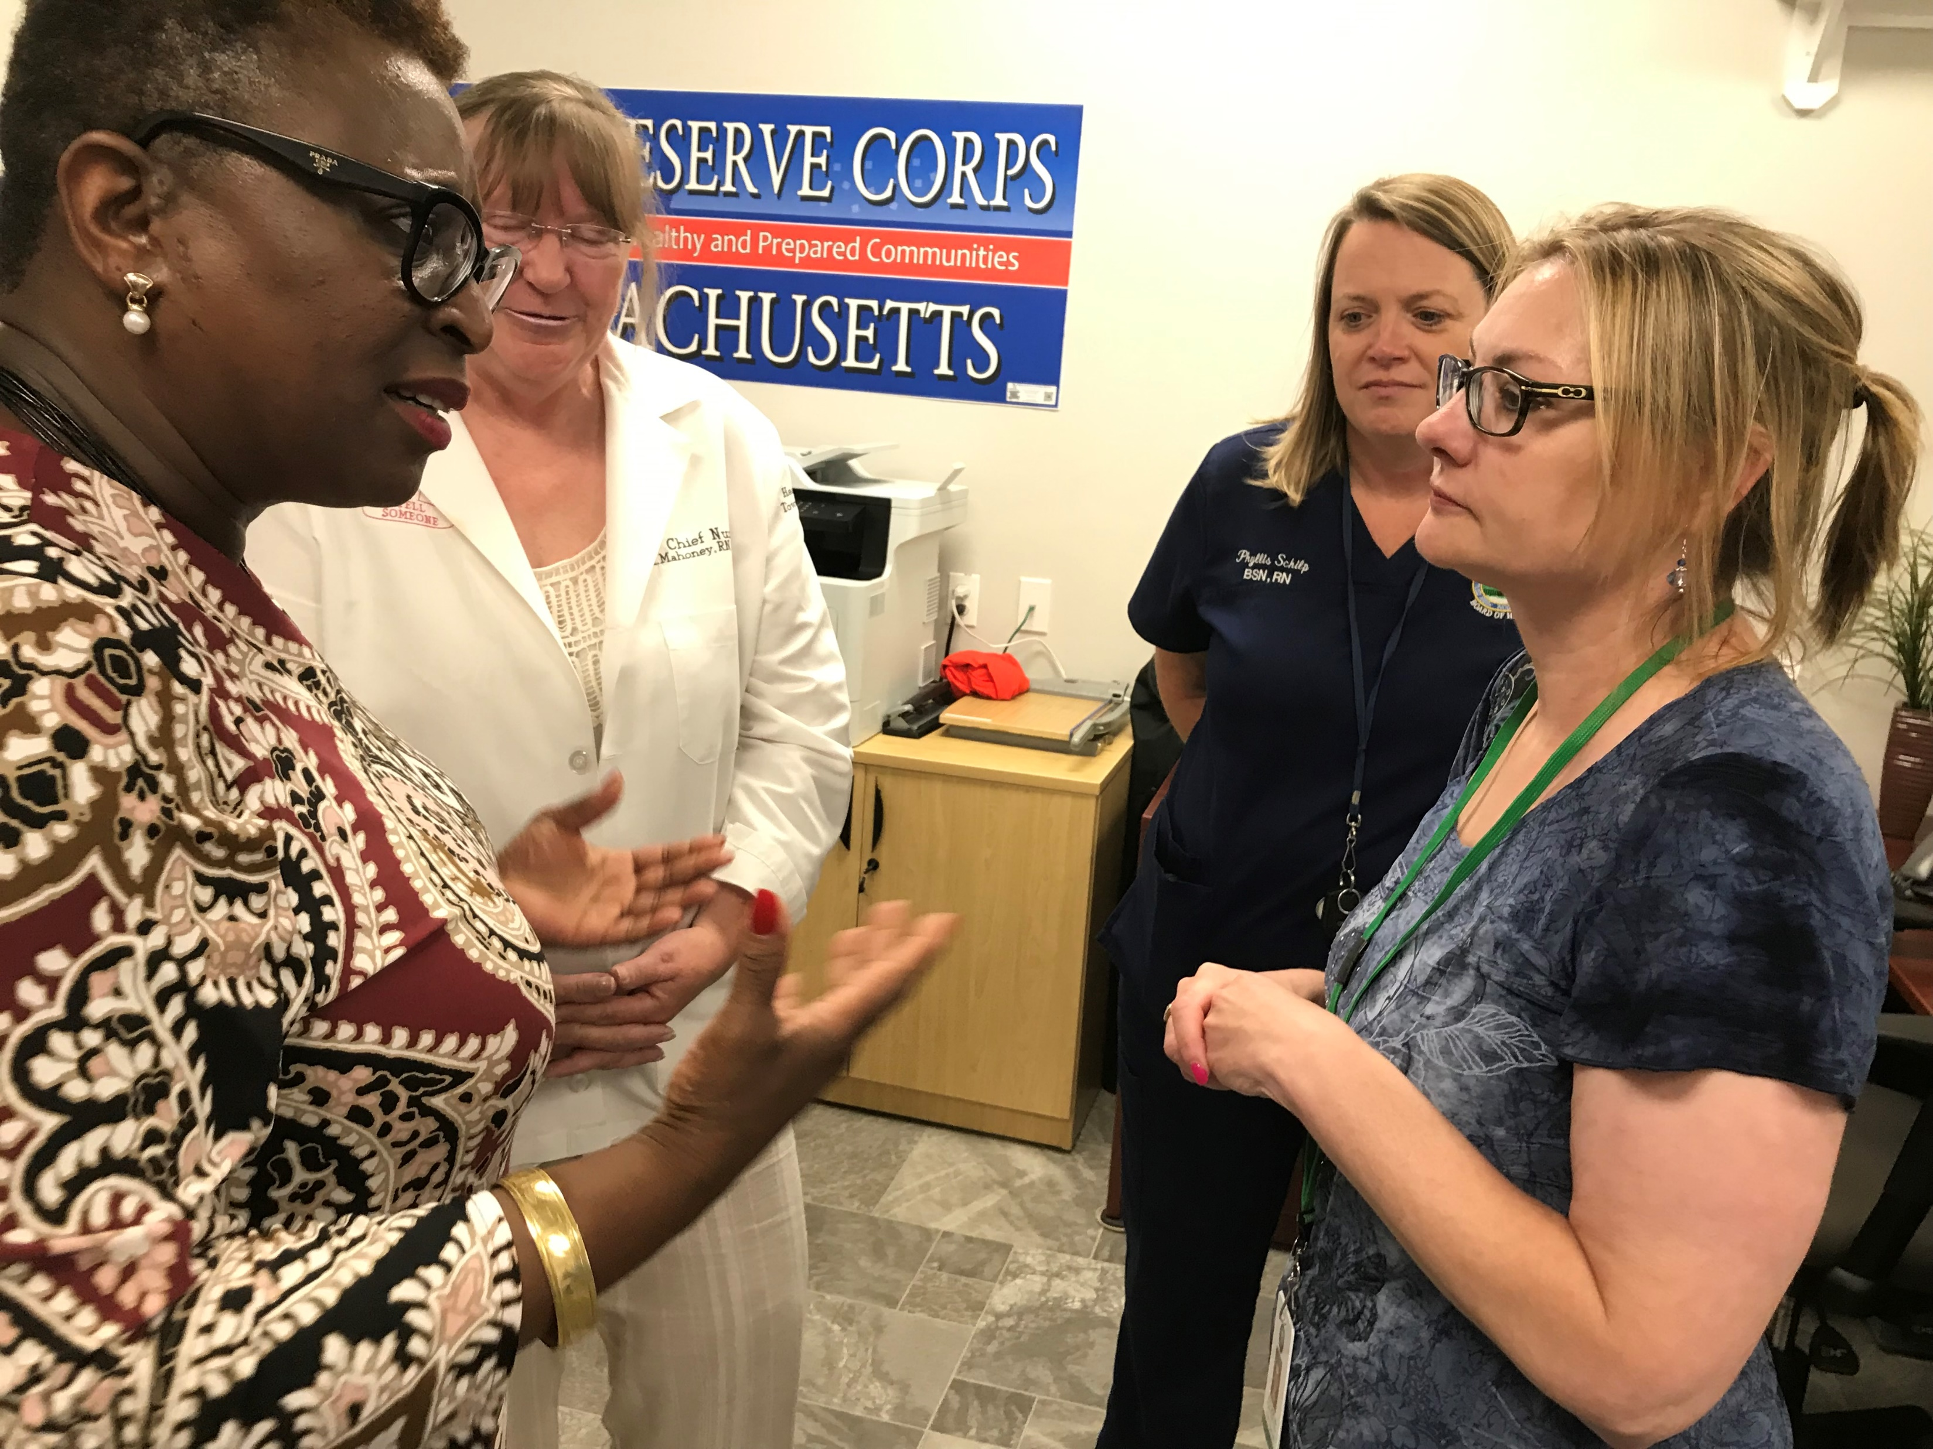
History of MRC in Framingham
OPENING OF NURSING CLINIC
&
REGION 4A OFFICE
AUGUST 20, 2019

Slide 6
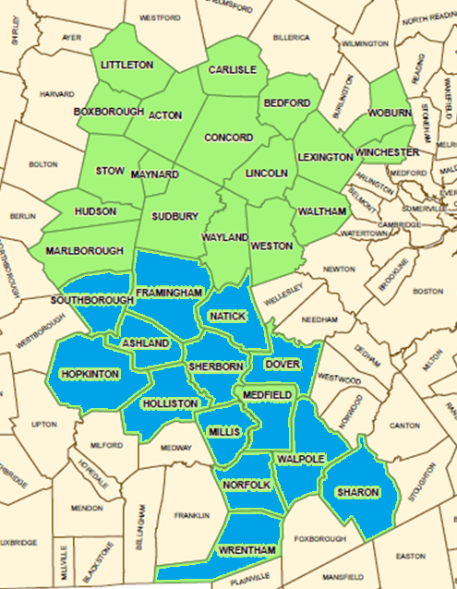
History of MRC in Framingham
Region 4A was restructured into three new units that
was federally approved on December 12, 2022. Region 4A
that was once comprised of 31 communities has been
established as:
Central Middlesex: Acton, Bedford, Boxborough, Carlisle, Concord, Lexington, Lincoln, Littleton, Maynard, Stow, Winchester, and Woburn
MetroWest: Hudson, Marlborough, Natick, Southborough,
Sudbury, Waltham, Wayland, and Weston
Middlefolk: Ashland, Dover, Framingham, Holliston, Hopkinton, Medfield, Millis, Norfolk, Sherborn, and Wrentham.
The Town of Sharon aligned with the Bristol Norfolk MRC.

Slide 7
Recruiting at Community Level
Tax letter from Treasurers office
Mayoral Message or Town Manager
Social media: Facebook, Twitter, municipal websites
Bring MRC information and applications to health fairs and community events
Invite the Press to every event or follow up by sending information, photos! (Obtain photograph release!)
Get invited, then you will be invited
Joint marketing with affiliated organizations-Lions Club, International Rotary, COA, Police & Fire Departments
Cost-free workshops
Movie Night—MRC Volunteer brings a non-MRC member. Movies relevant to public health concerns (Patriot’s Day, Contagion, Outbreak)

Slide 8
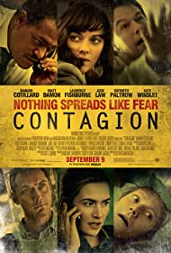
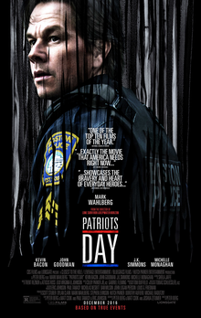
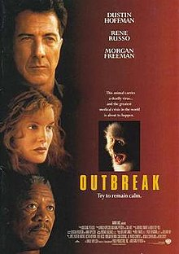
MOVIE NIGHT
OUTBREAK
Fictional Ebola Virus
CONTAGION
Deadly Pandemic
Bird Flu/Avian Flu
PATRIOT’S DAY
Boston Marathon
Bombing

Slide 9
PARTNERING WITH THE COMMUNITY
Religious Organizations
Churches of various denominations
Temples
Synagogues
Cultural Organizations
Danforth Art Museum
Framingham History Center
Framingham State University
Brazilian American Center (BRACE)
Health Facilities
Edward M. Kennedy Community Health
Latino Health Services
MetroWest Medical Center

Slide 10
PARTNERING WITH THE COMMUNITY
City Agencies
Police Department
South Middlesex Opportunity Council (SMOC)
Fire Department
Libraries (Framingham Public Library & Christa McAuliffe Branch Library)
Schools (Public and Private)
Justice Resource Institute (JRI)
Department of Public Works
Senior Center/Council on Aging

Slide 11
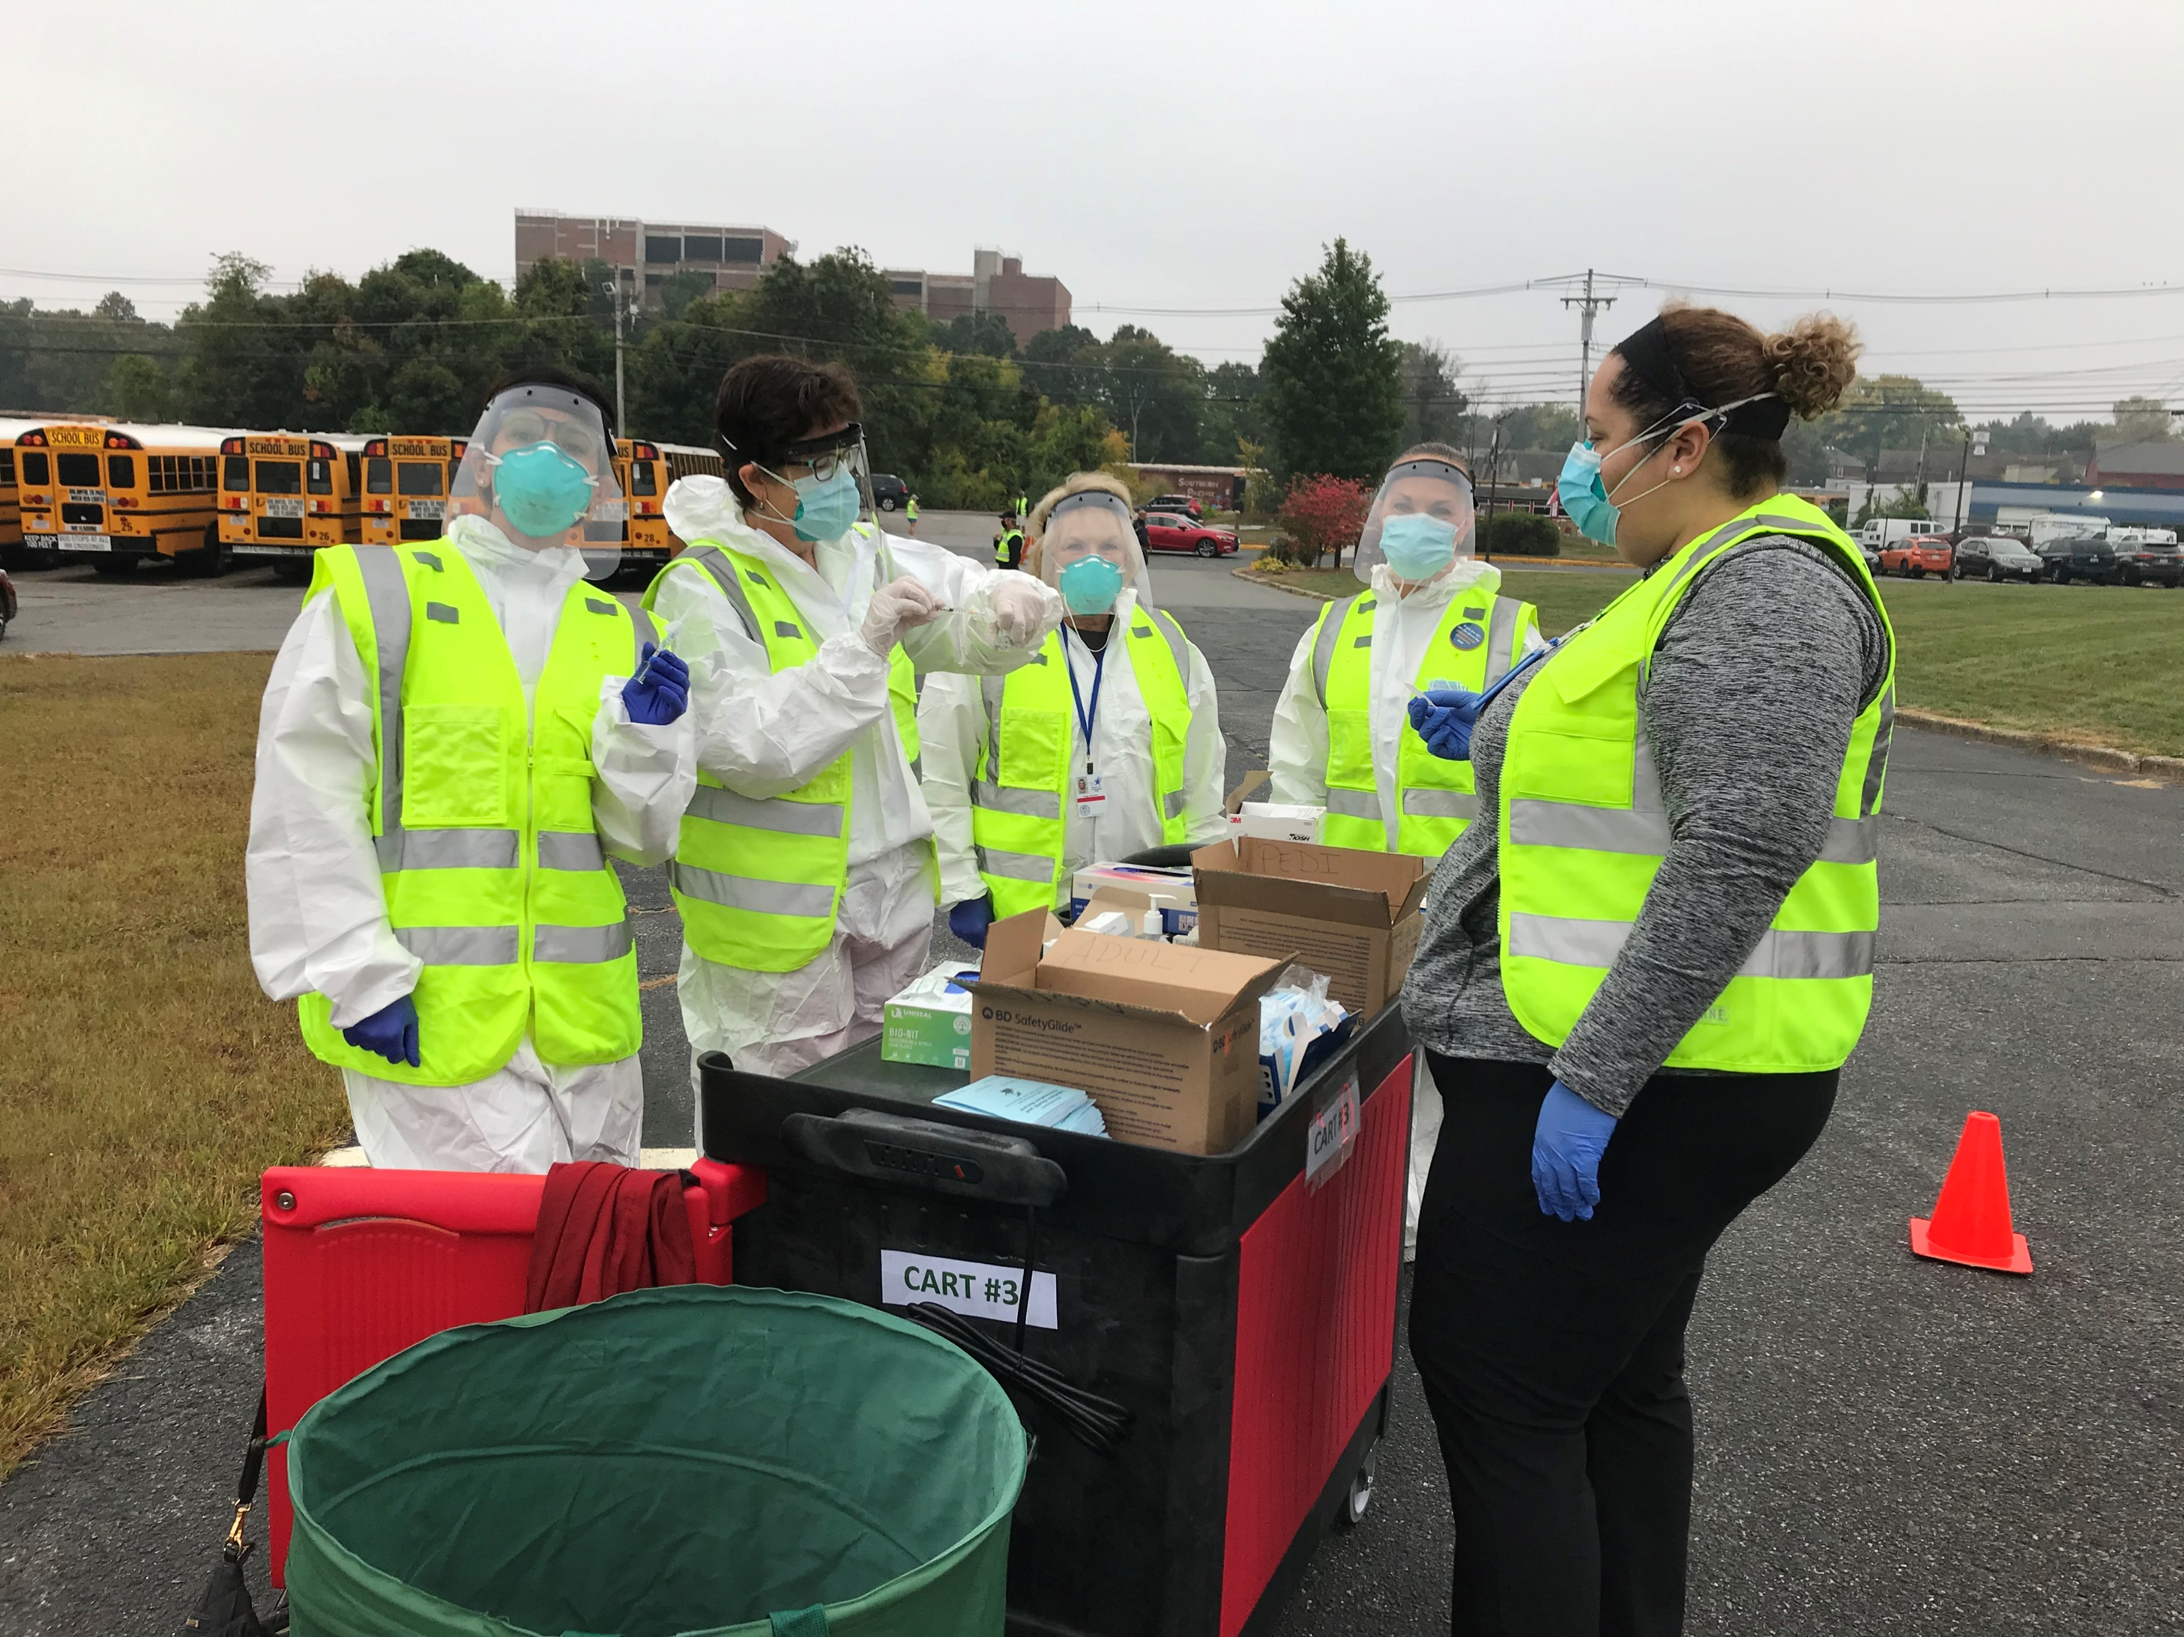
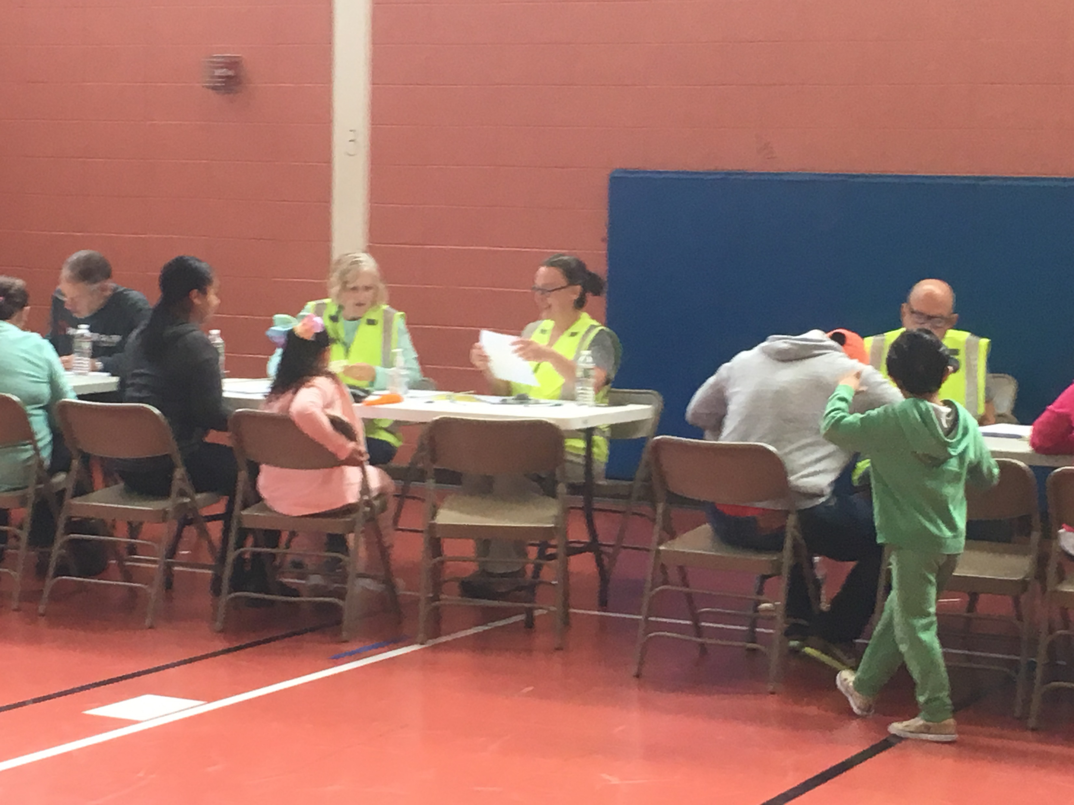
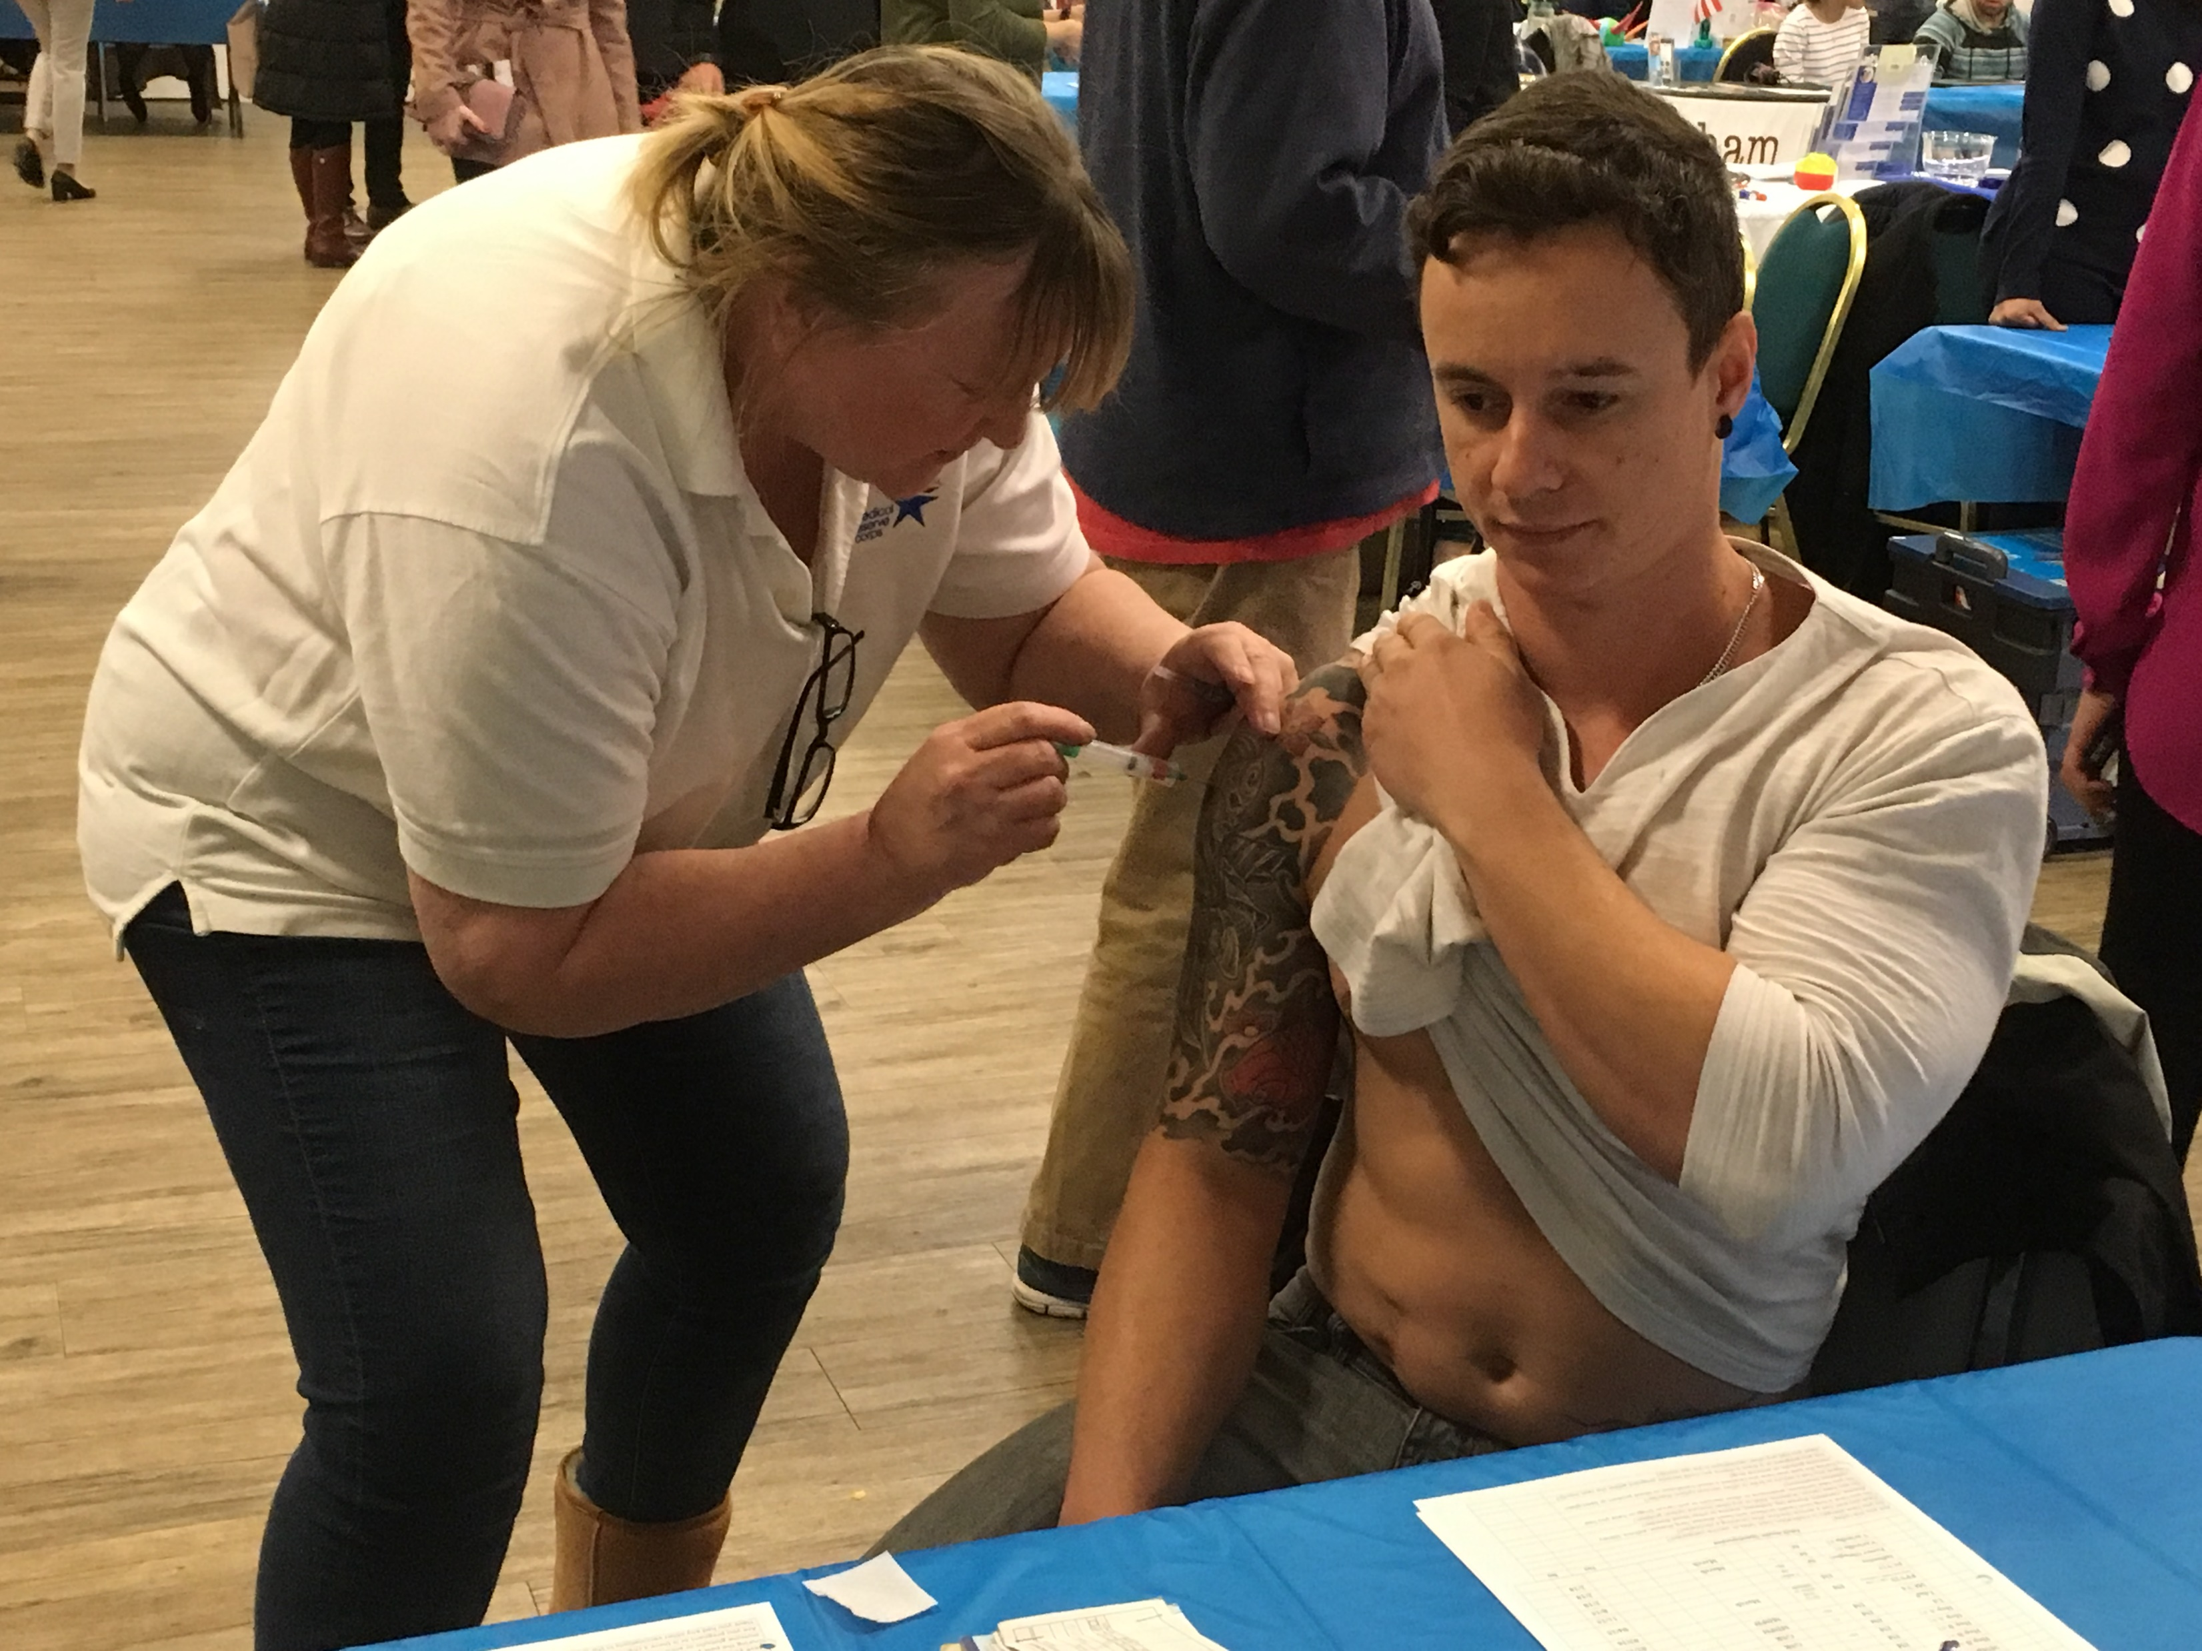
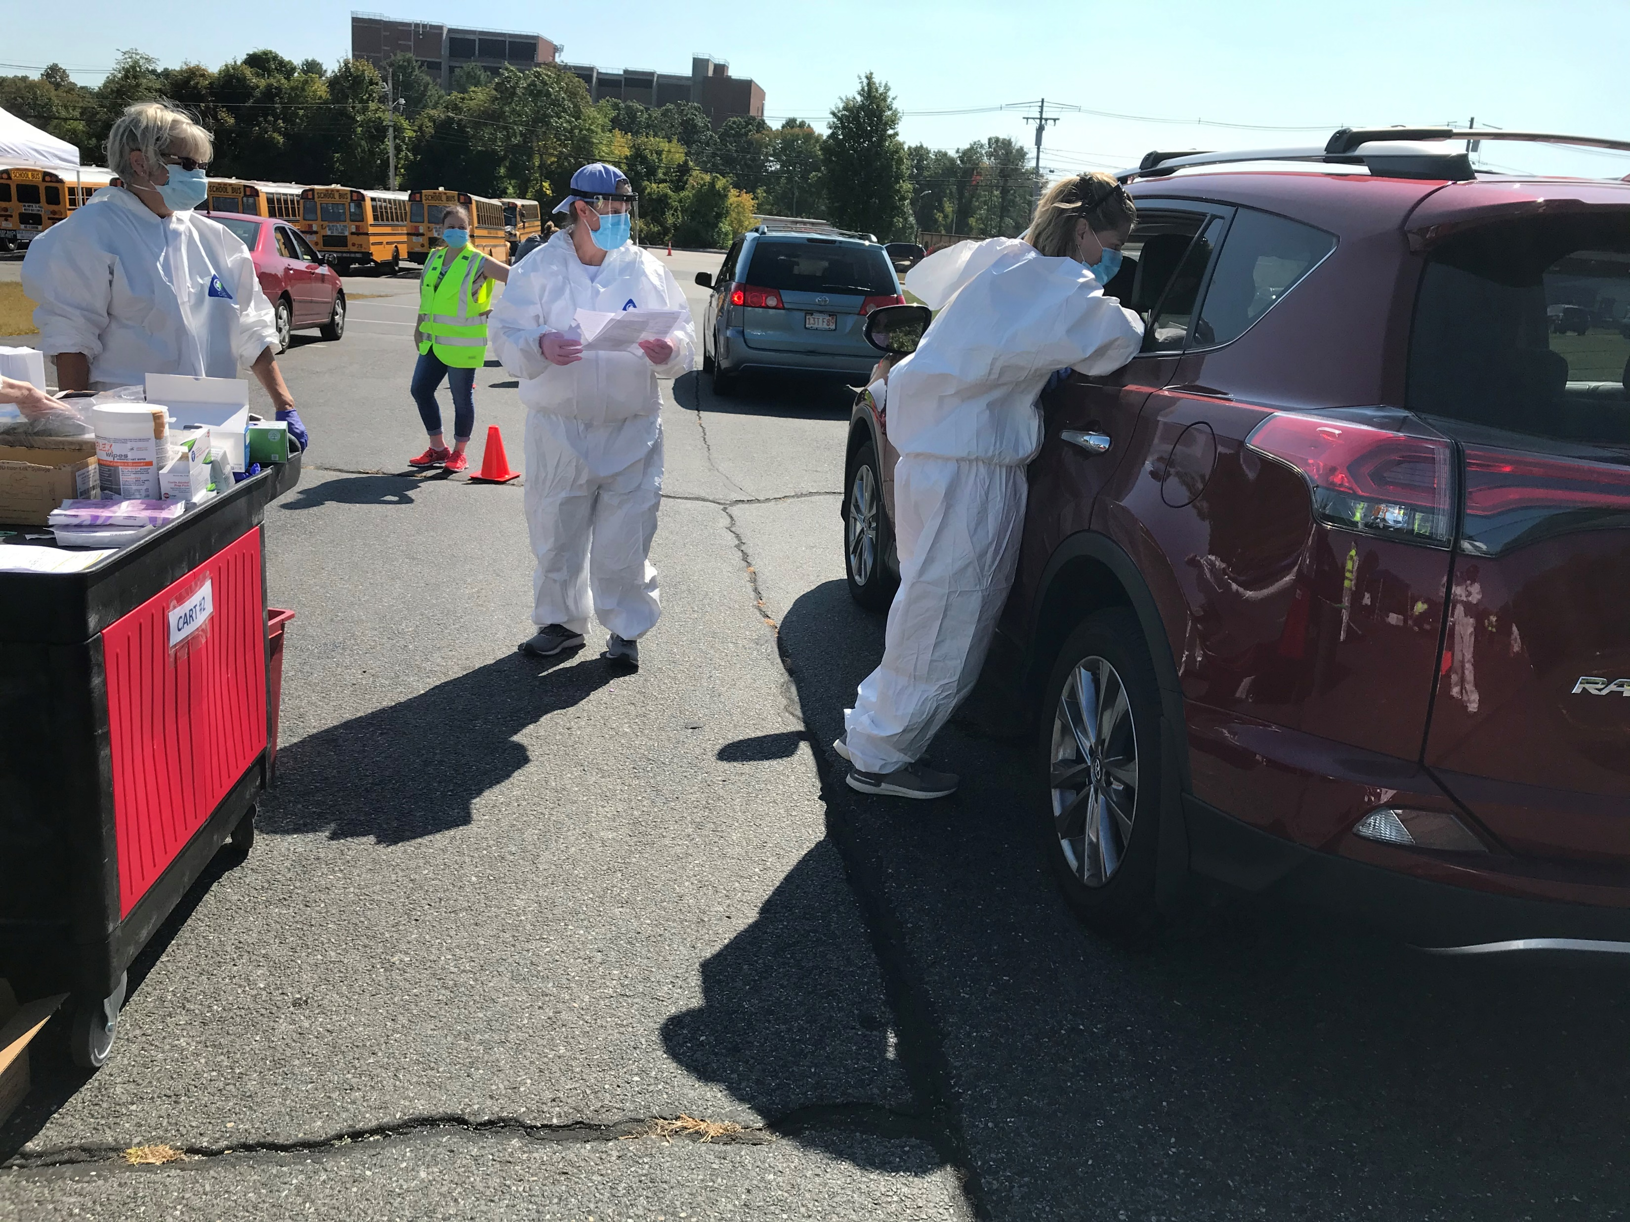
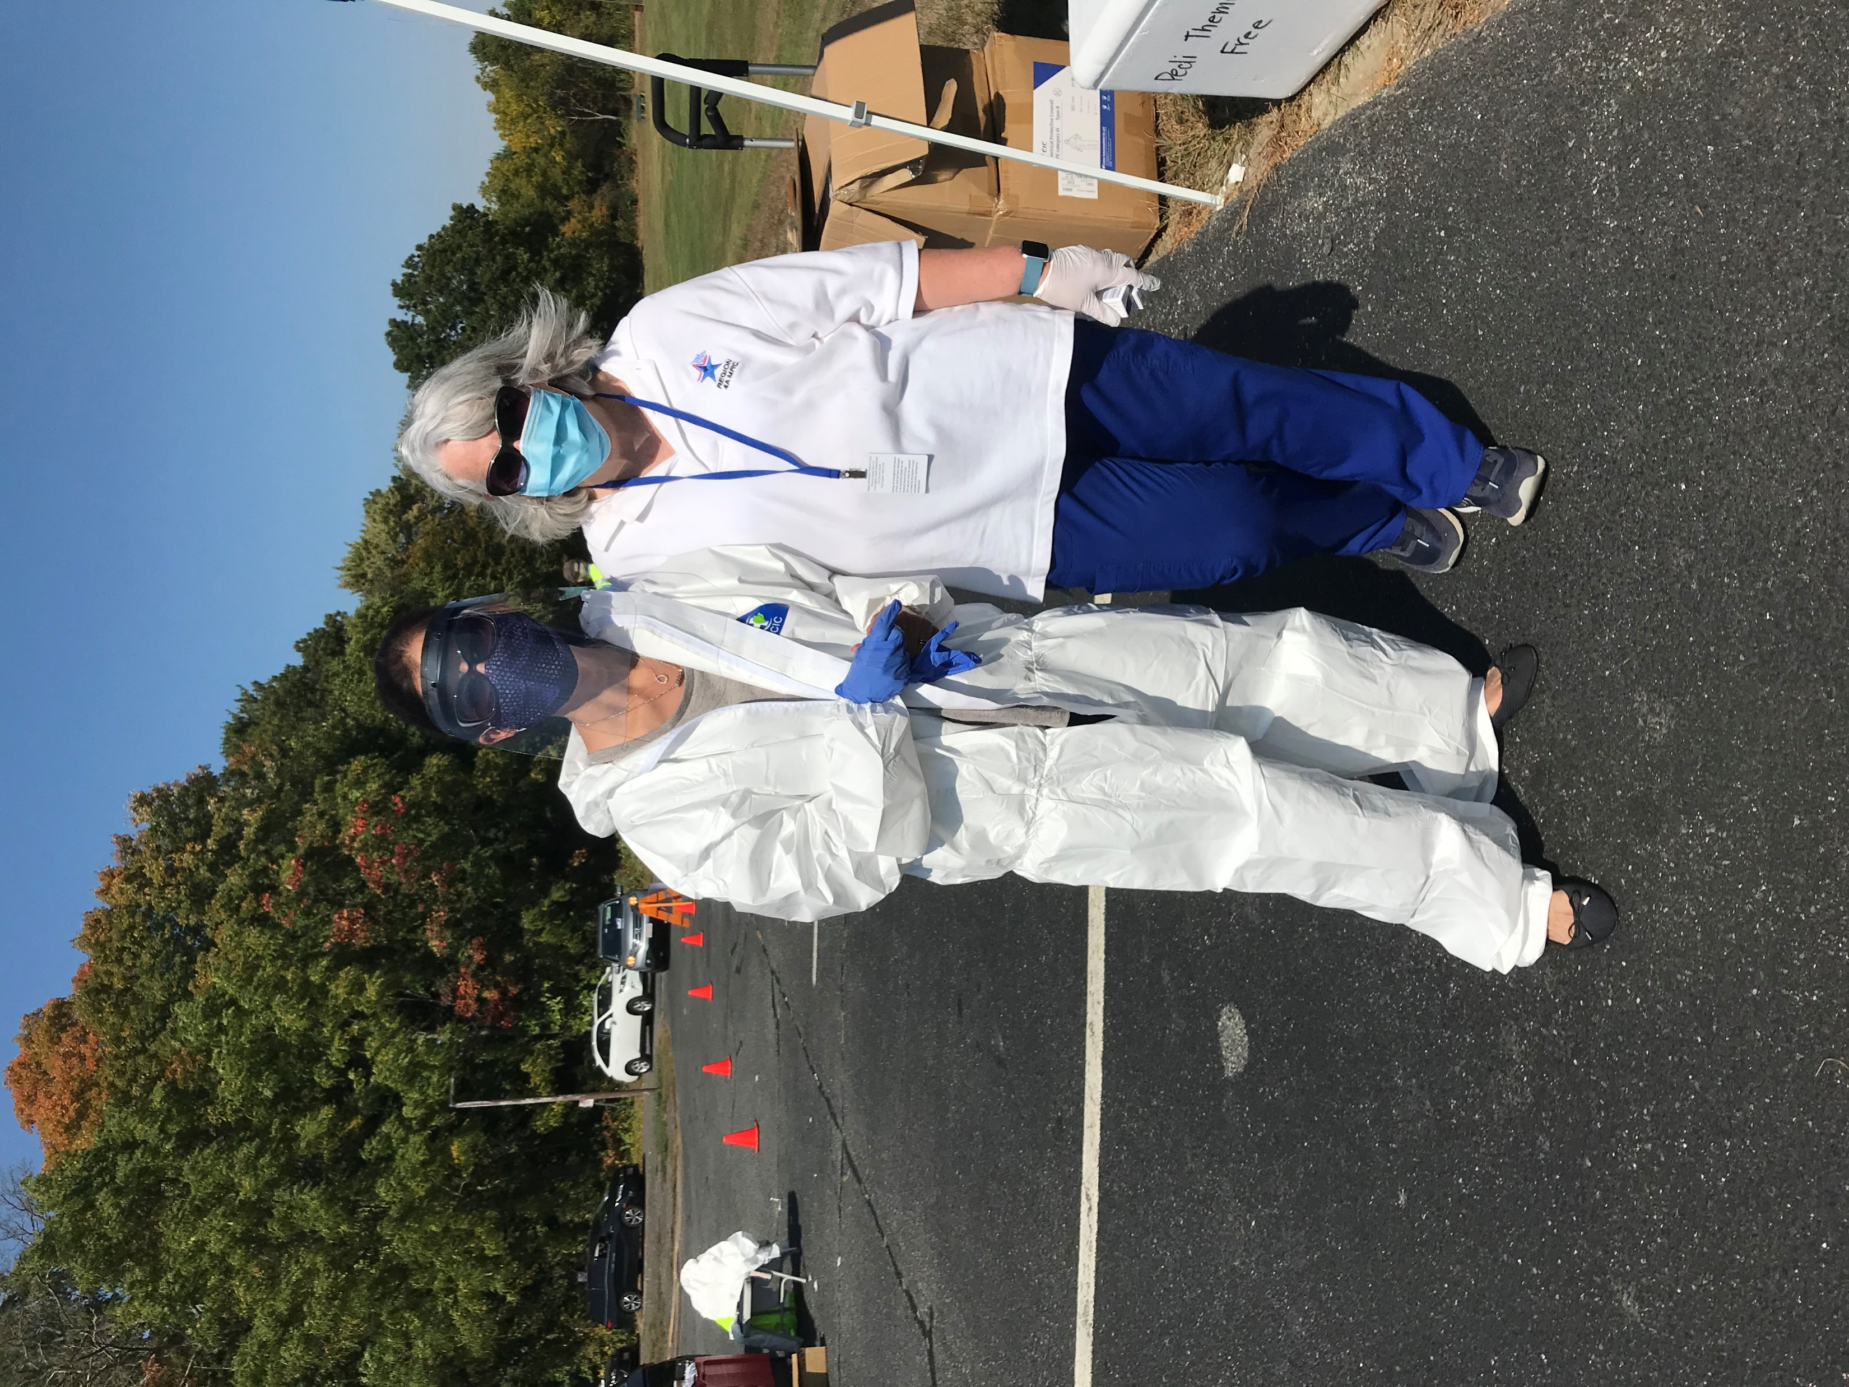
FLU
CLINICS

Slide 12
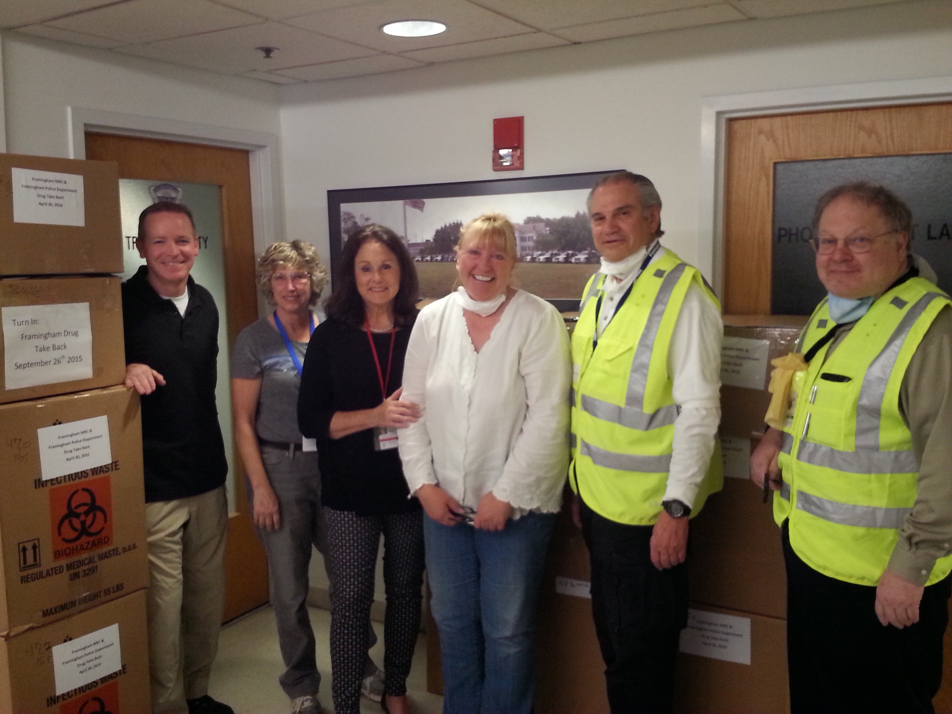
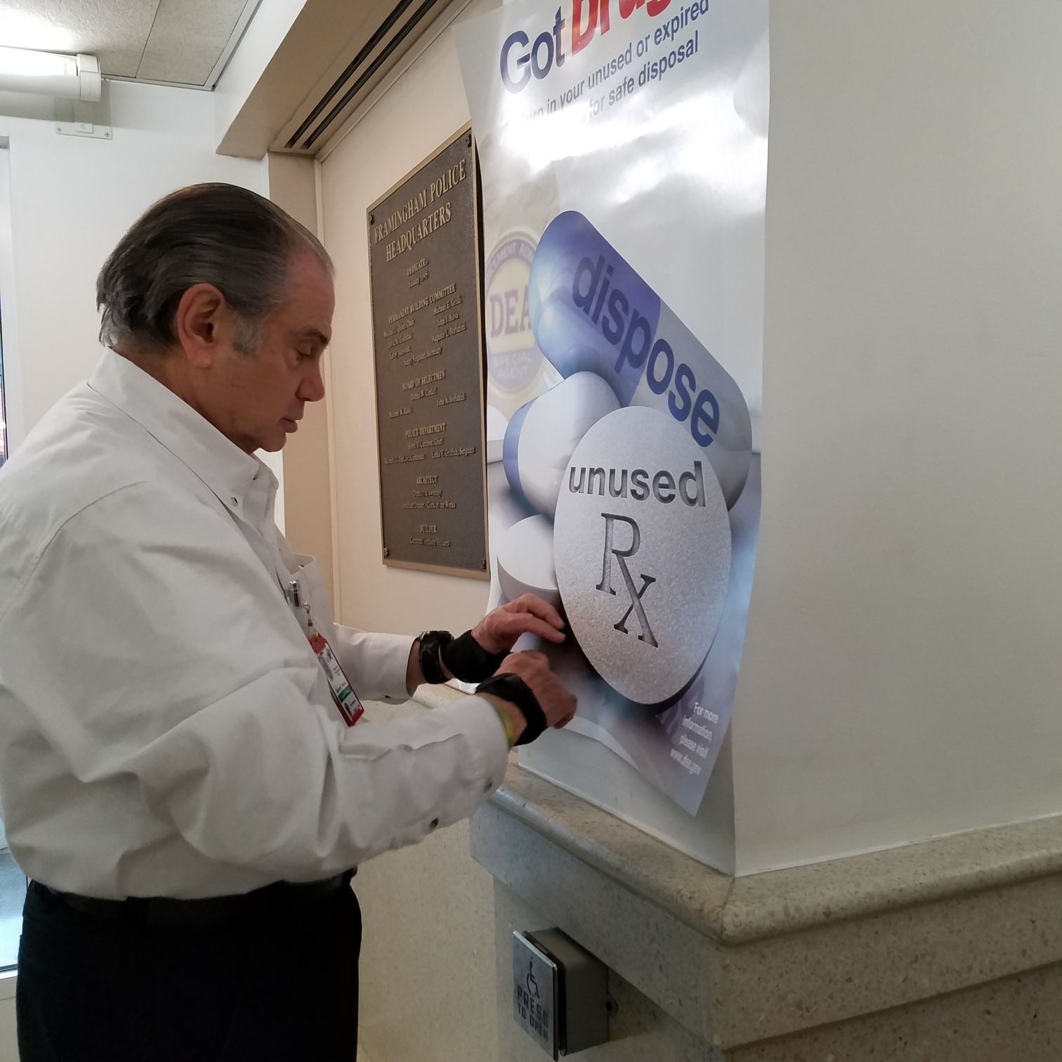
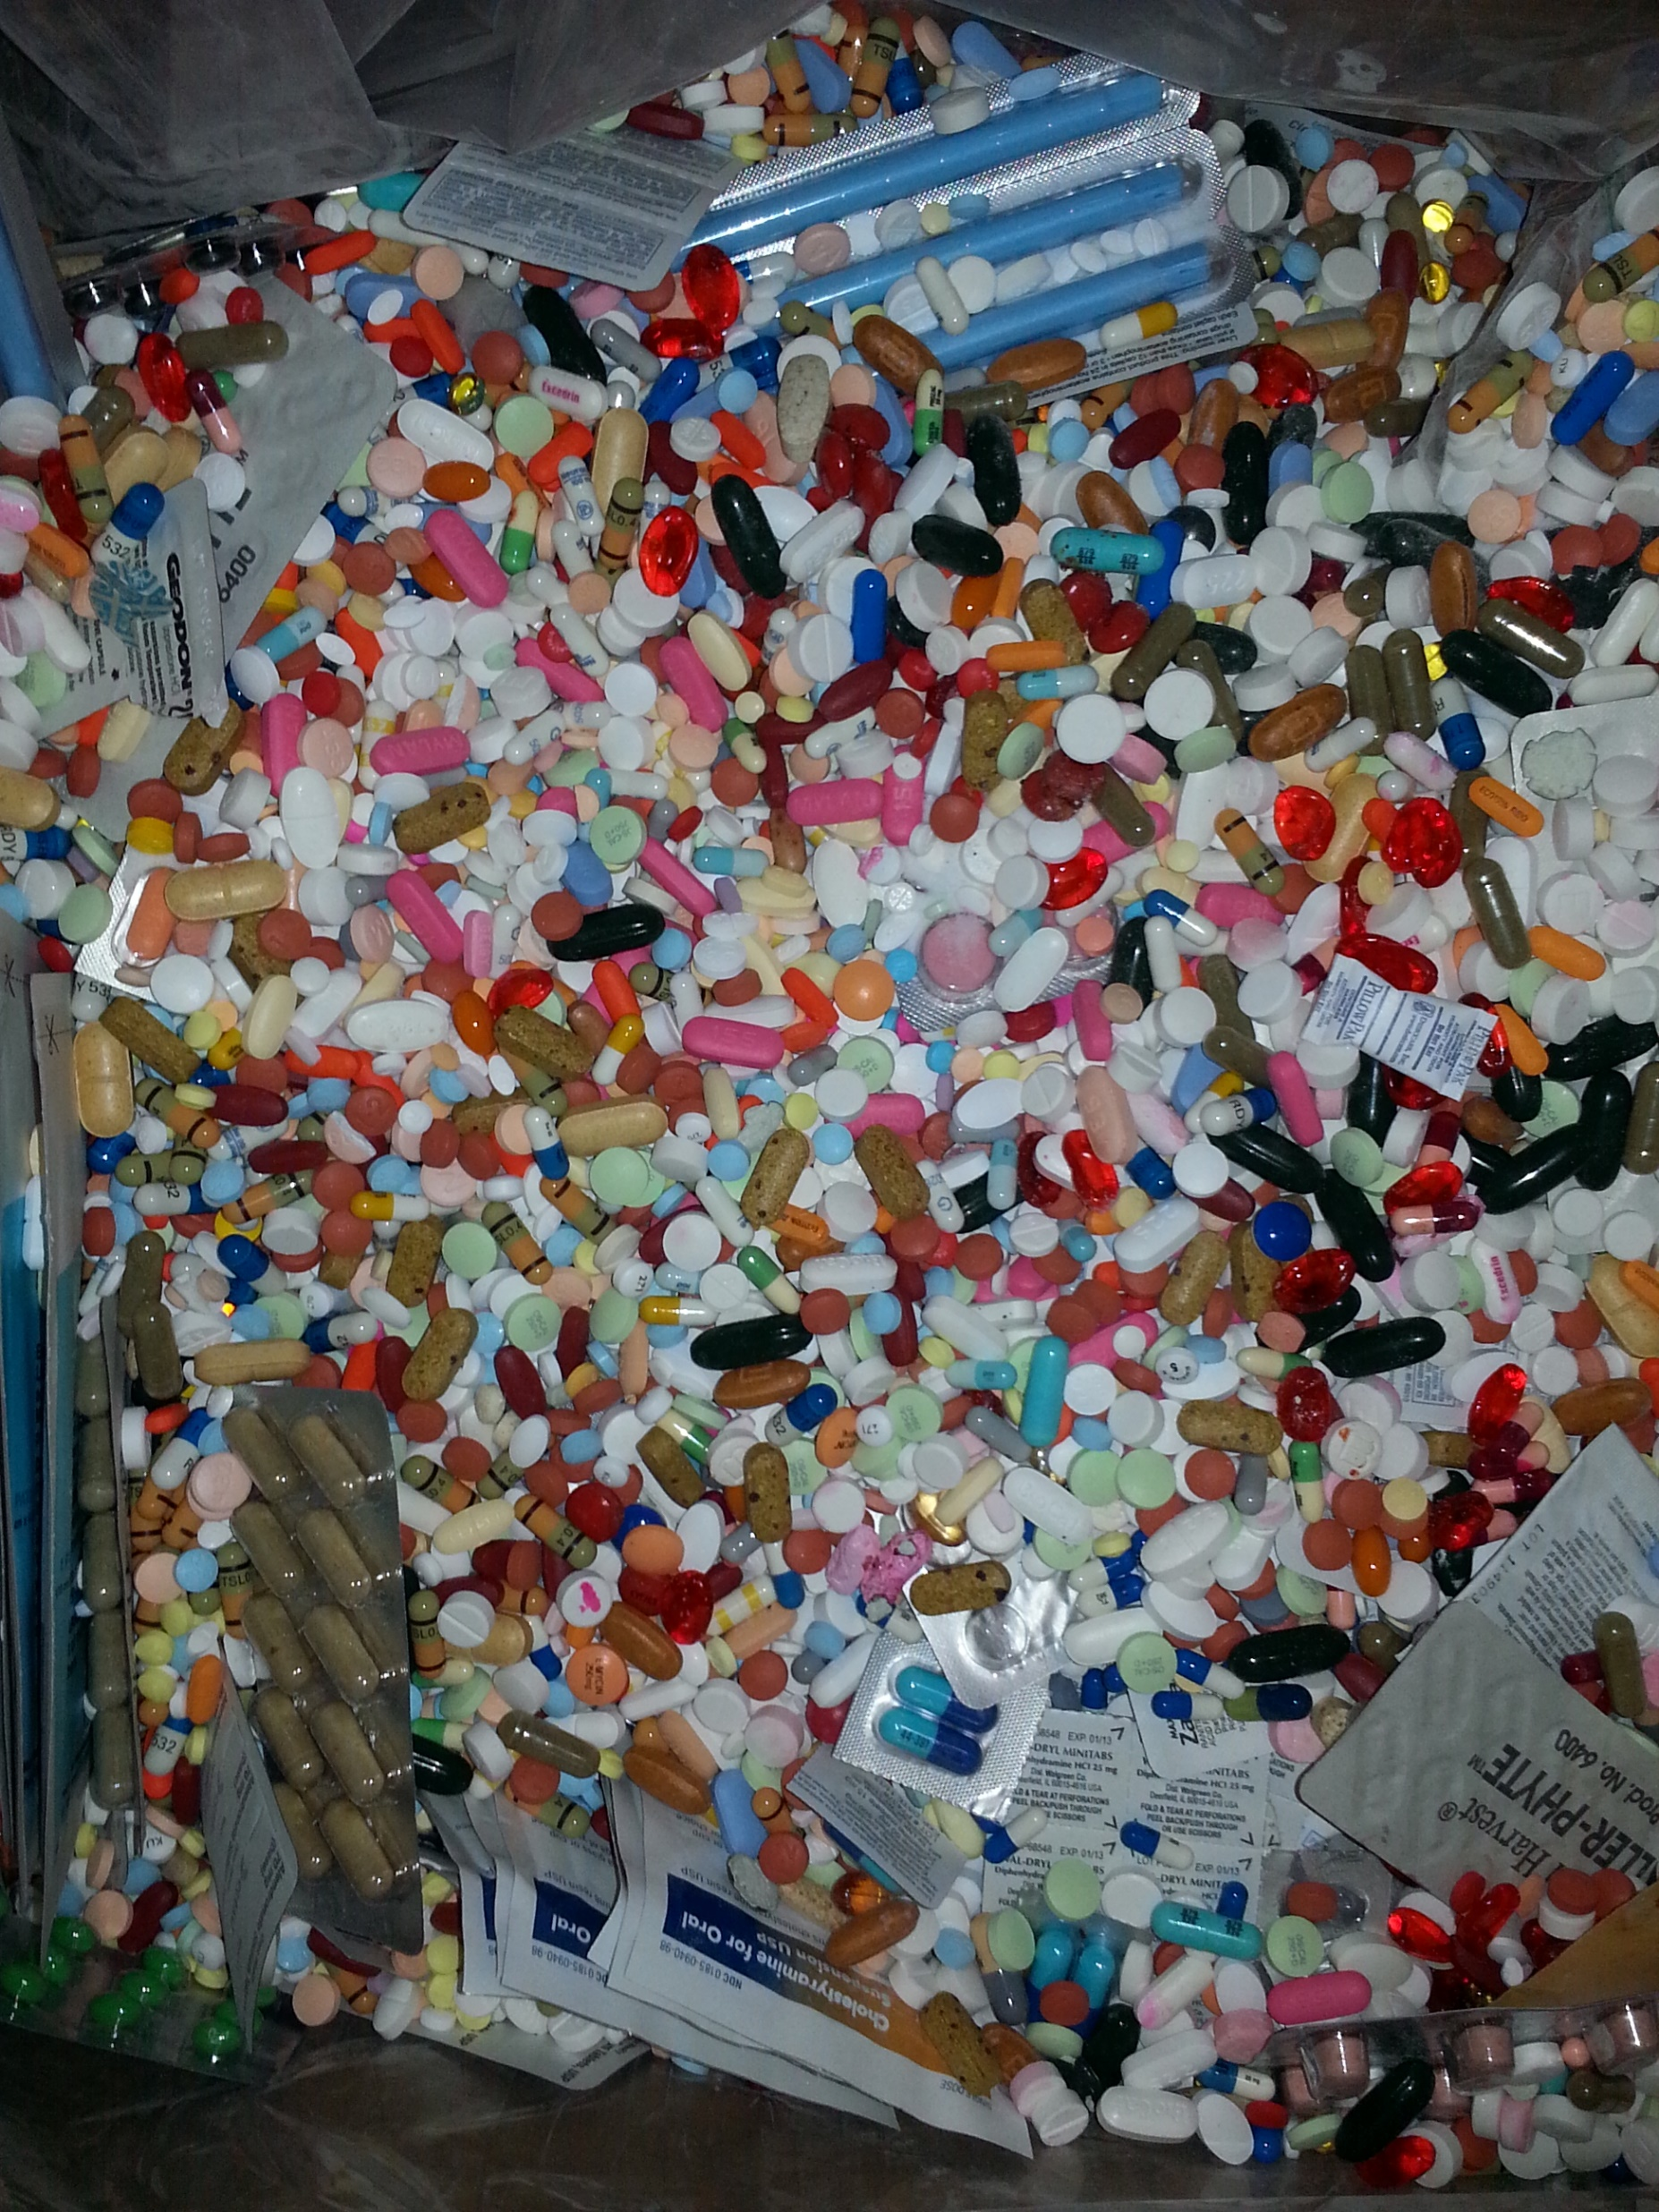
NATIONAL DRUG TAKE BACK DAY
Two times per year(April and October)
Work with DEA and Framingham Police Department
Framingham is drop off center for Metro West area
Hundred of pounds of expired drugs and liquids collected
for disposal

Slide 13
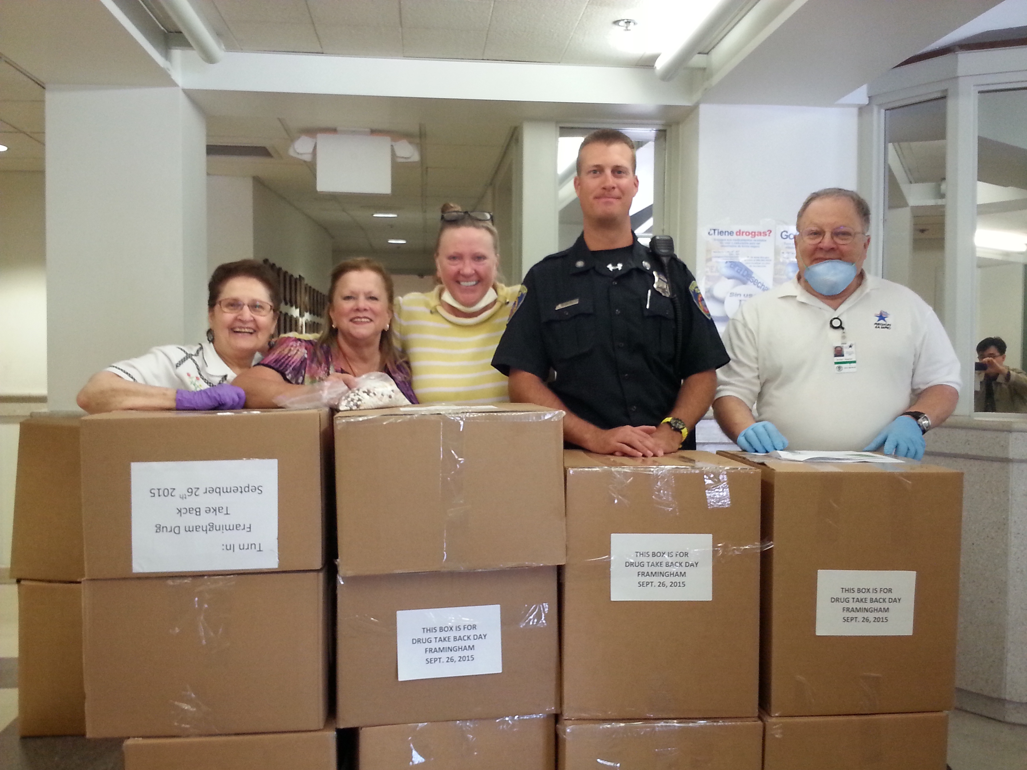
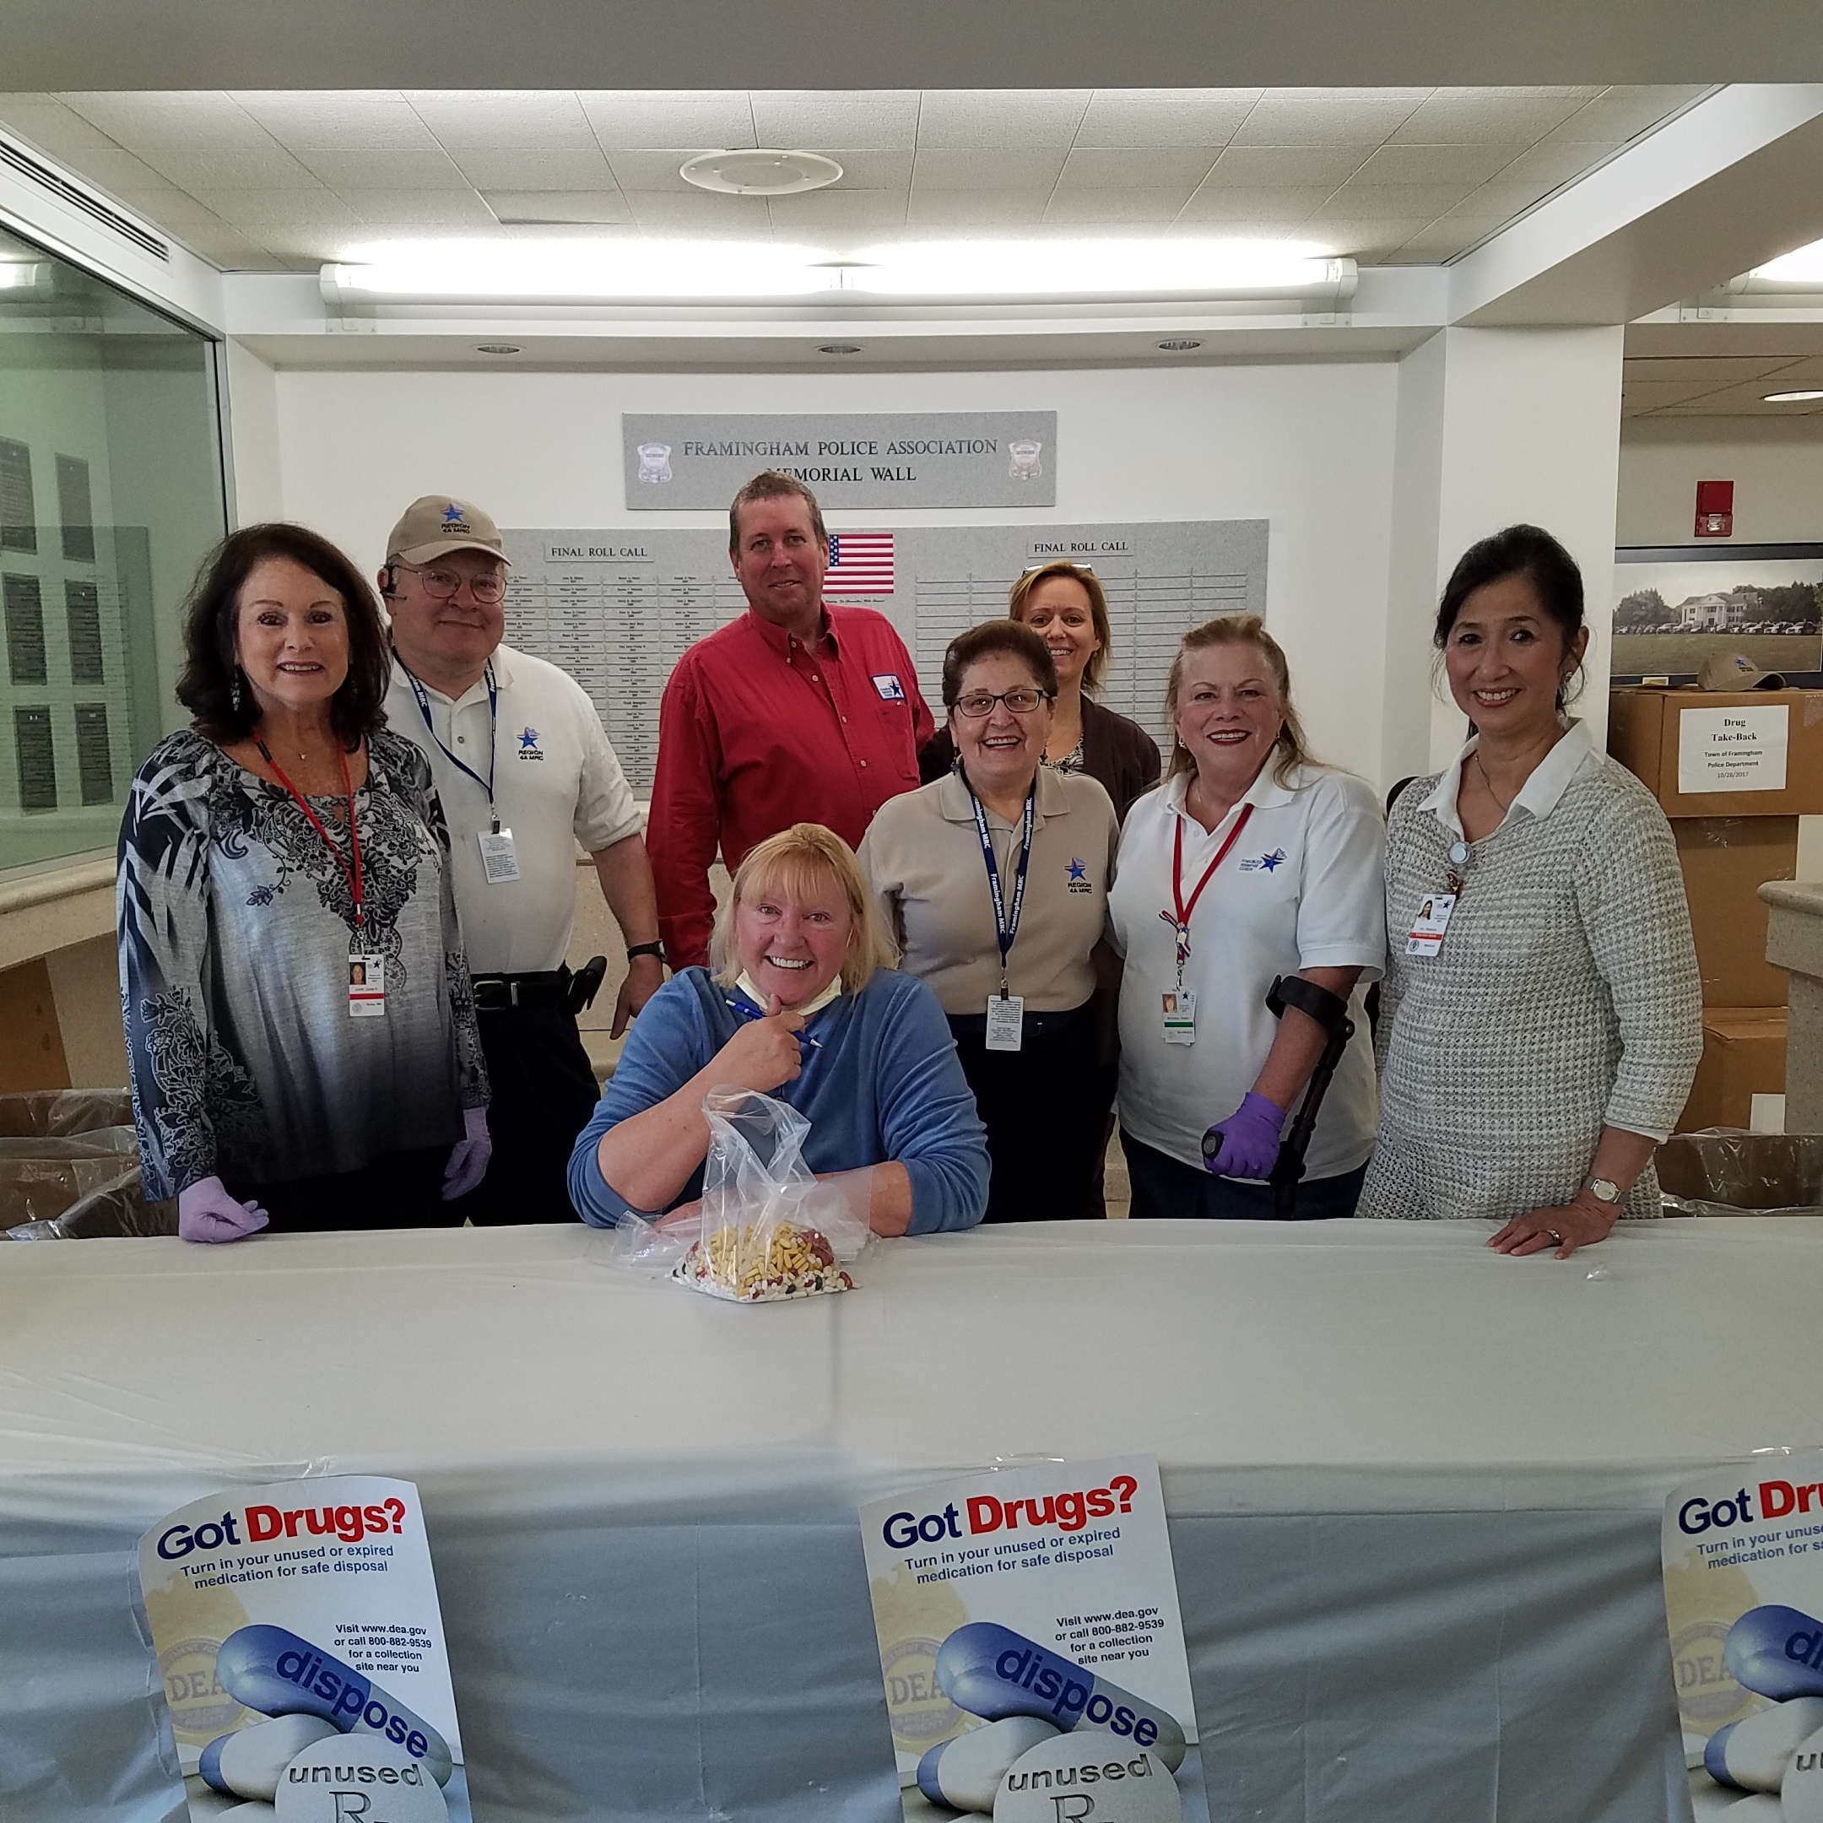
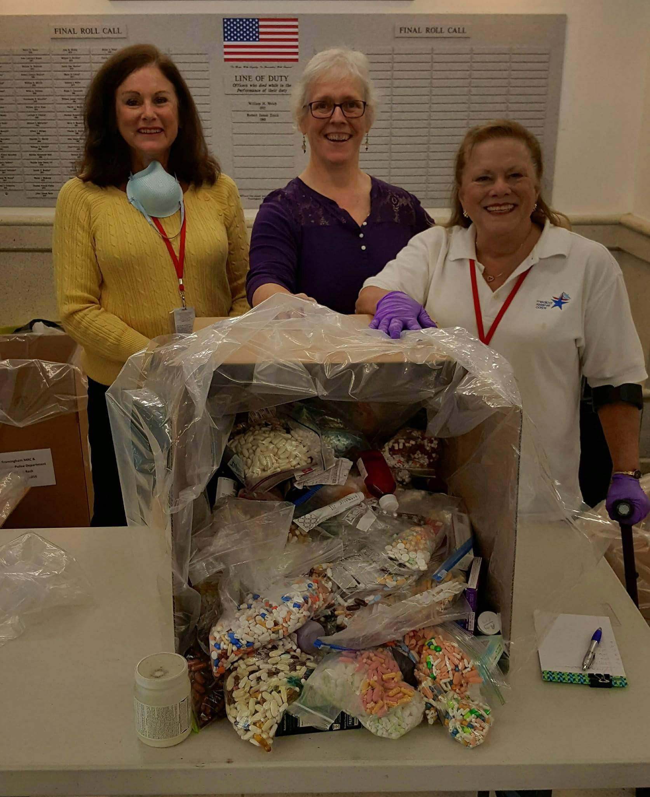
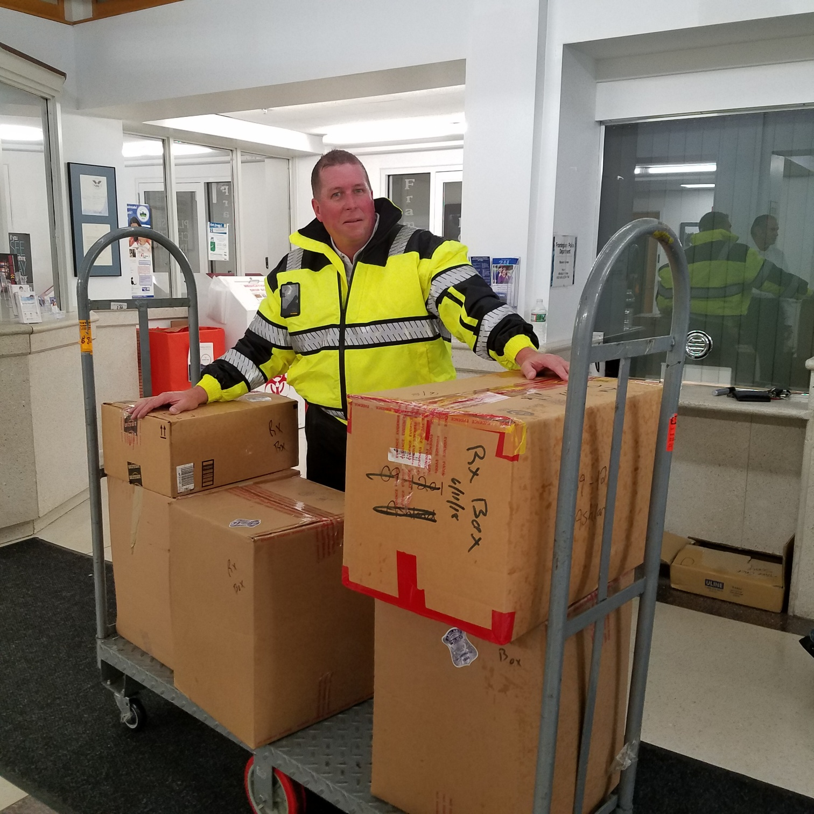
NATIONAL DRUG TAKE BACK DAY

Slide 14
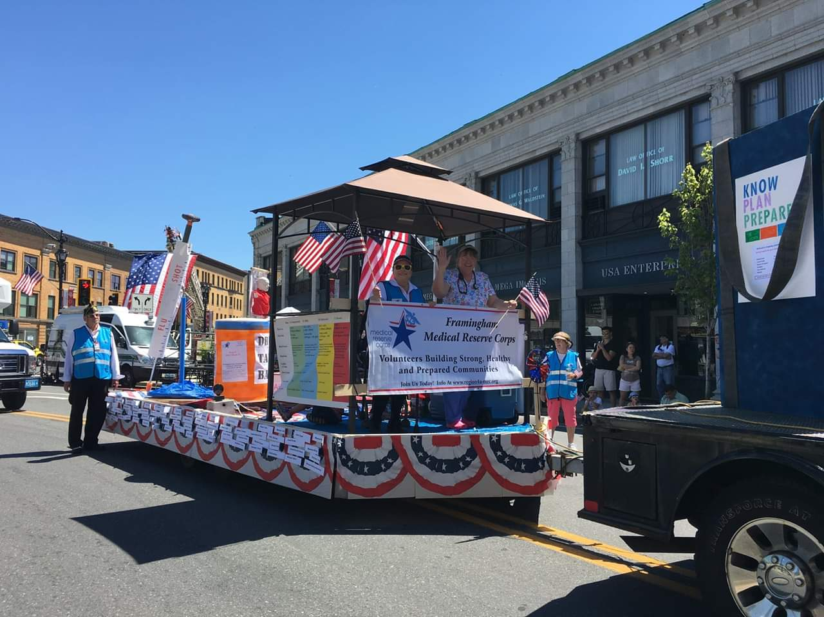
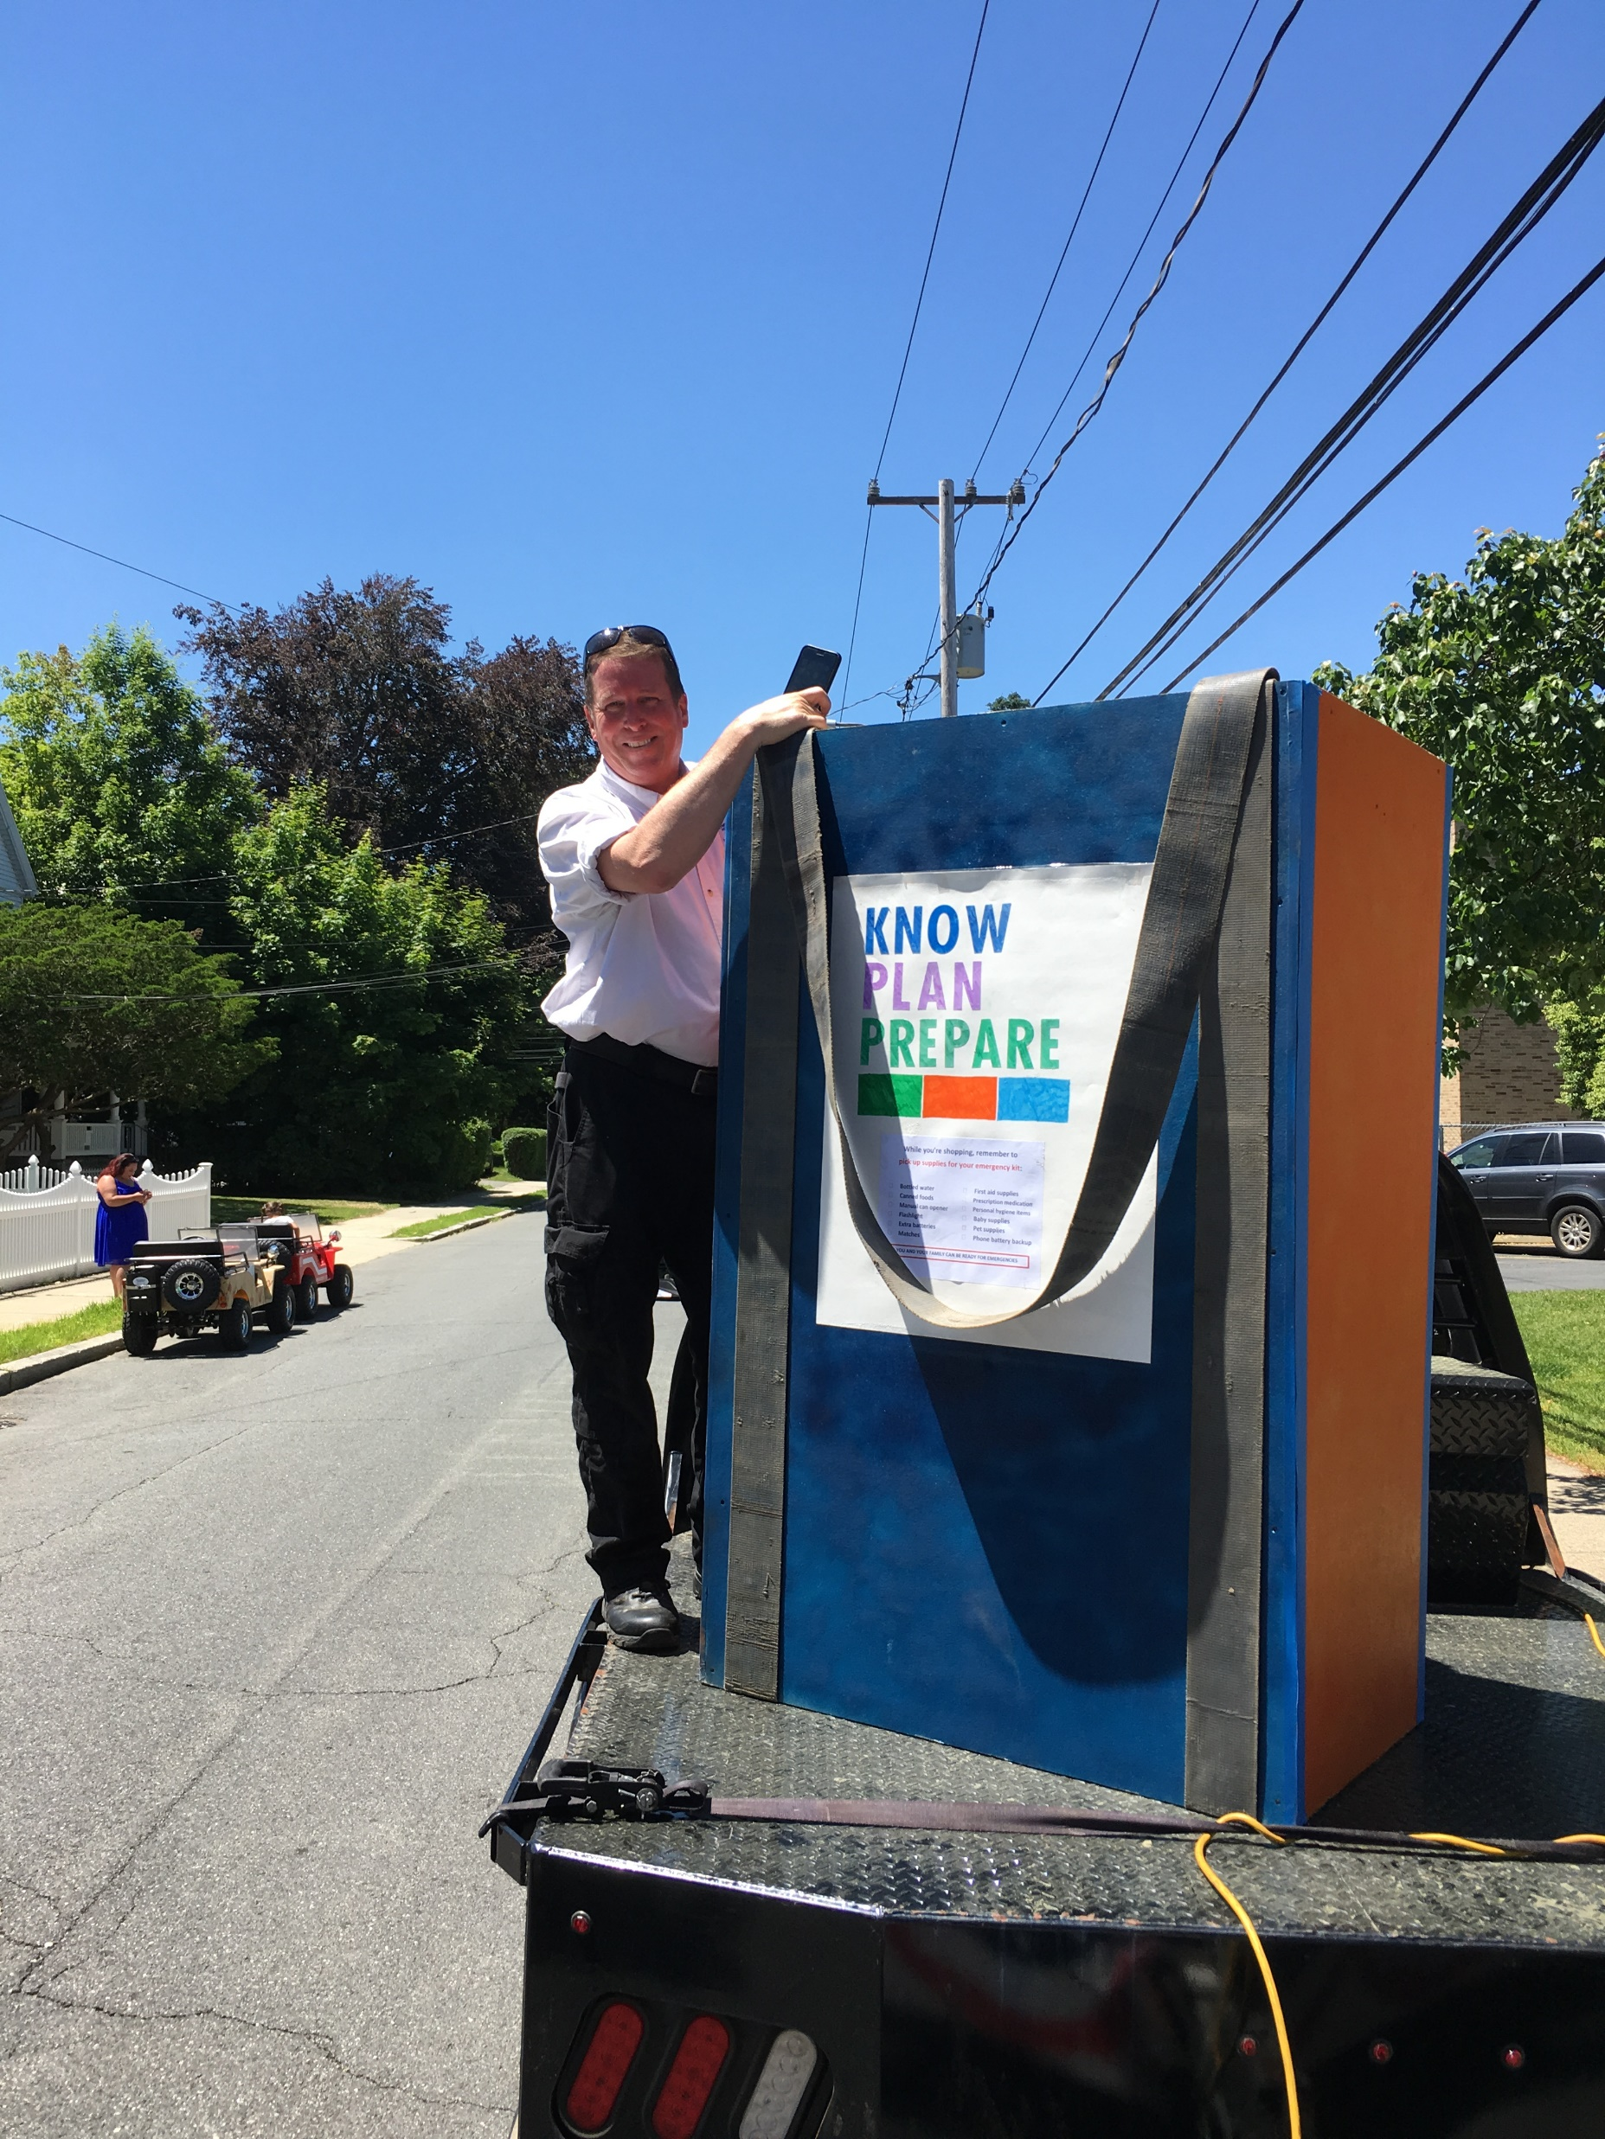
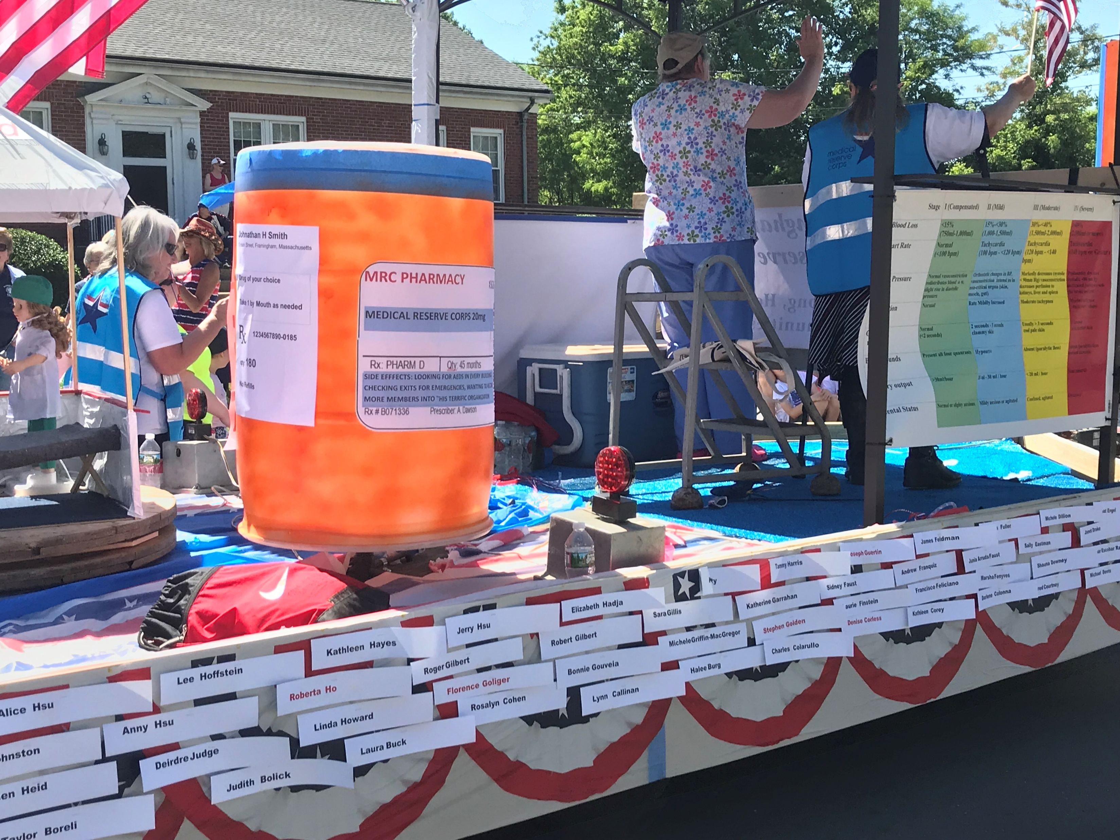
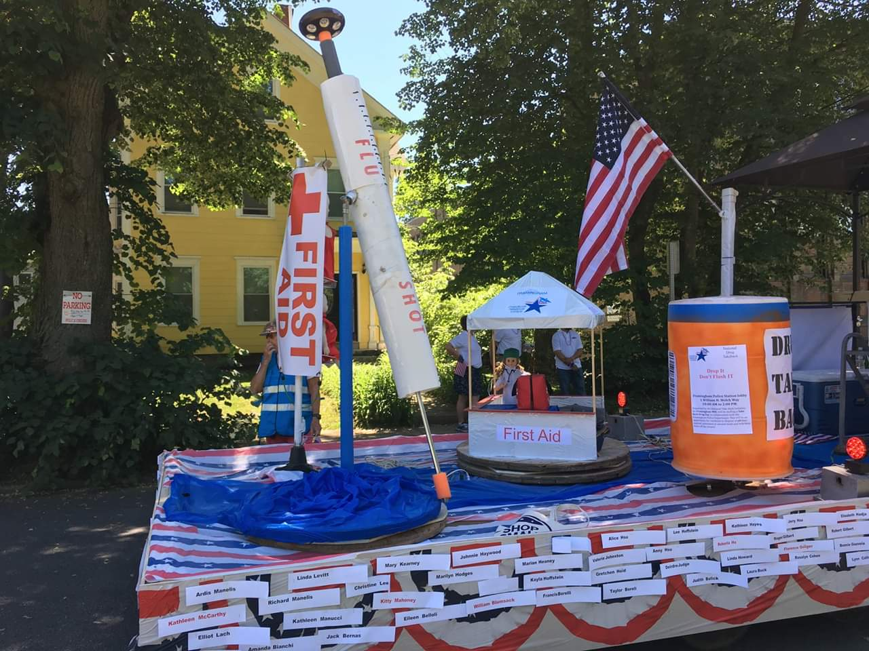
COMMUNITY PARADES
Float built and assembled by
MRC Volunteers

Slide 15
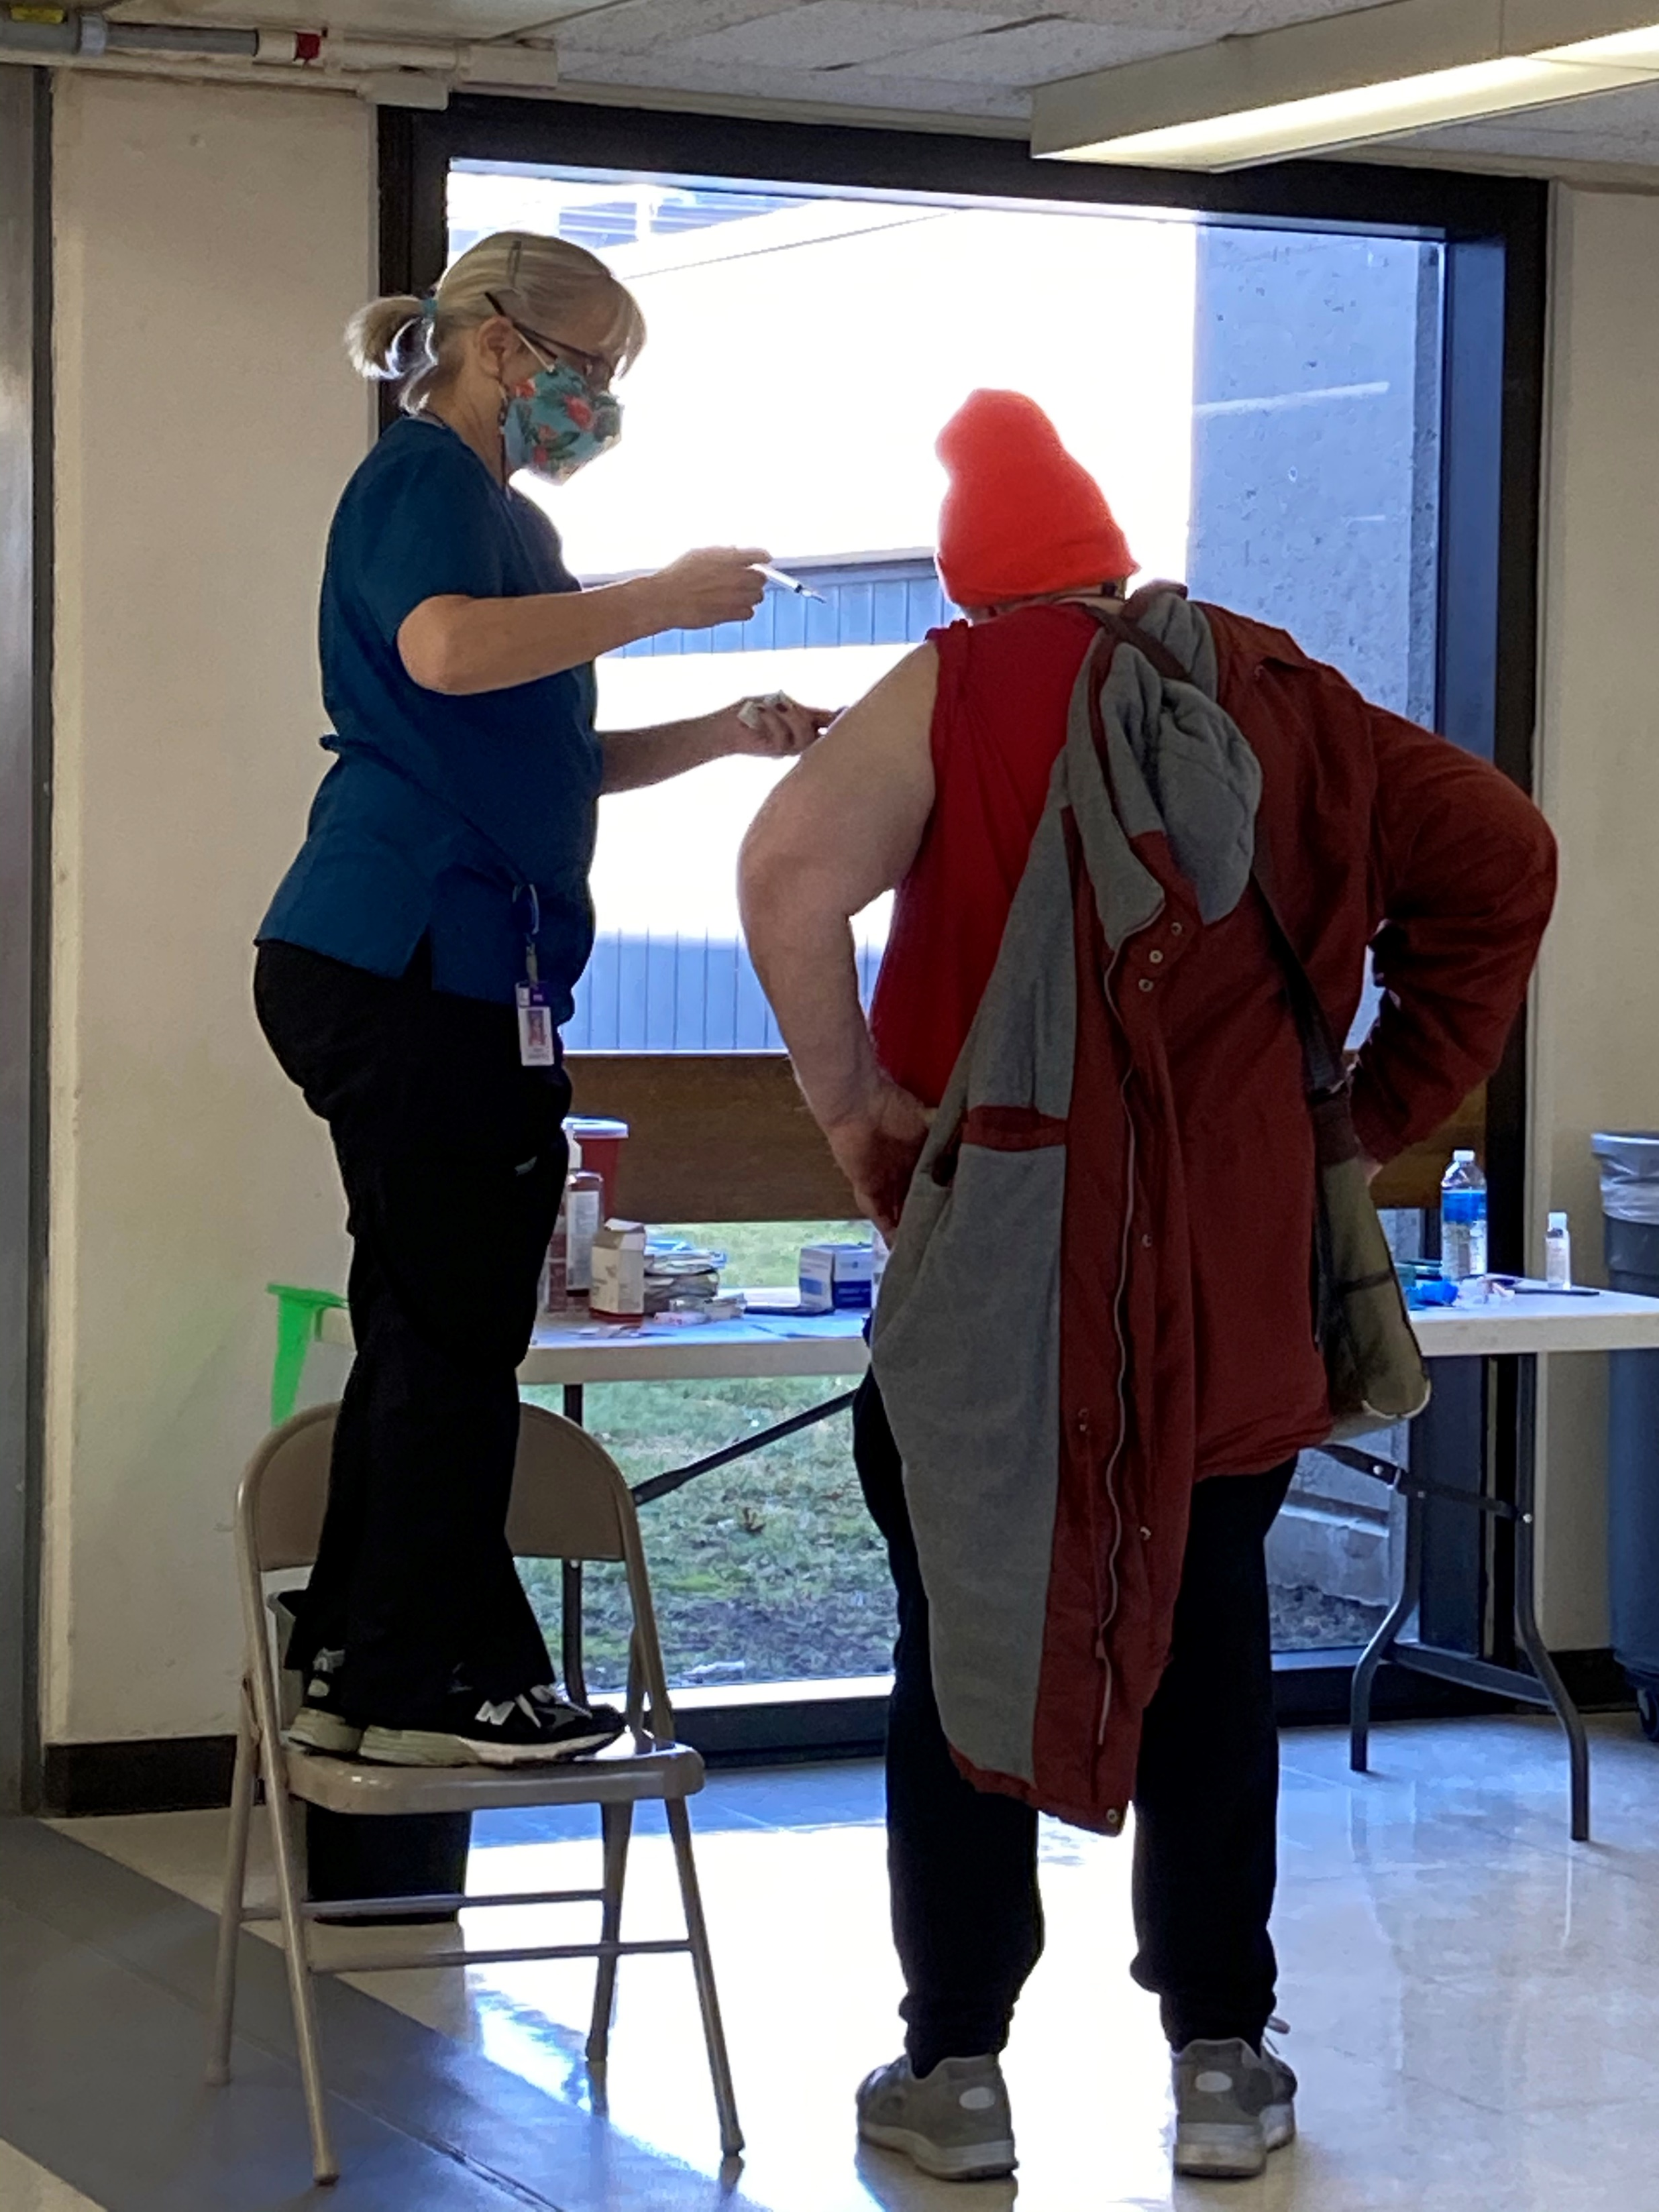
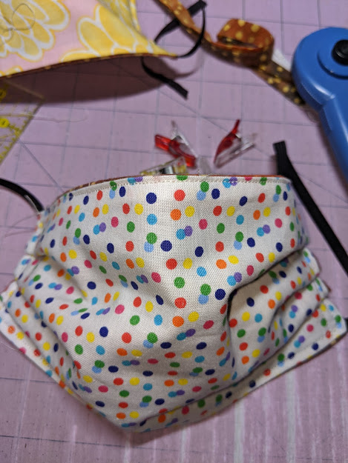
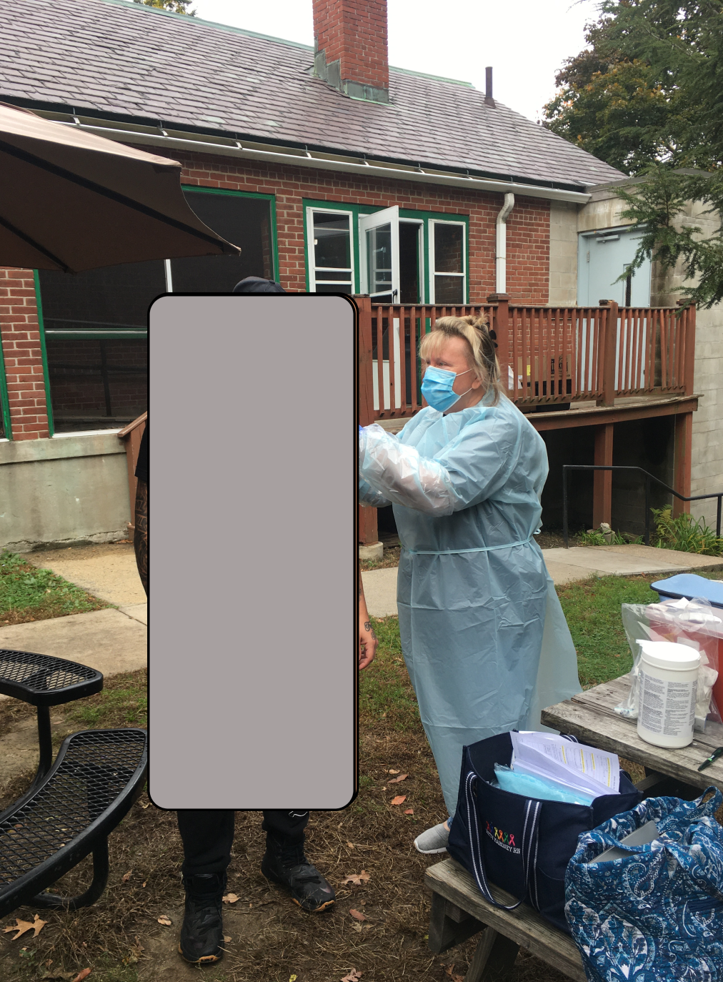
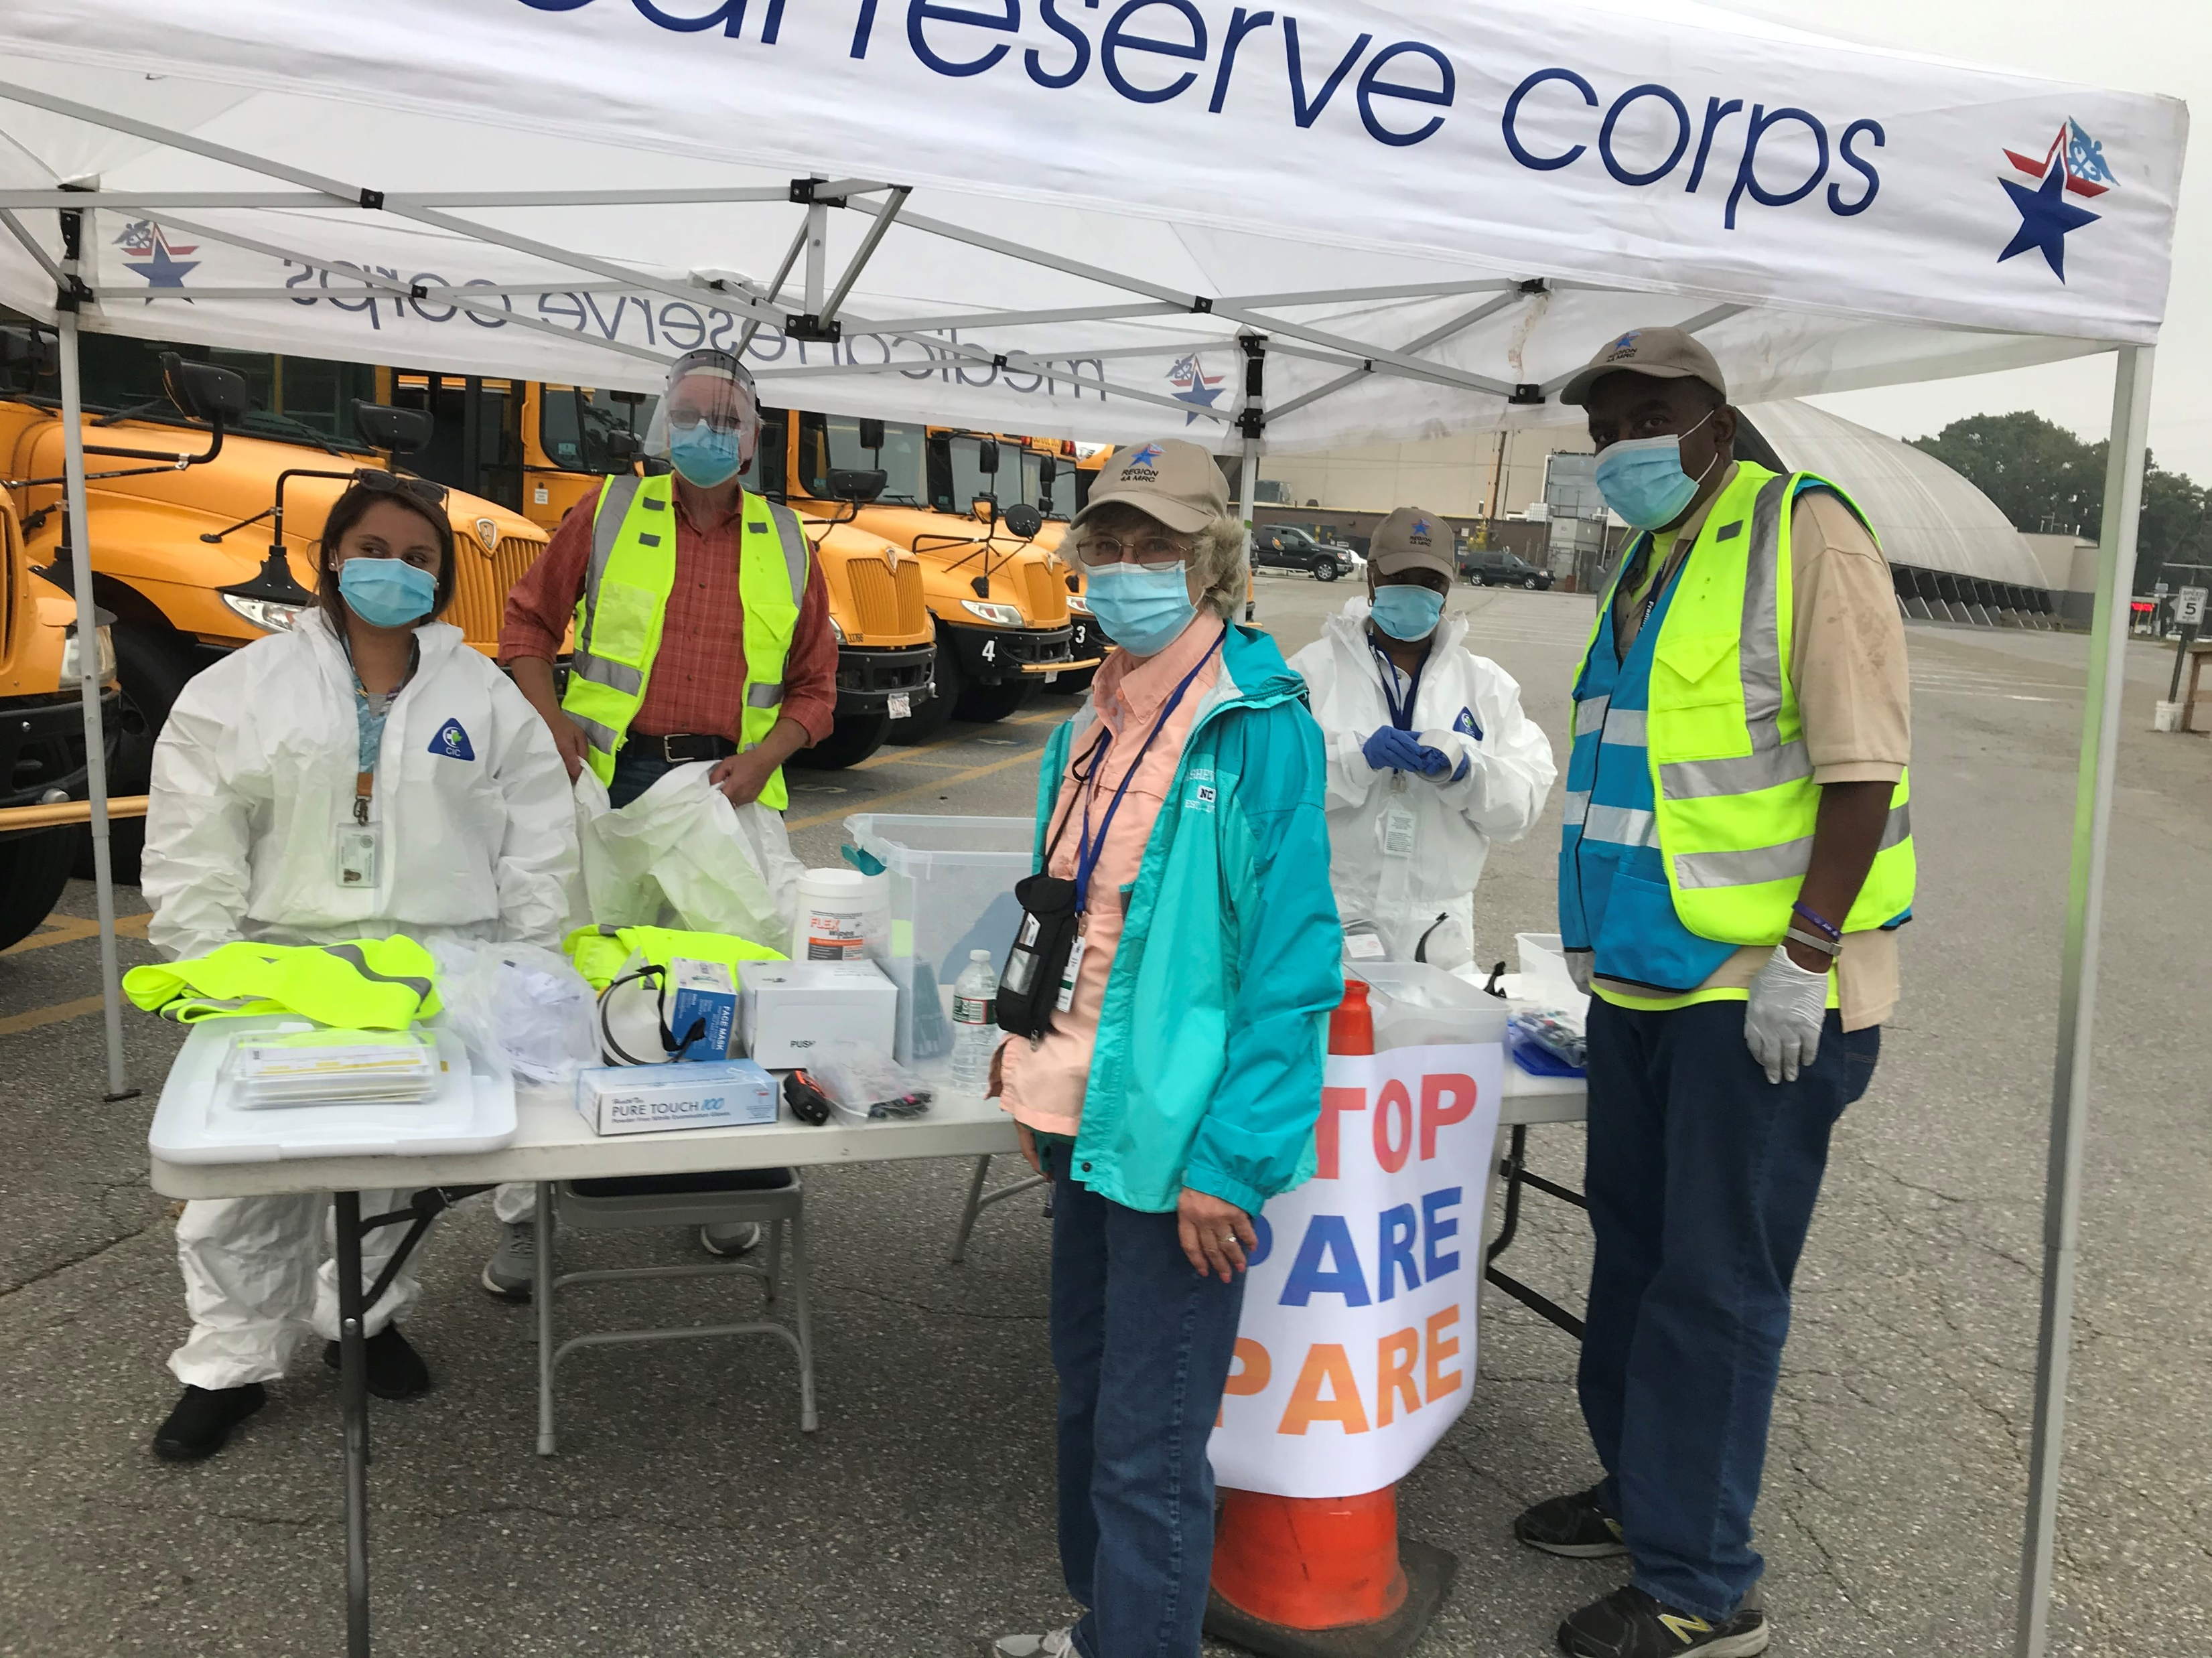
COVID 19 PREVENTION
Off-Site Clinics—over 150
Home Visits—over 100 visits by 3 person teams
Handmade masks

Slide 16
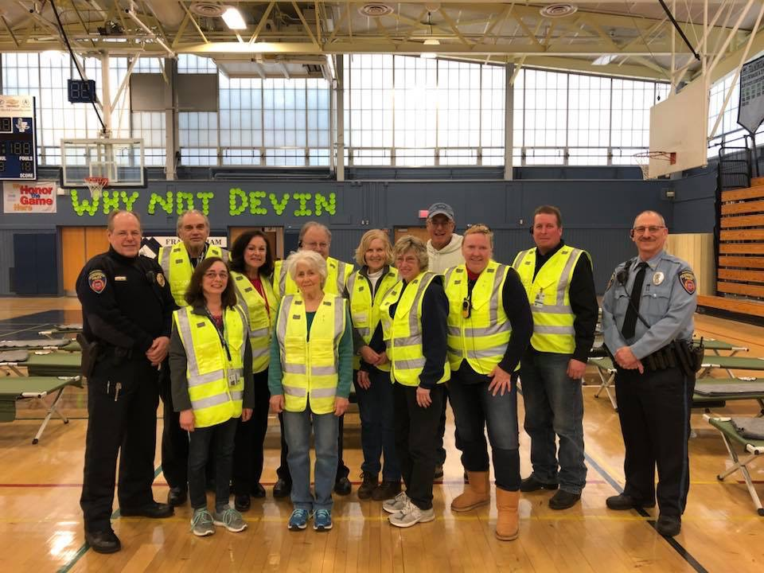
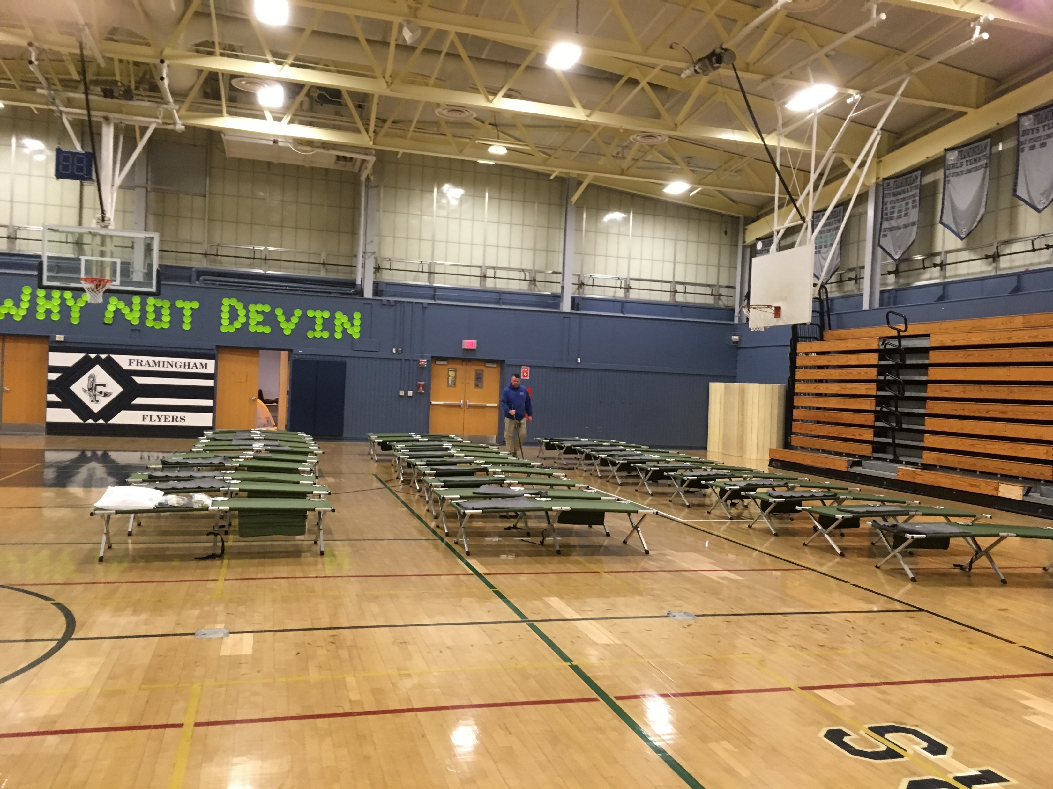
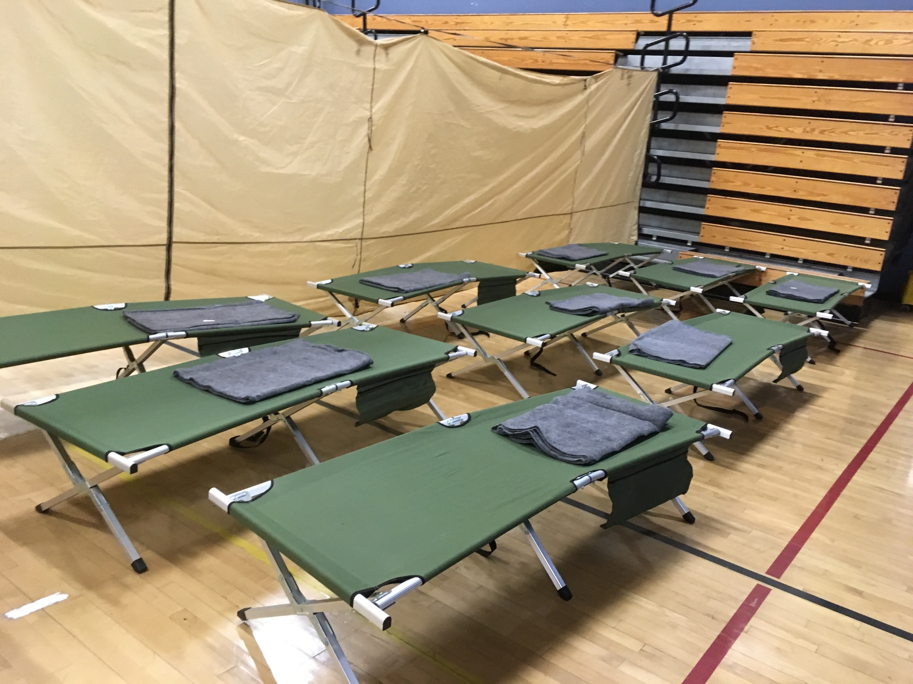
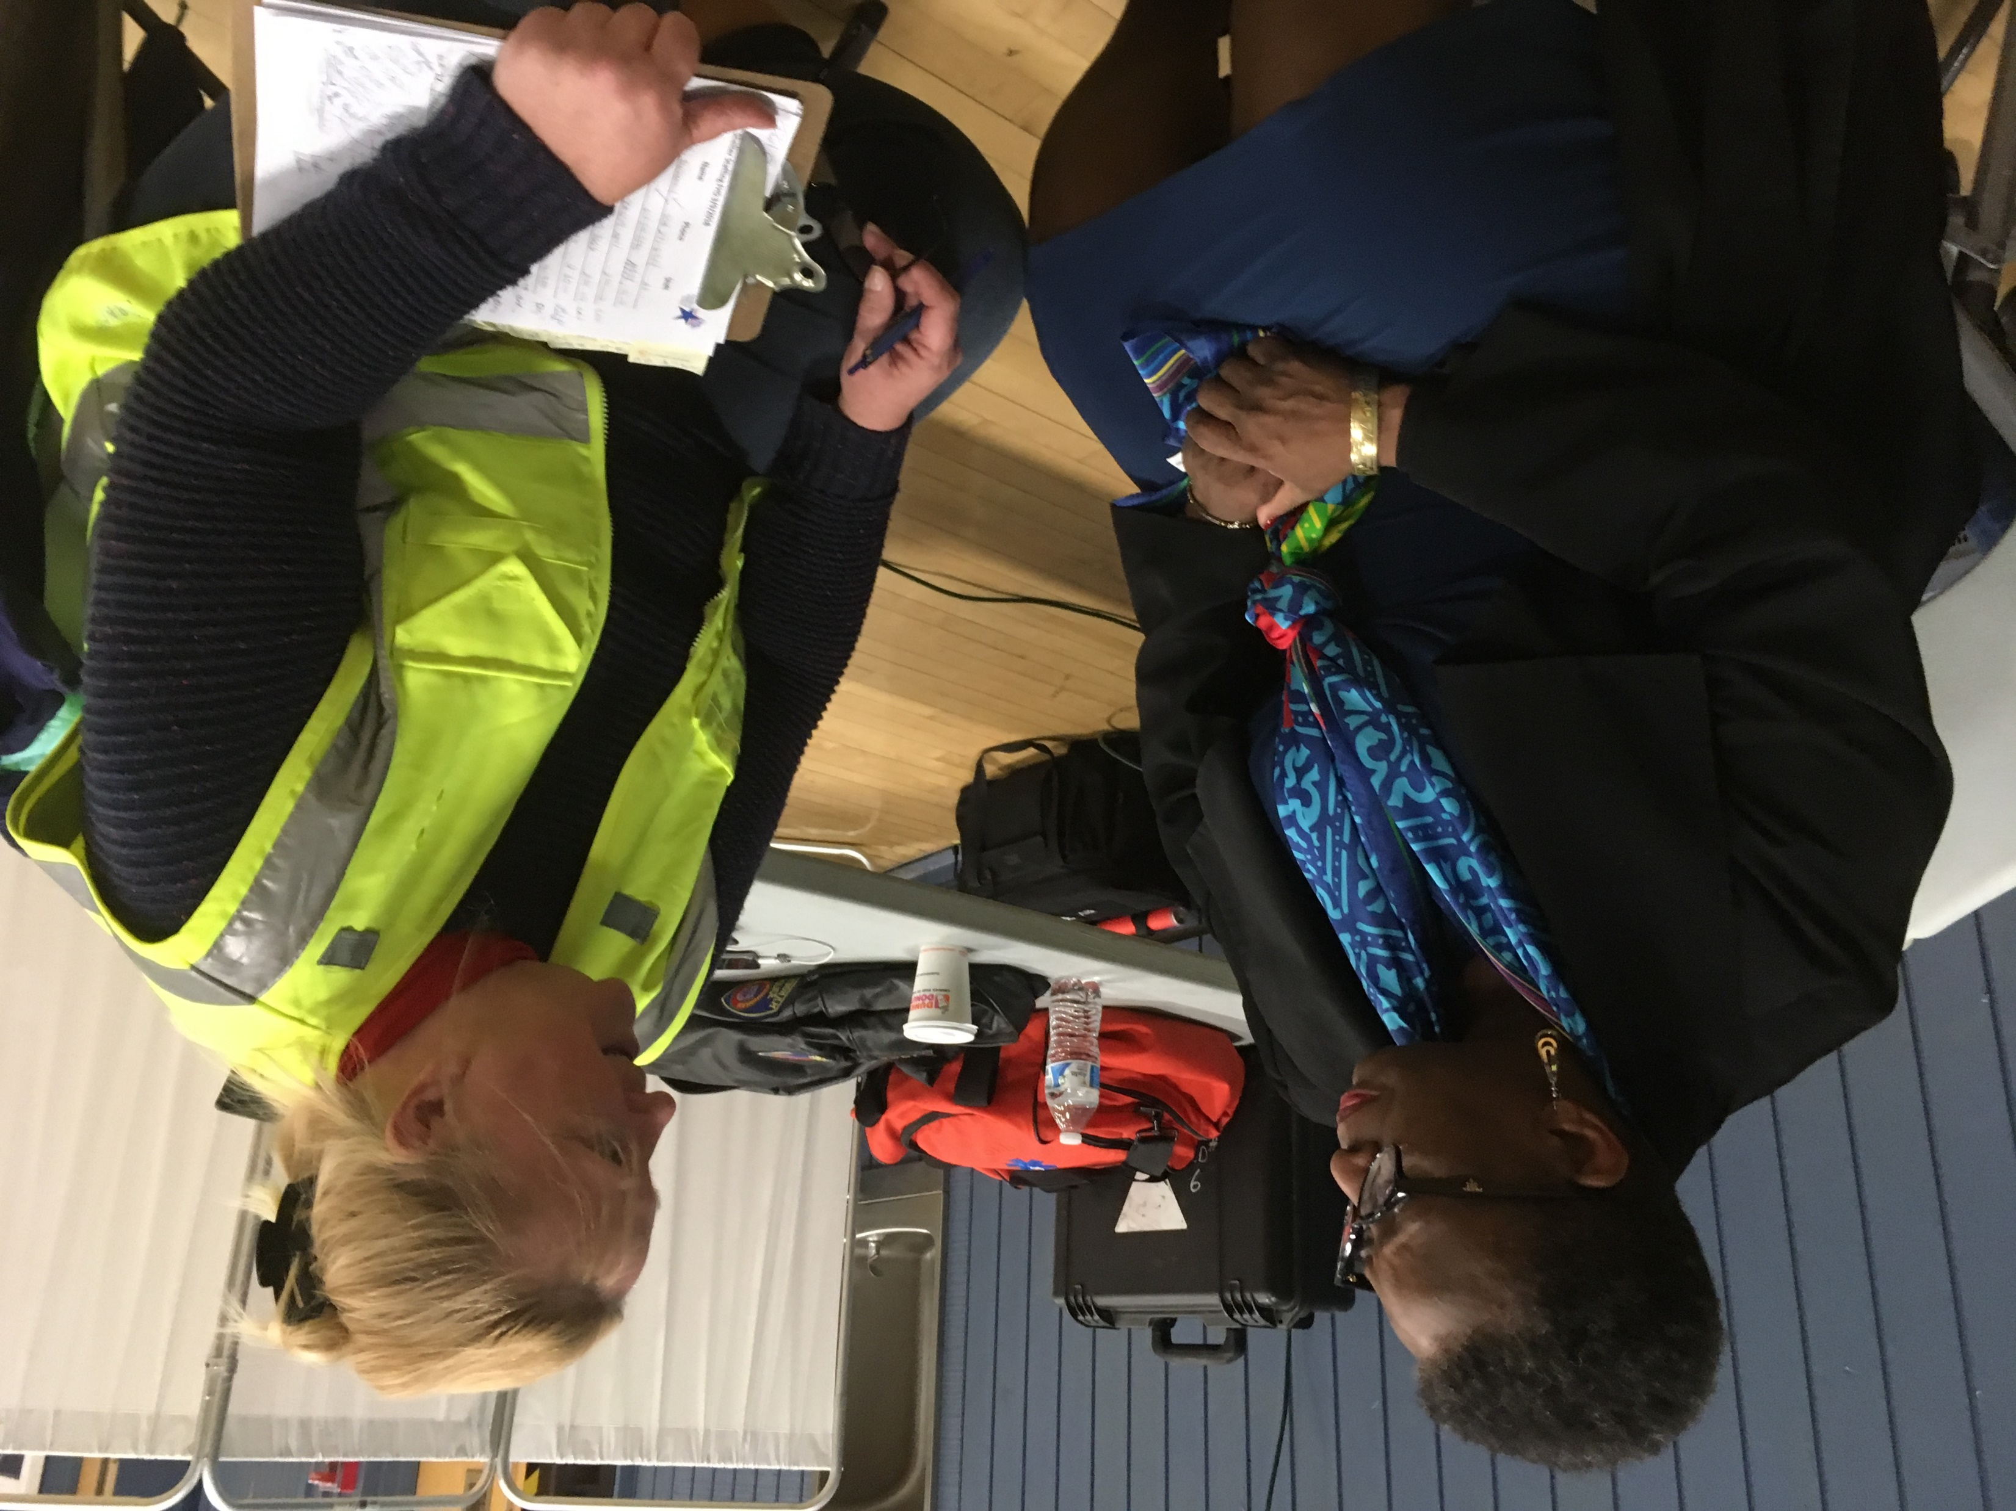
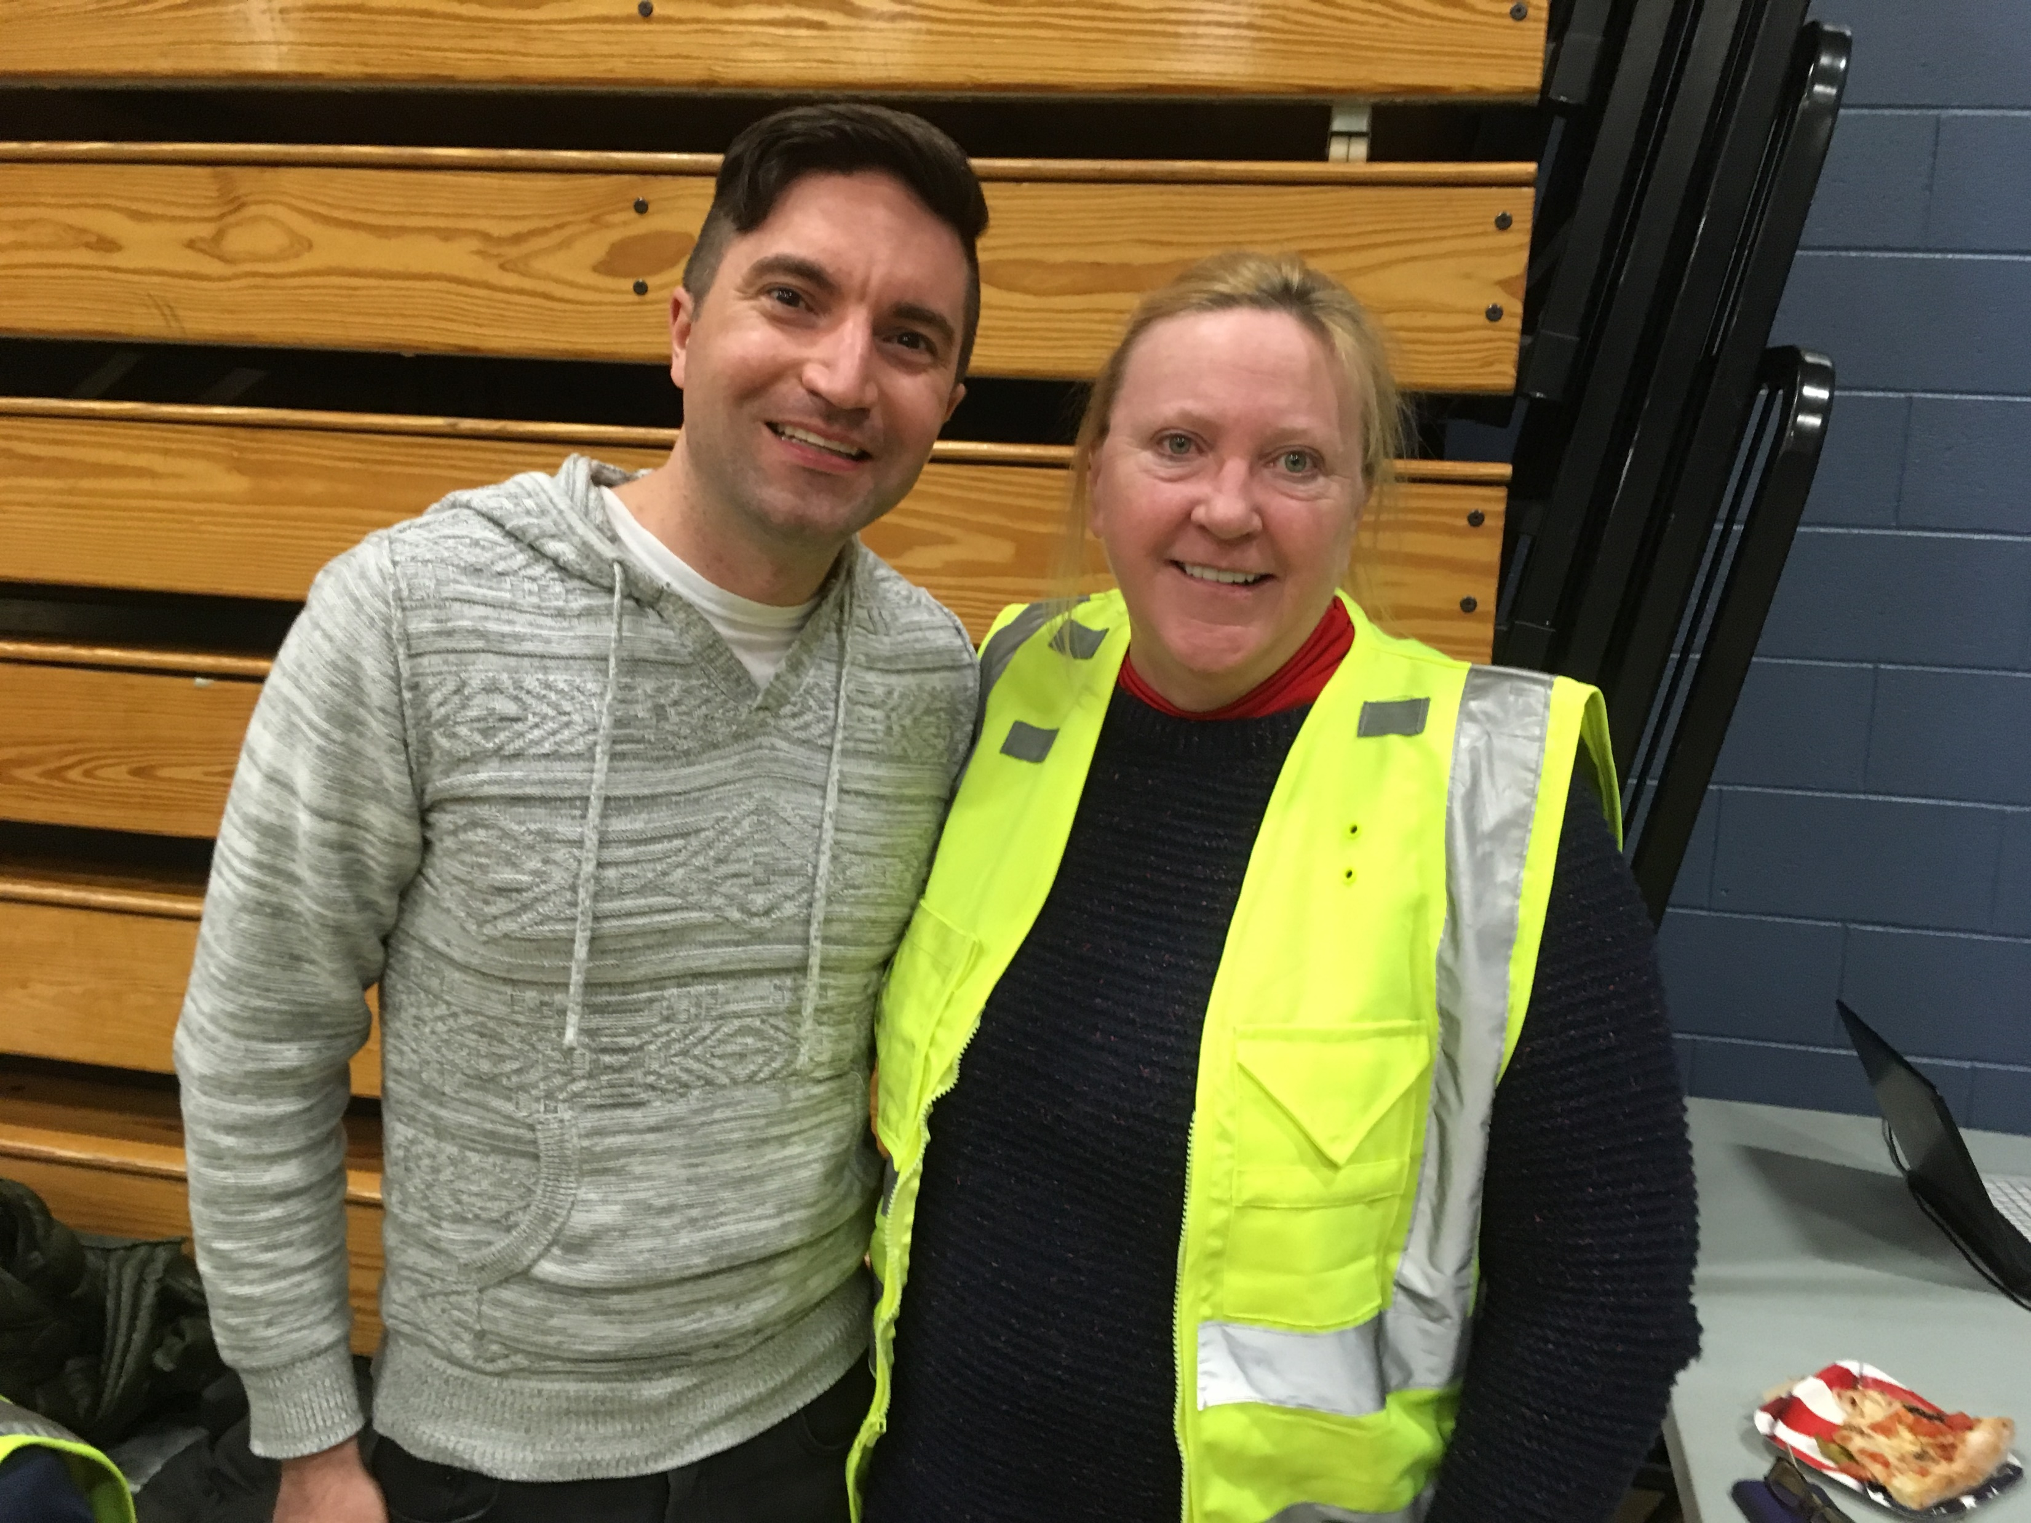
SHELTERING
Worked with City
Agencies—Mayor,
Auxiliary Police,
Framingham PD &
FD, School Facility
Management, DPW

Slide 17
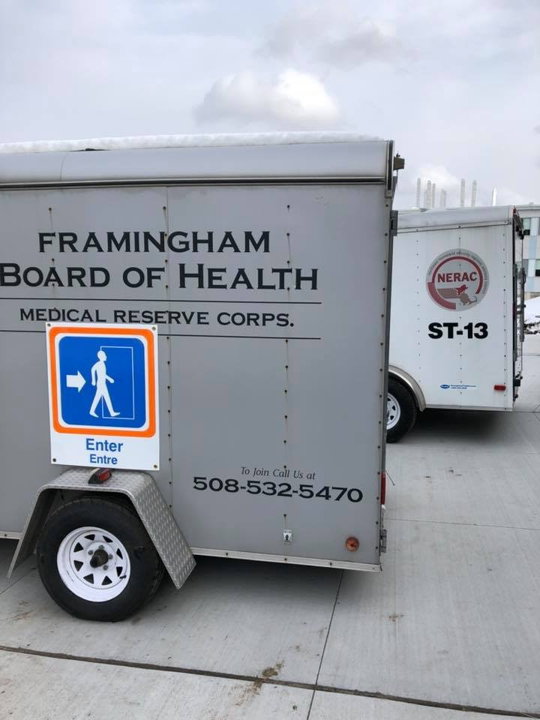
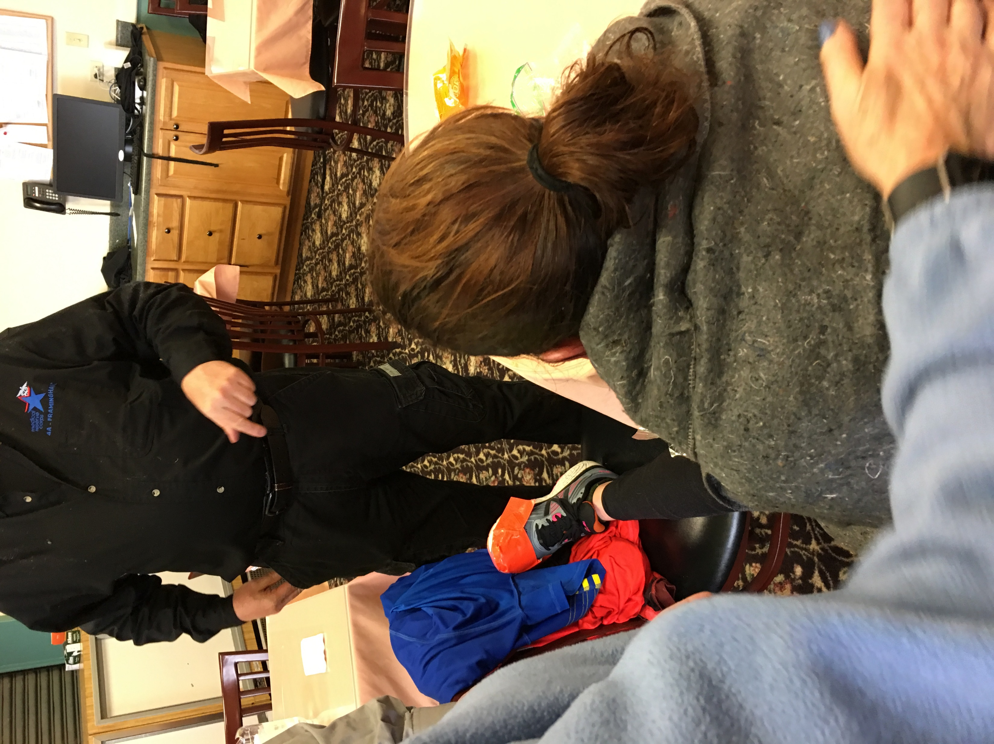
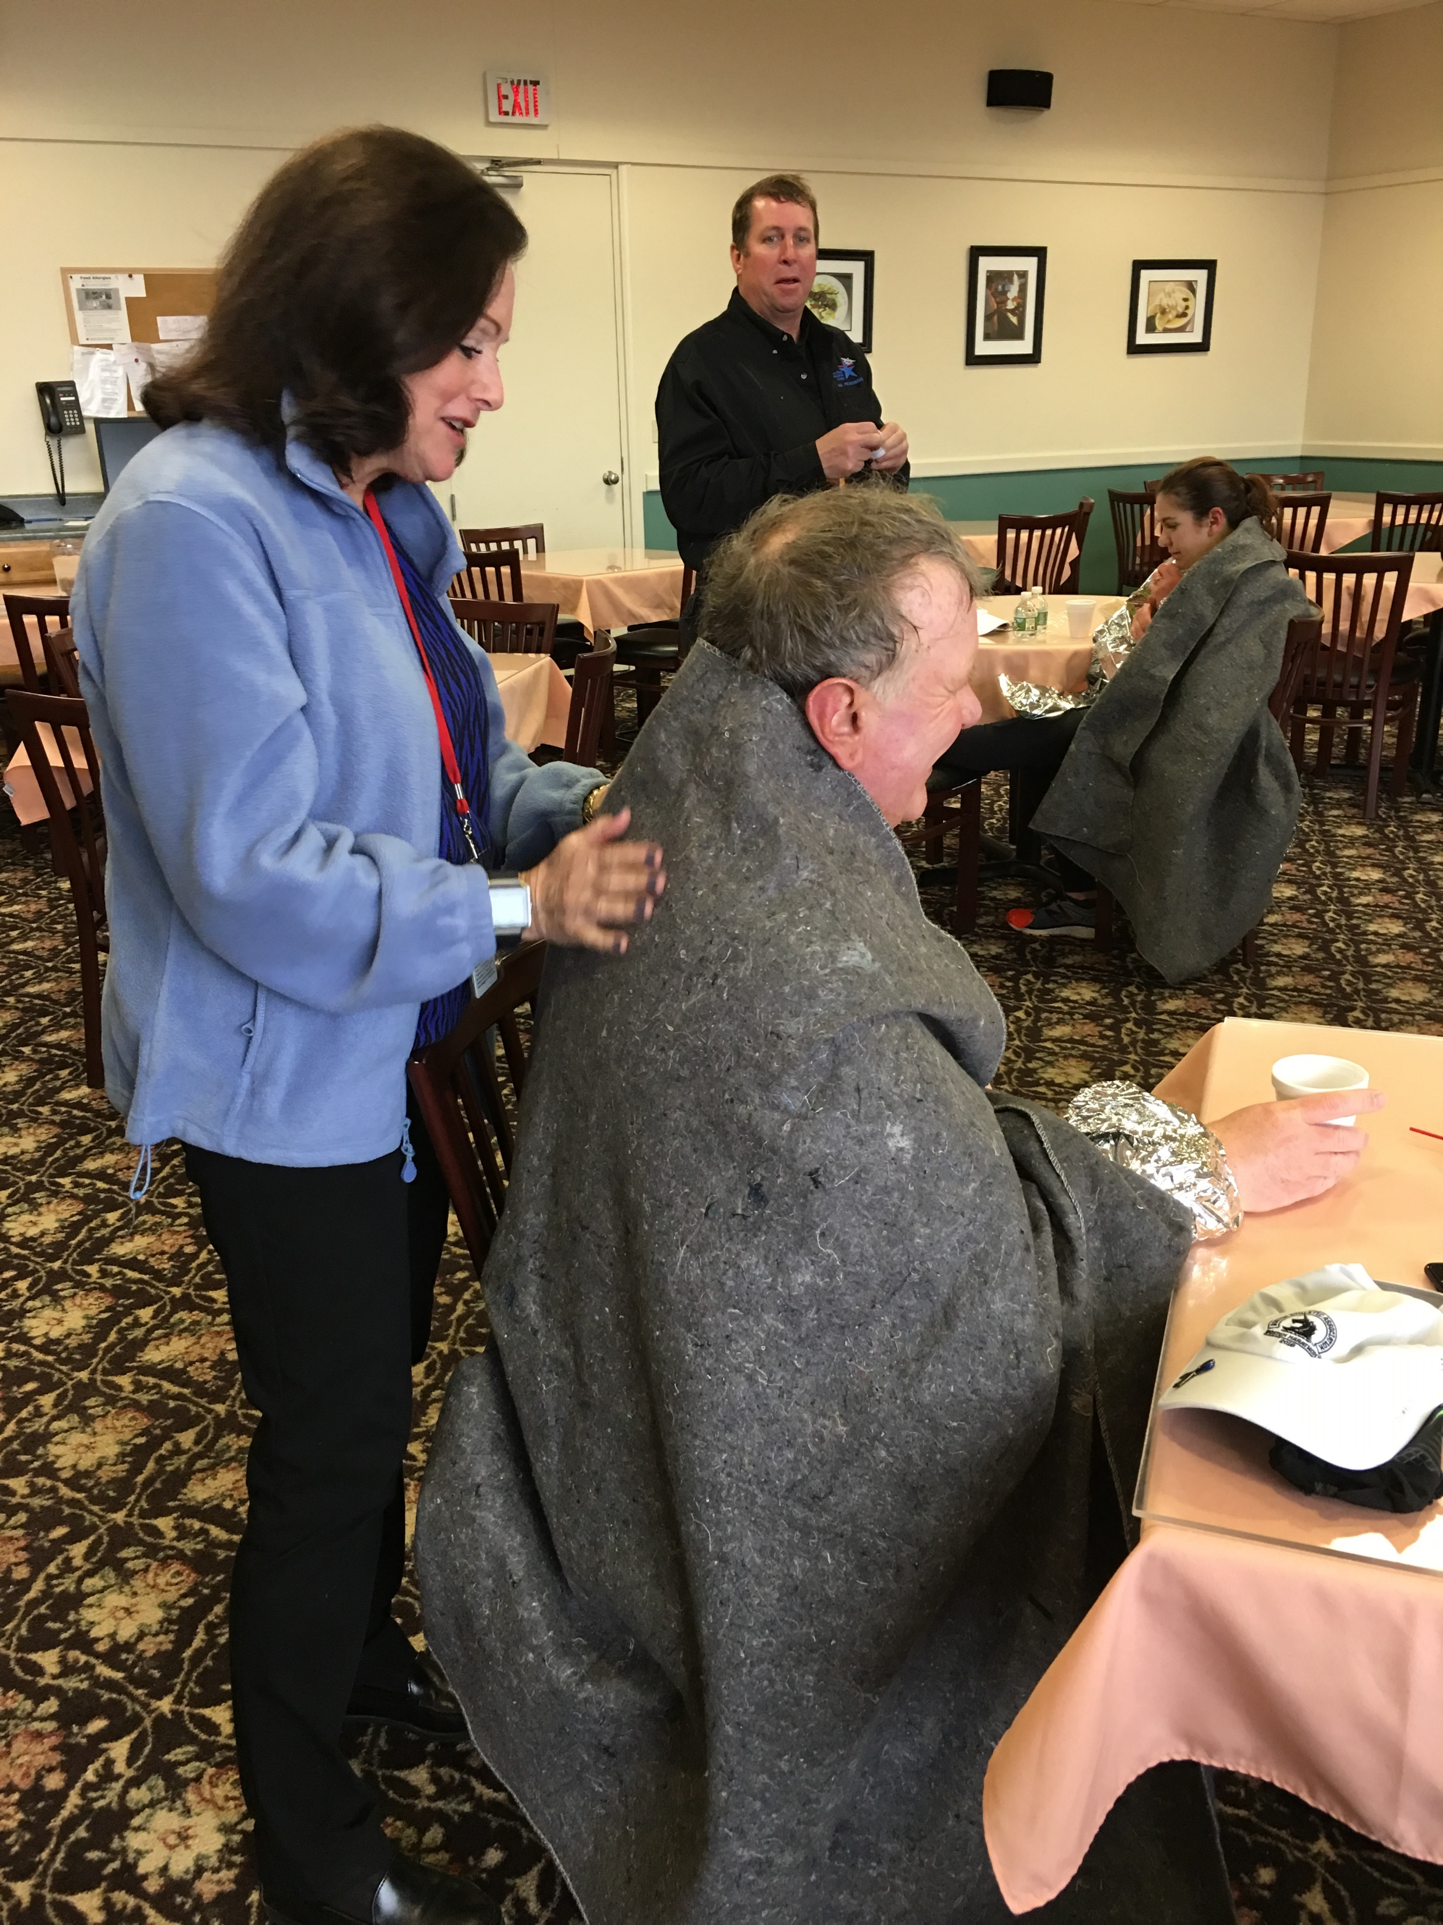
BOSTON MARATHON SHELTER OPERATIONS
Patriots’ Day
Certified/licensed healthcare professionals
MRC Volunteers
Work with FPD, FFD,
city contracted
ambulance services,
FDPW, school facilities
management

Slide 18
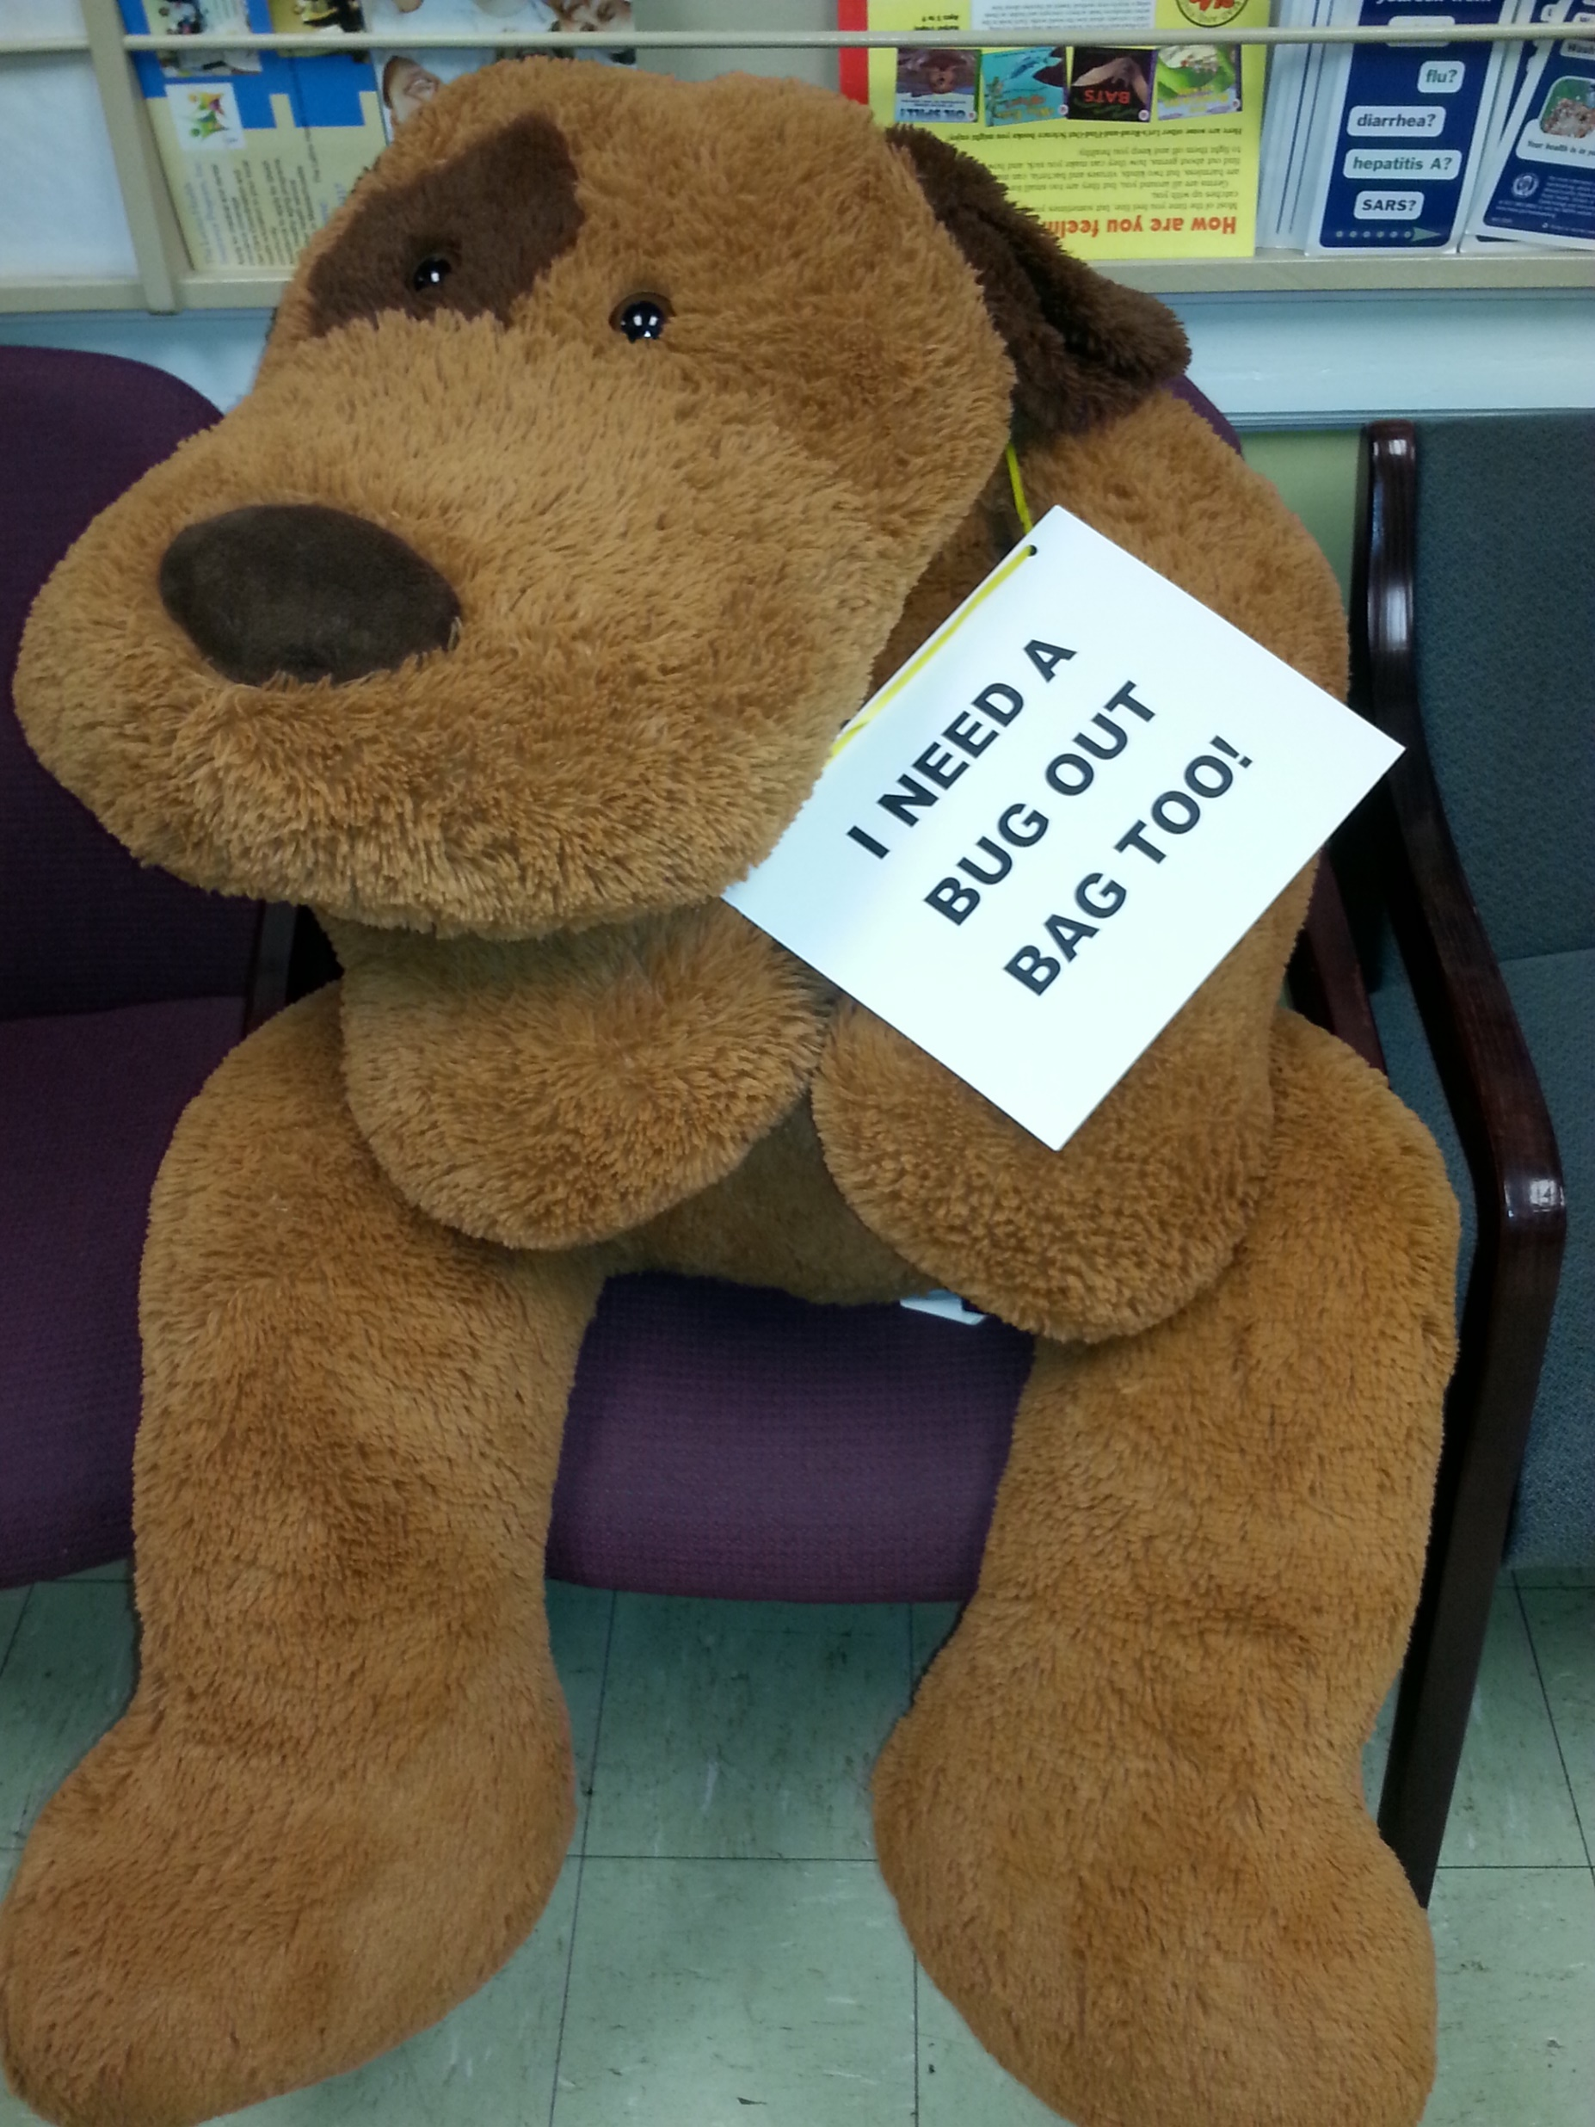
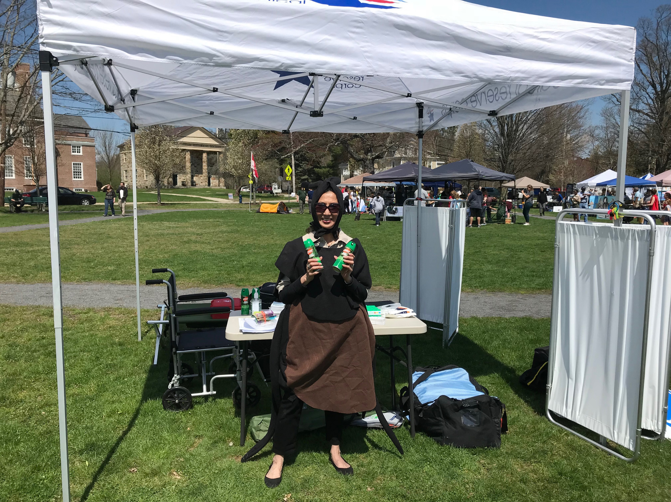
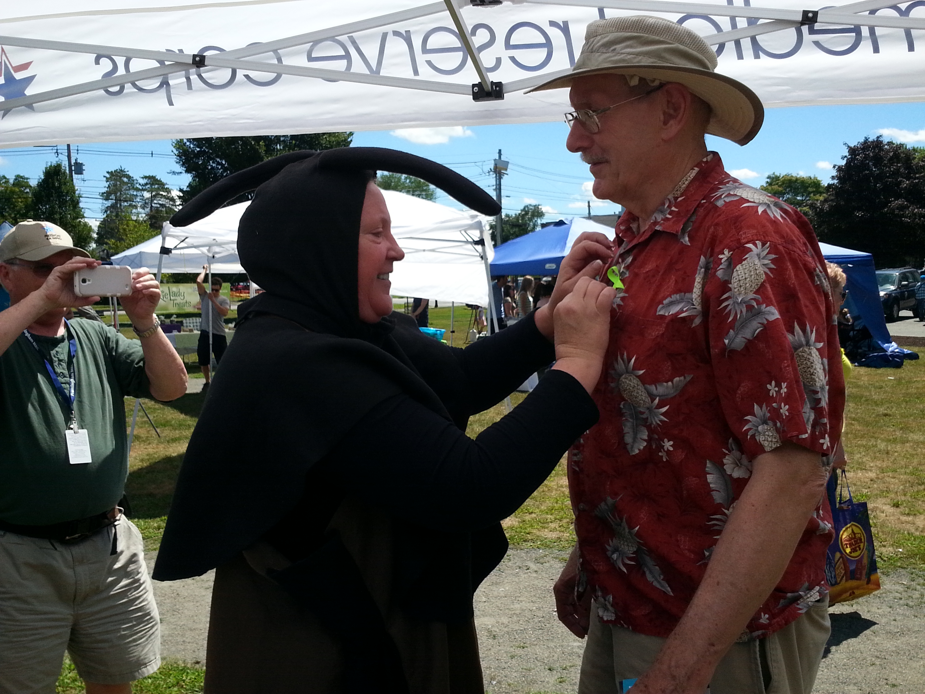
EARTH DAY
Last Saturday in April
Work with Earth Day
Director
Hand out info to
promote & educate
attendees on dangers
of tick, flee, mosquito
bites

Slide 19
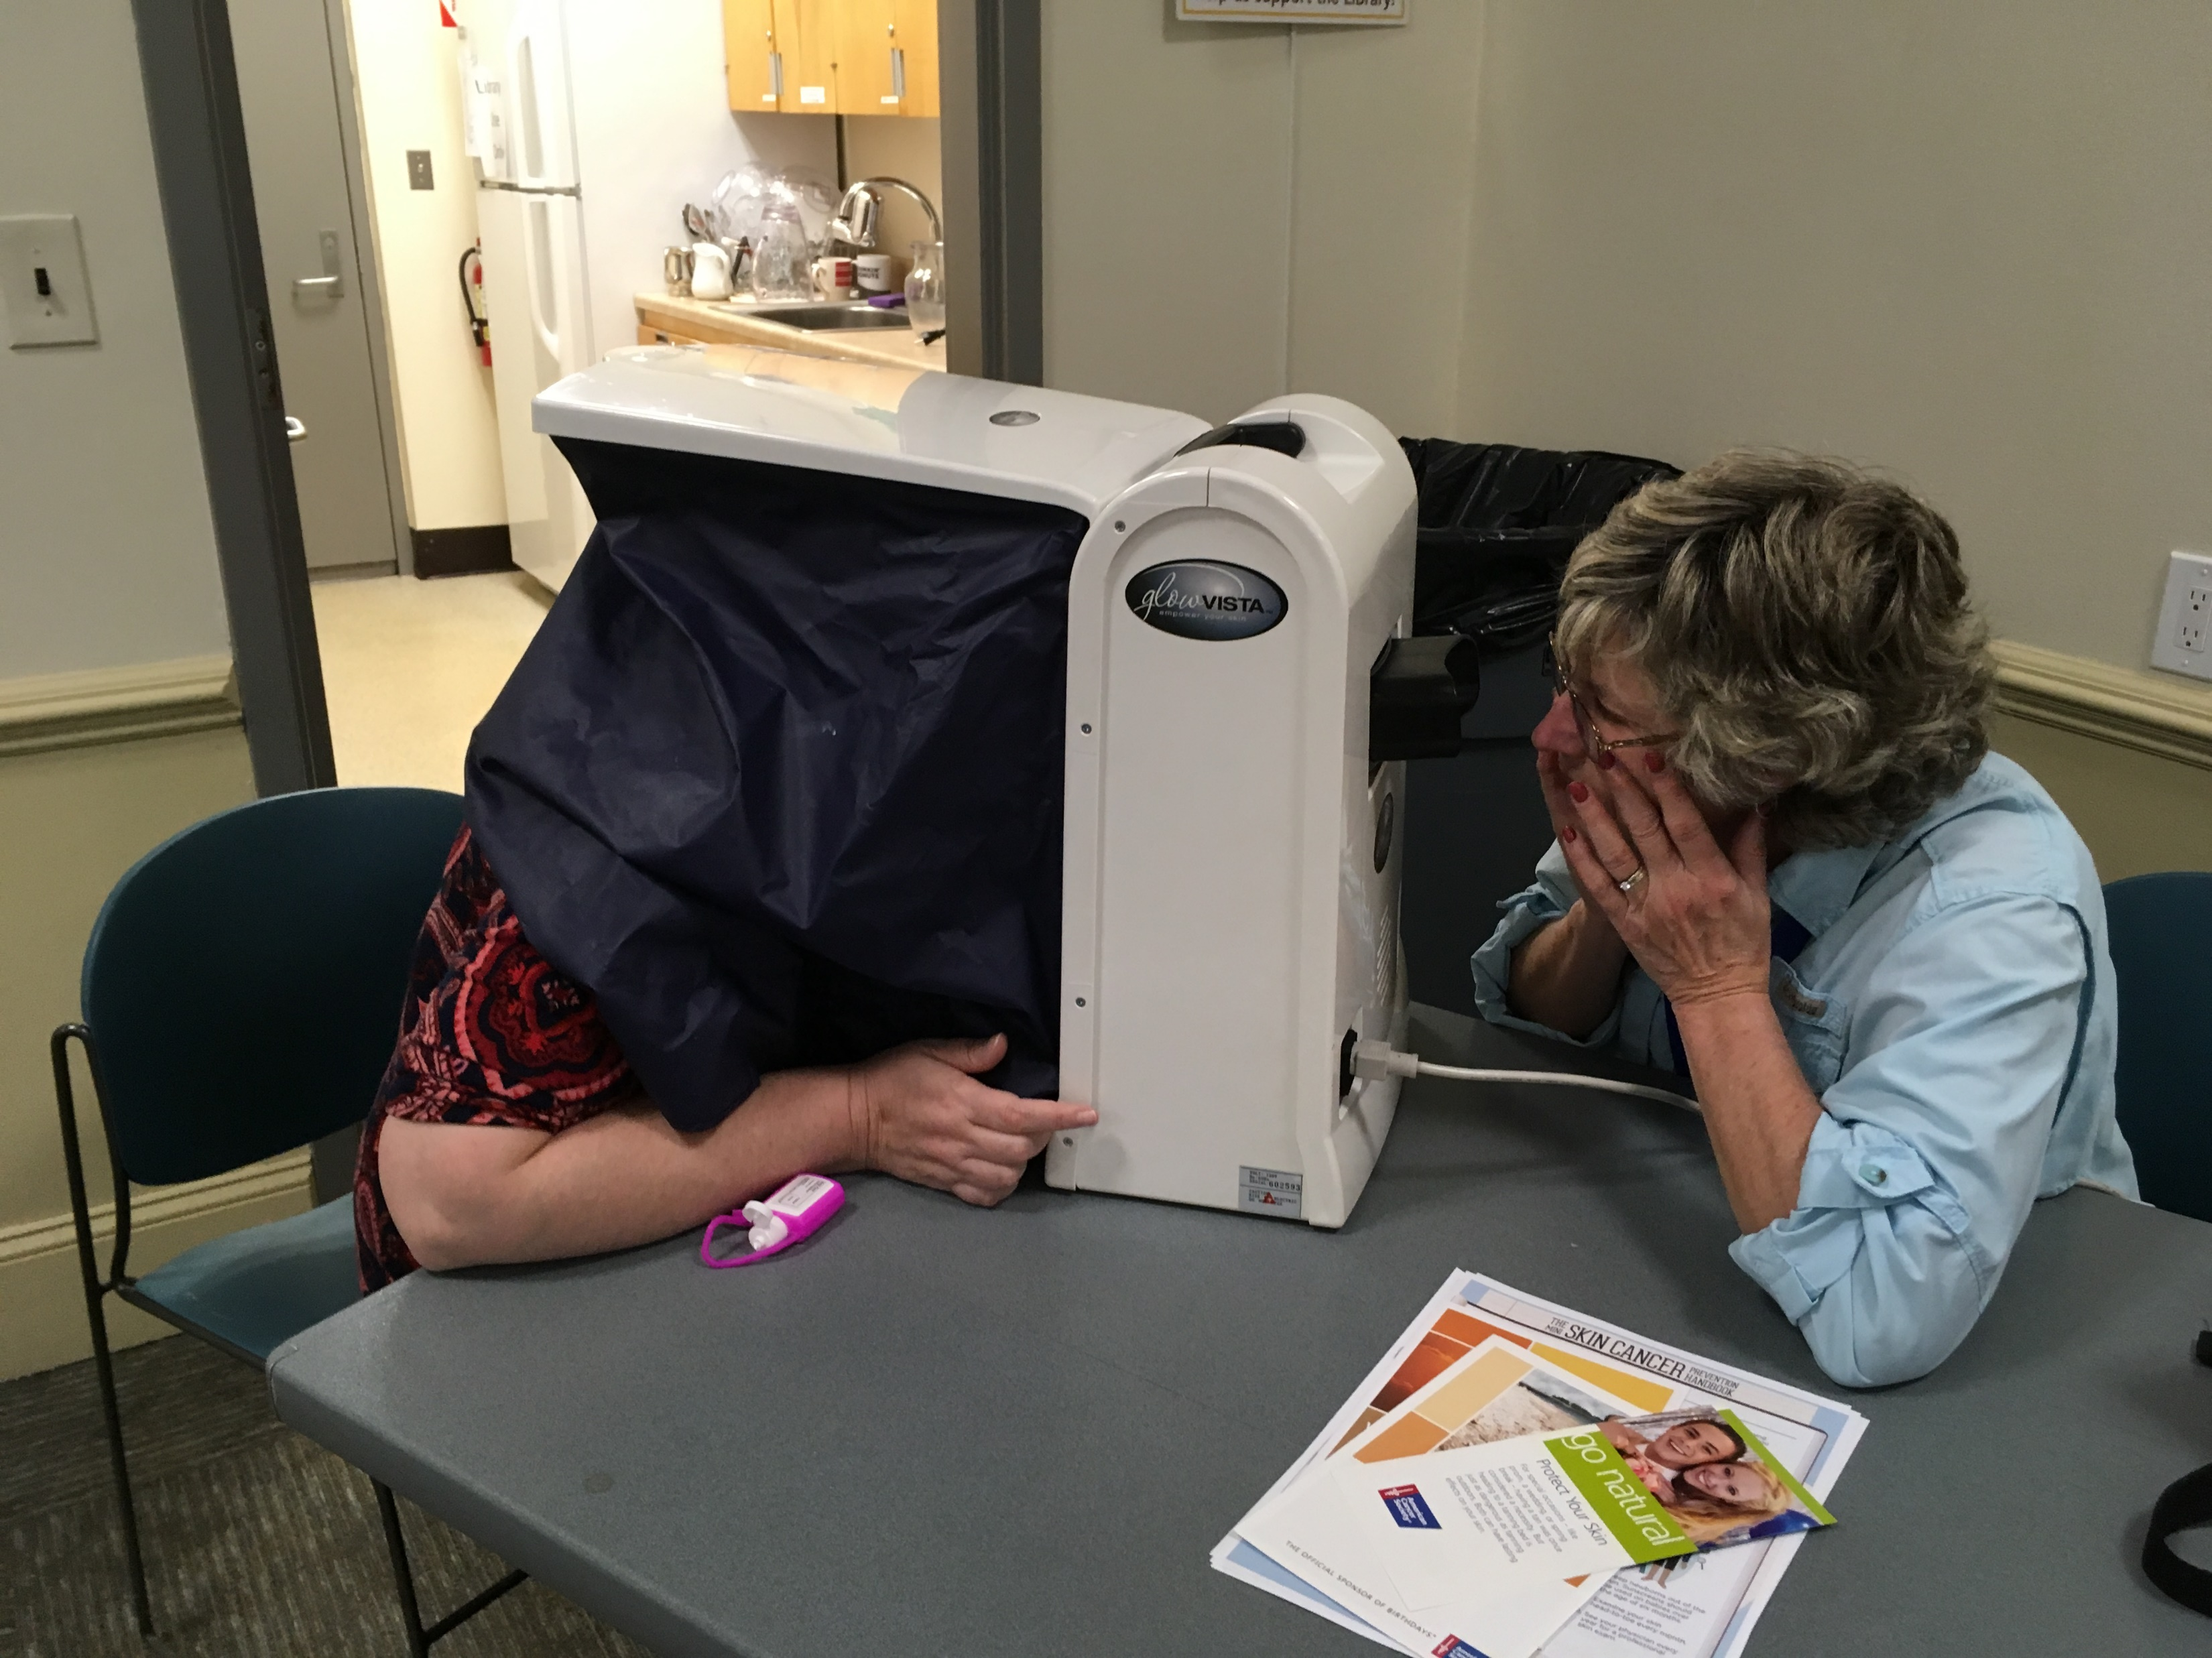
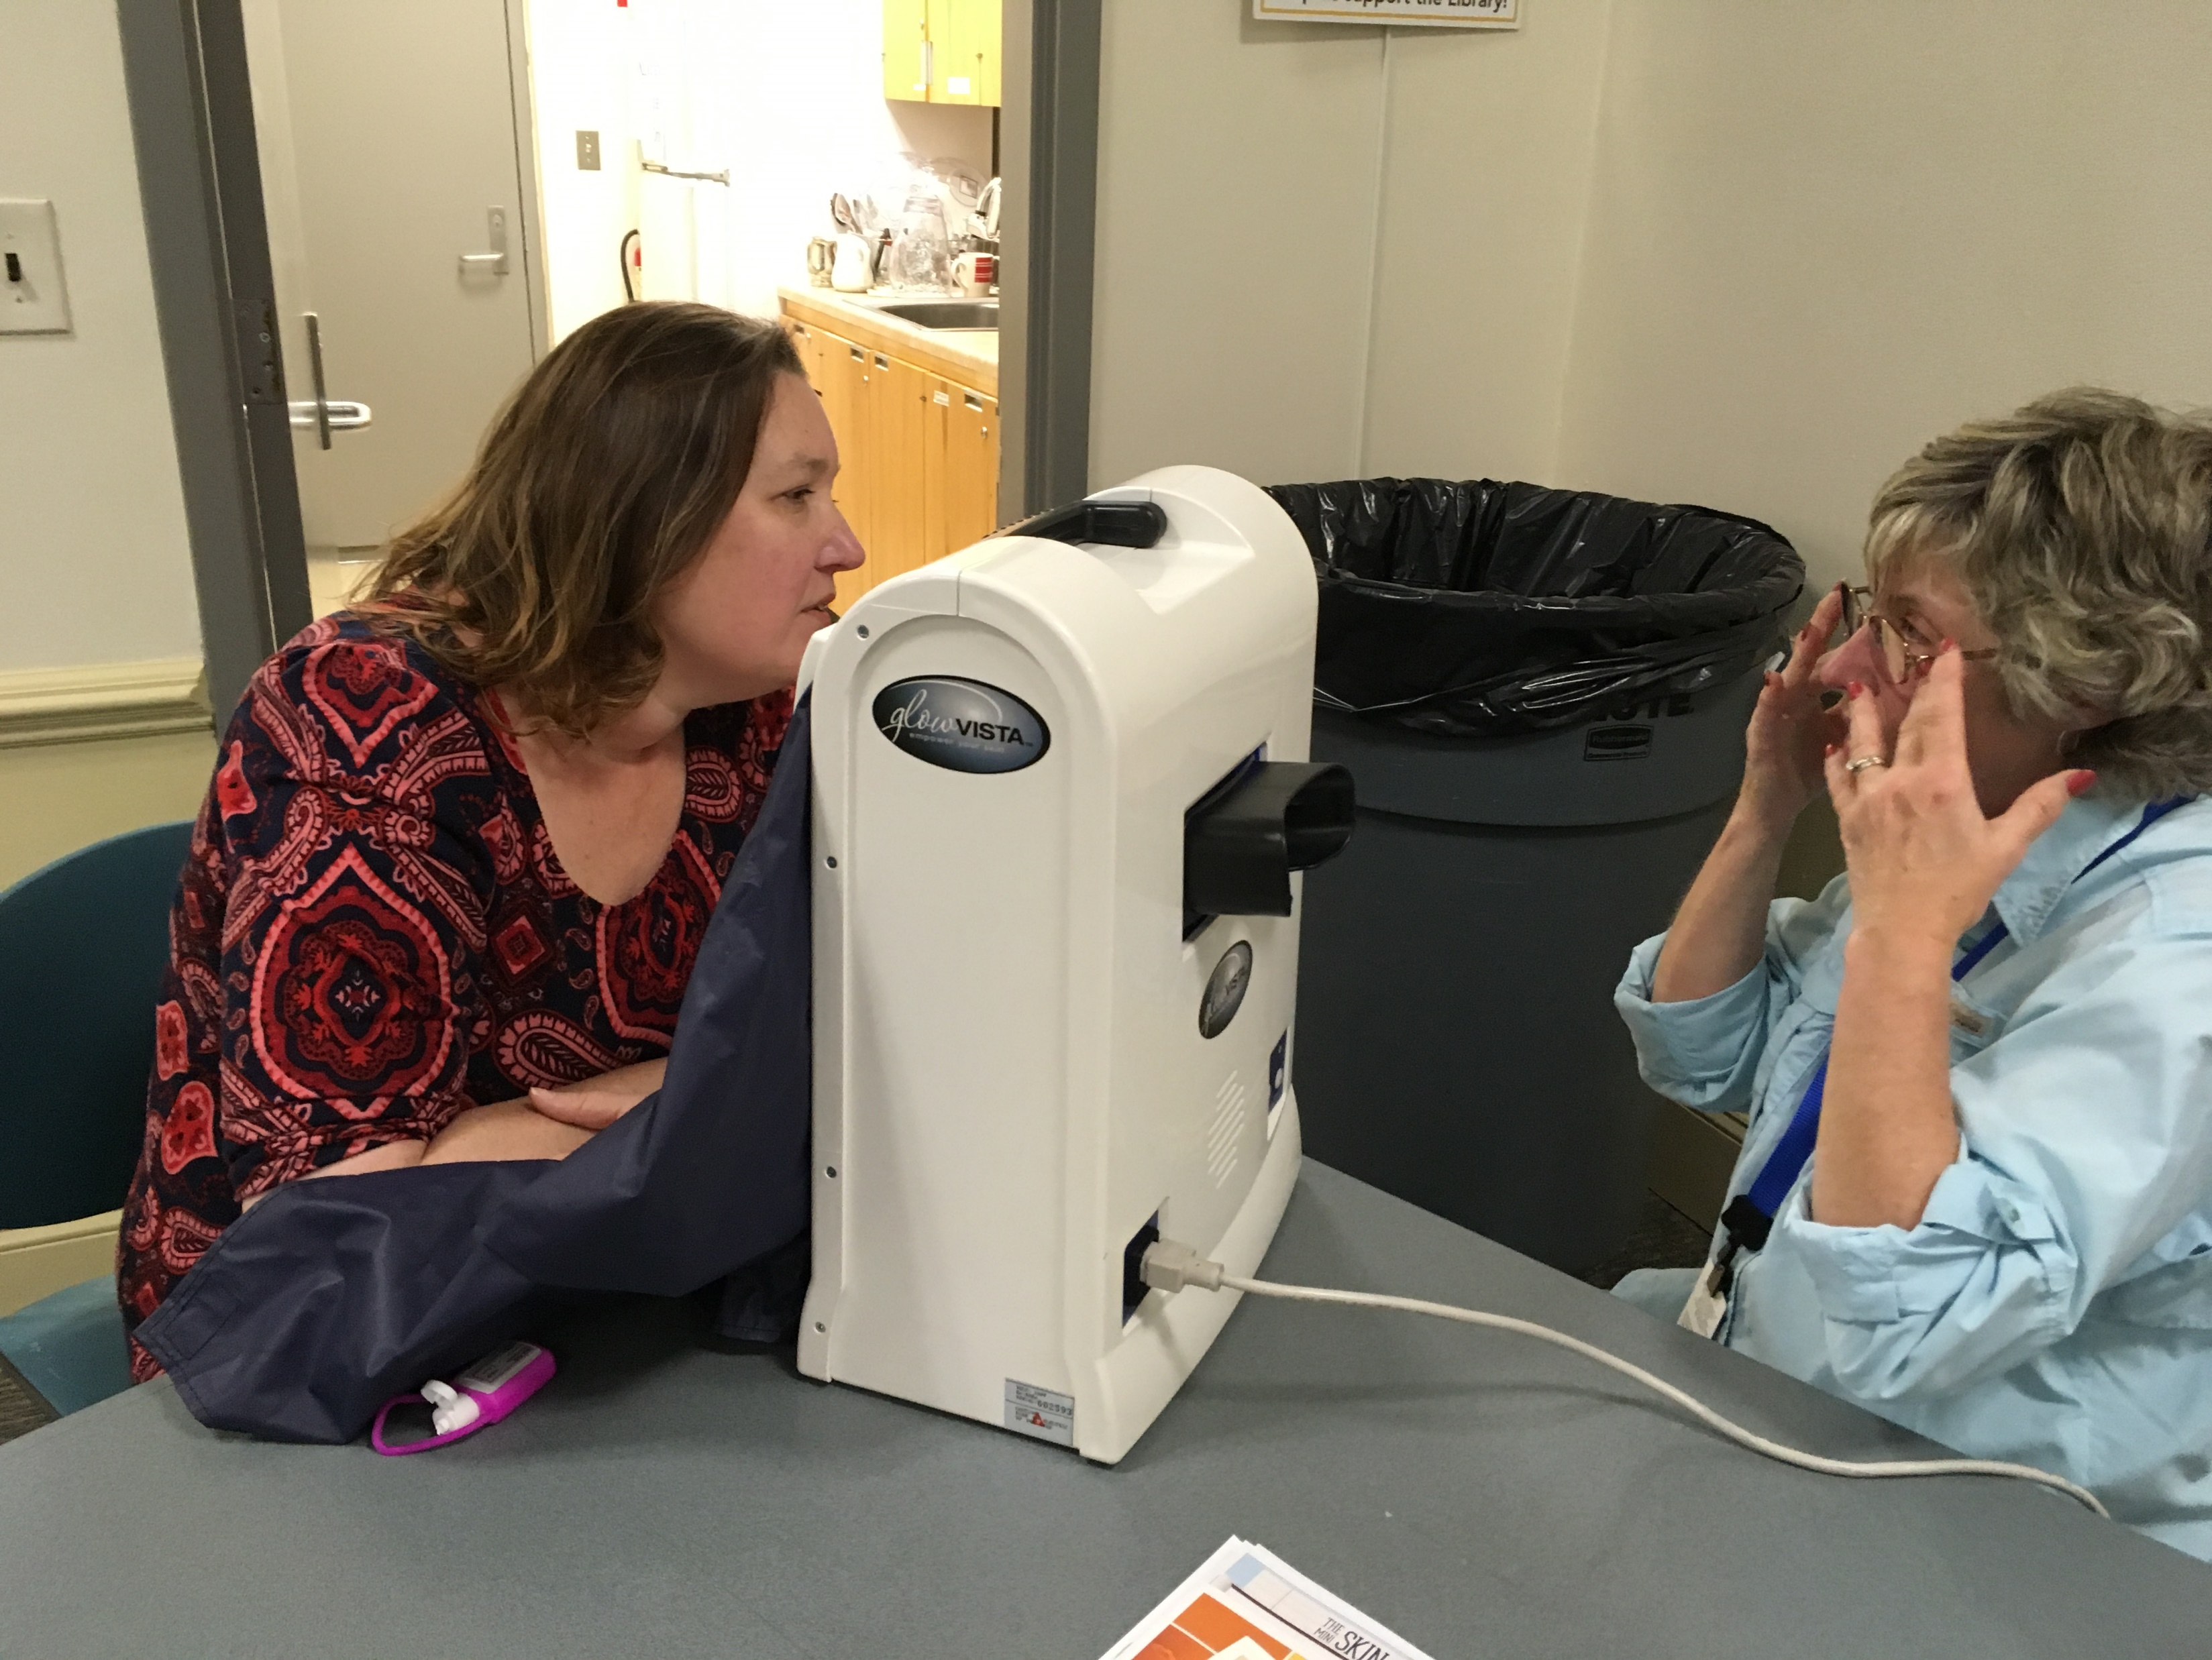
SKIN CANCER SCREENING
Melanoma Monday—First Monday in May
Facial DermaScan machine used for
facial screening.
Partnered with certified dermatologist who provided facial and upper body exam

Slide 20
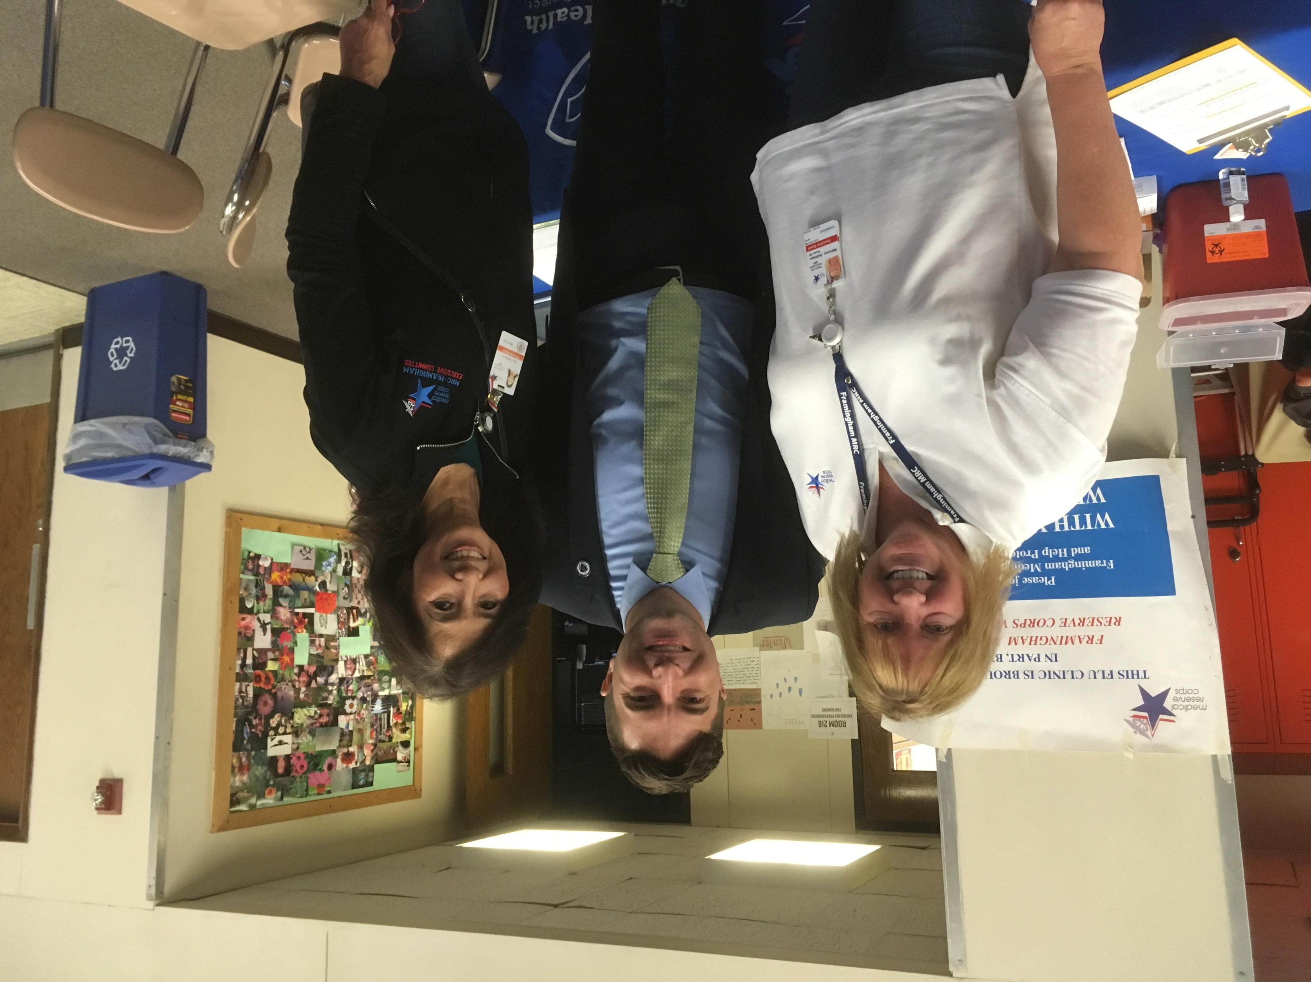
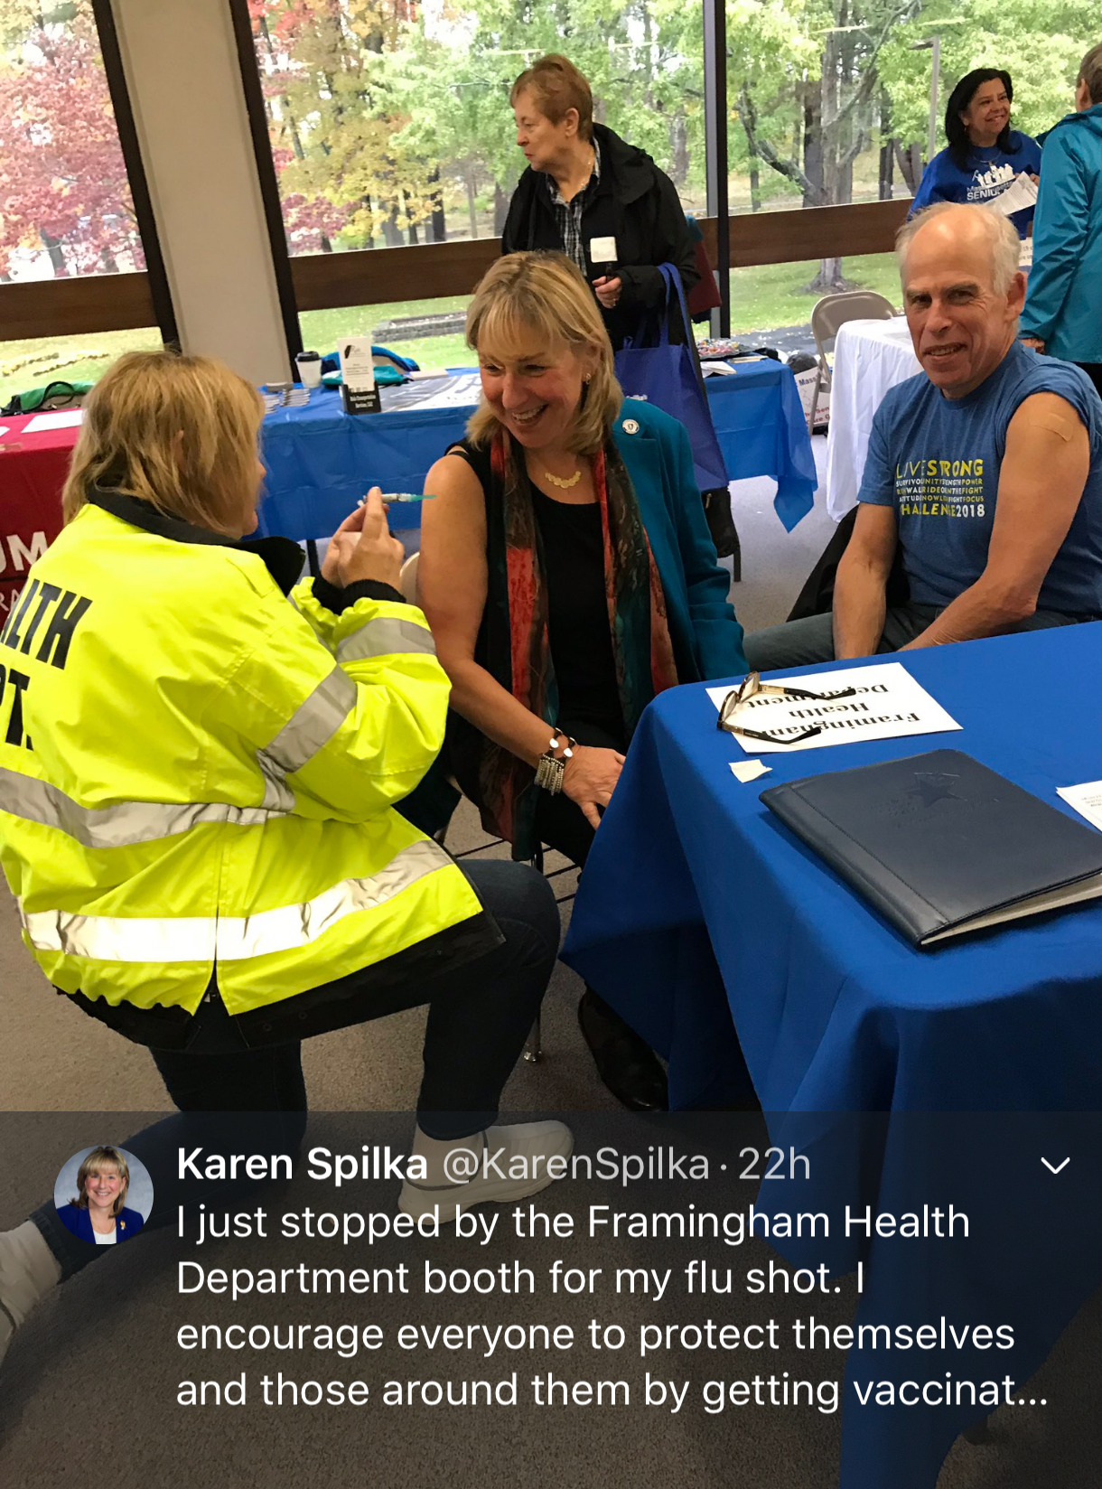
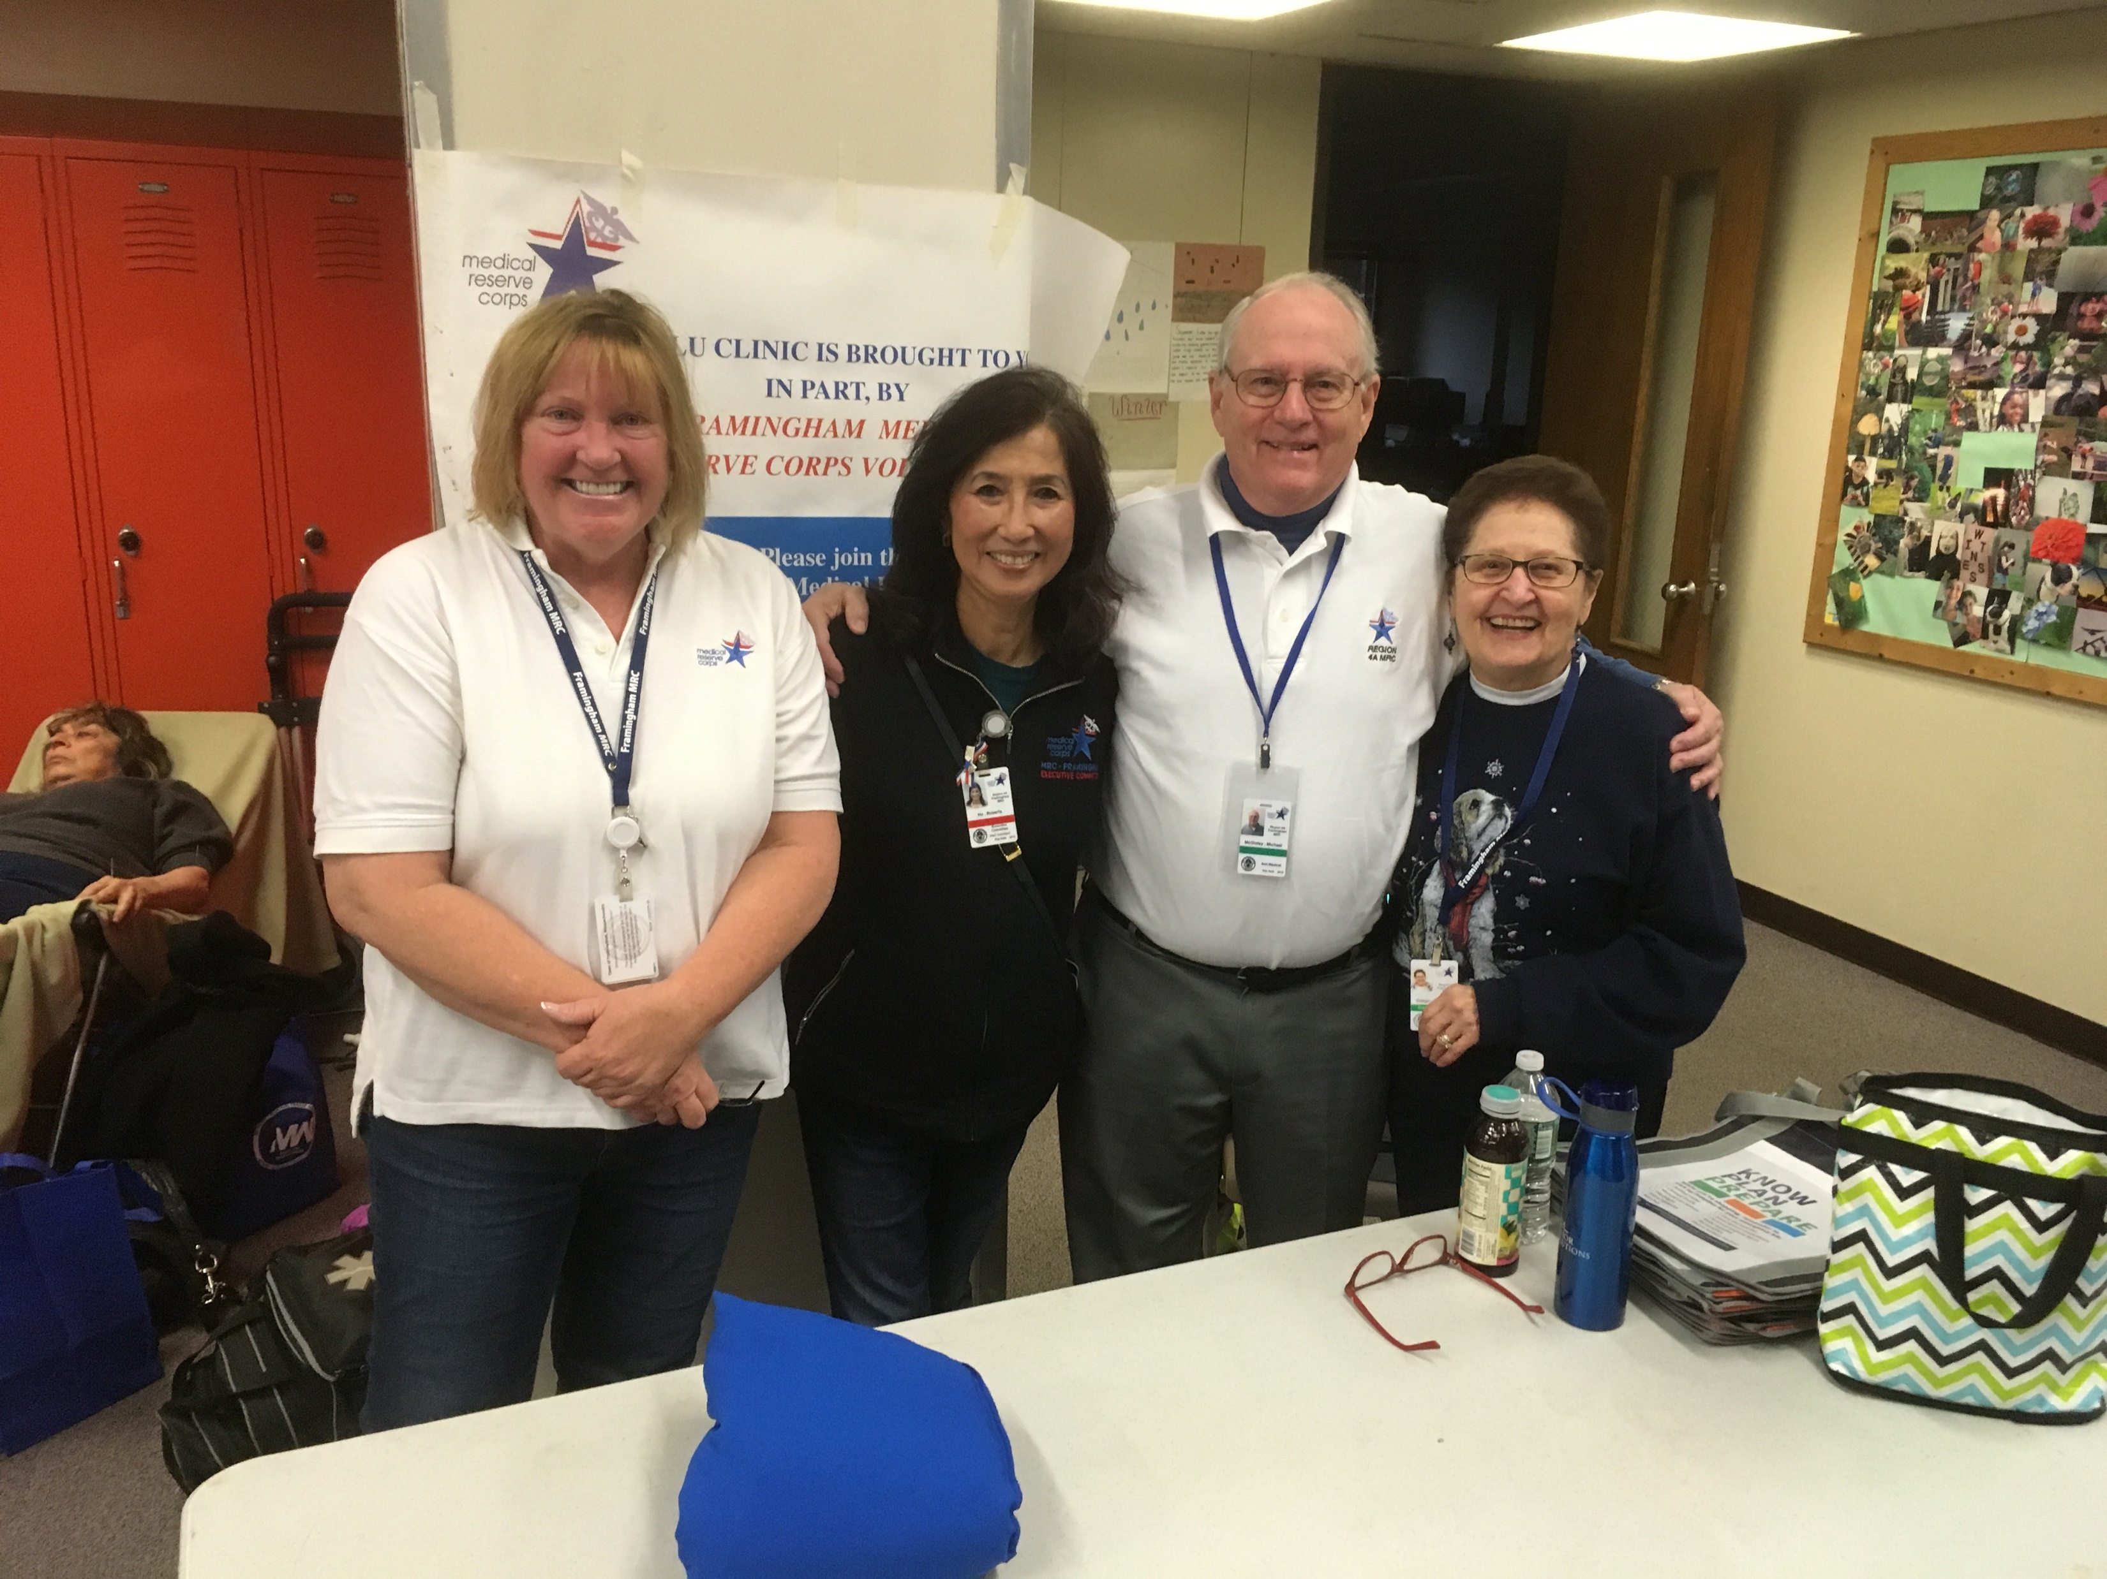
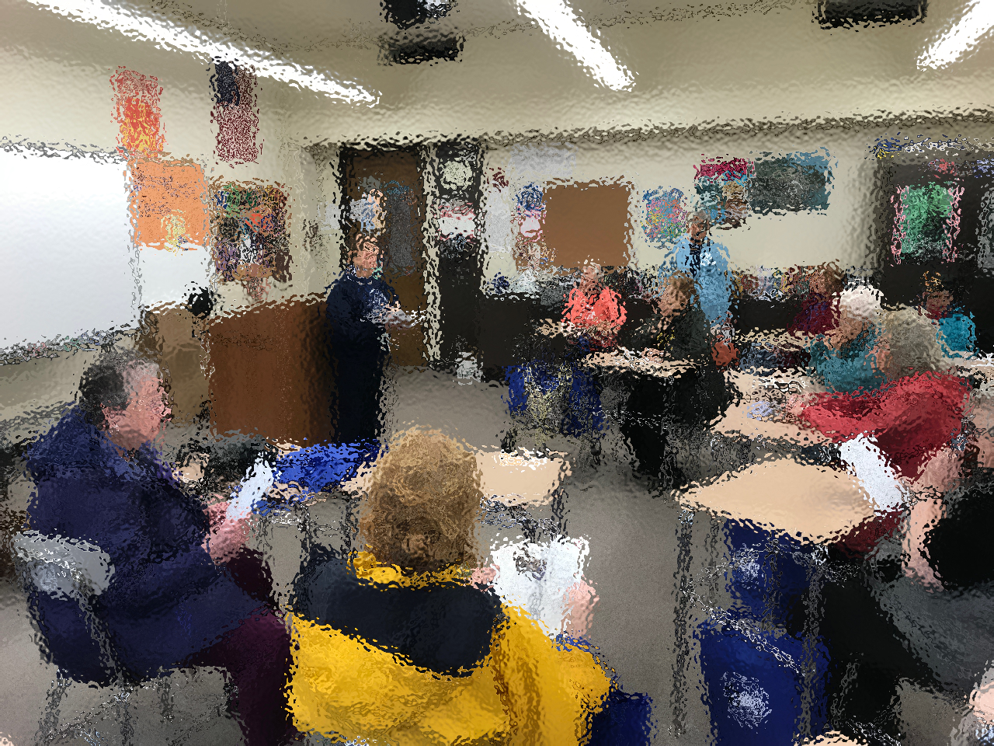
SENATOR SPILKA SENIOR HEALTH FAIR
Annual participation
Administer flu to seniors
Workshop on Emergency
Preparedness for Seniors

Slide 21
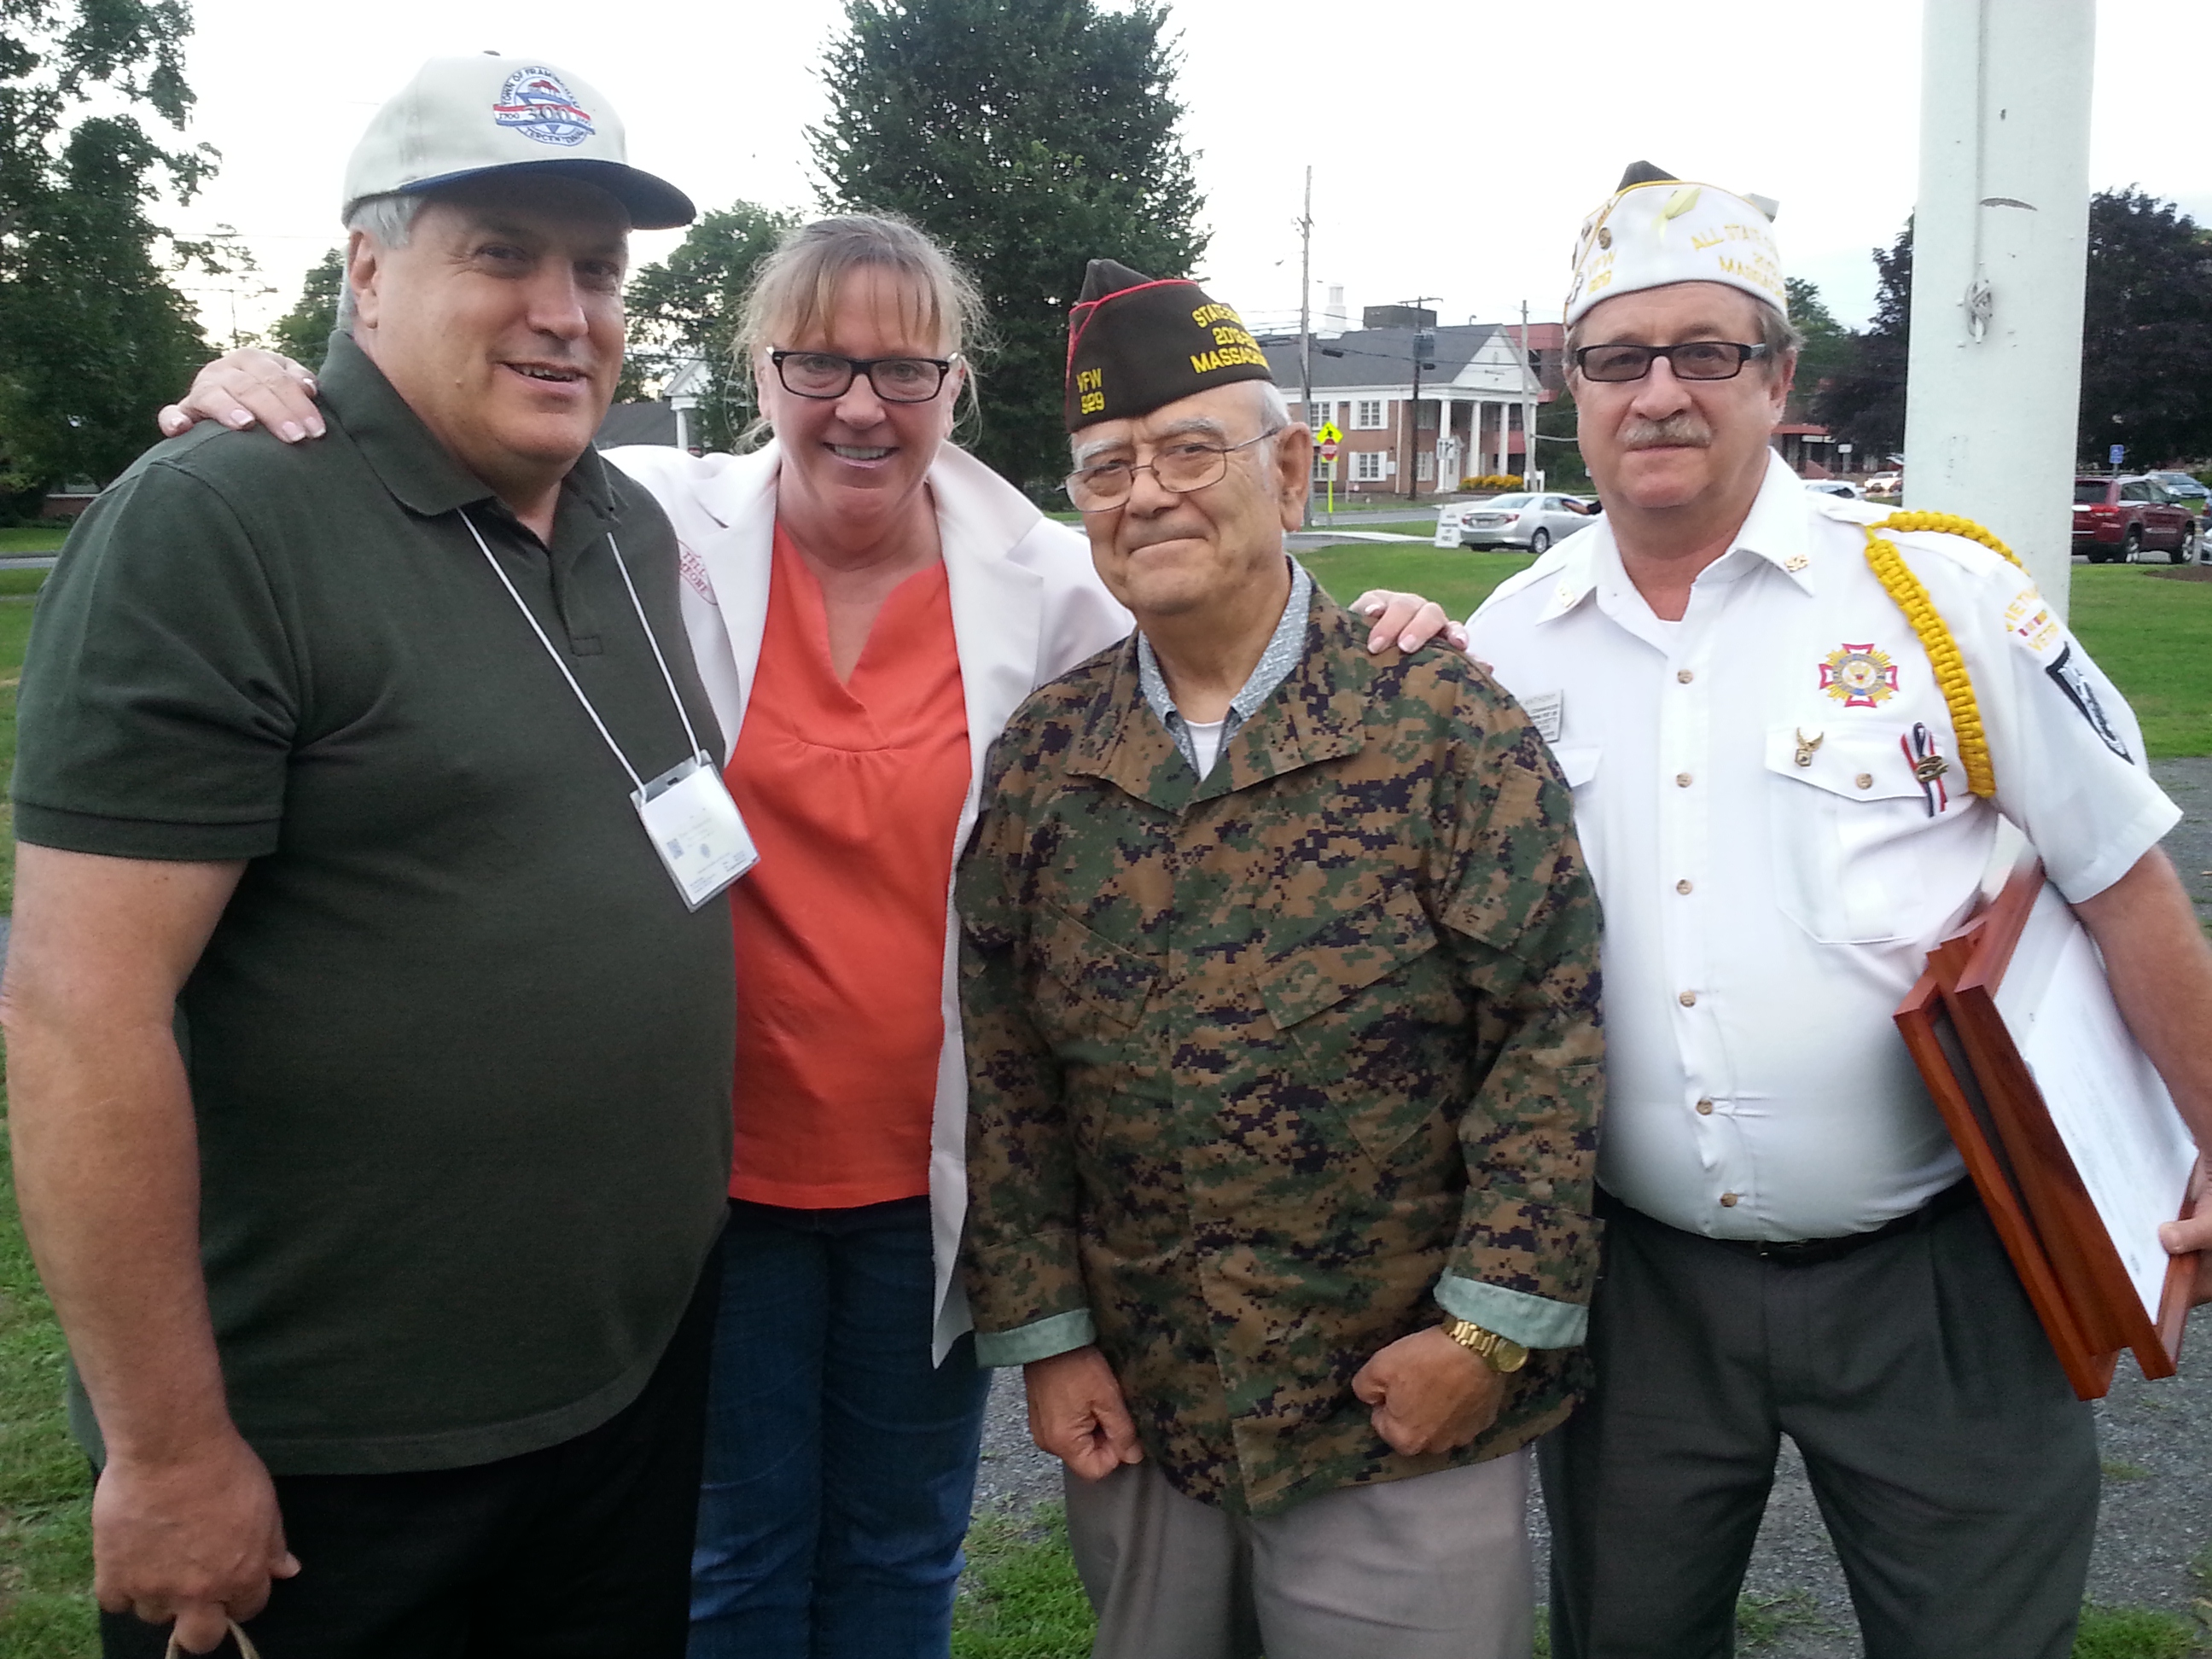
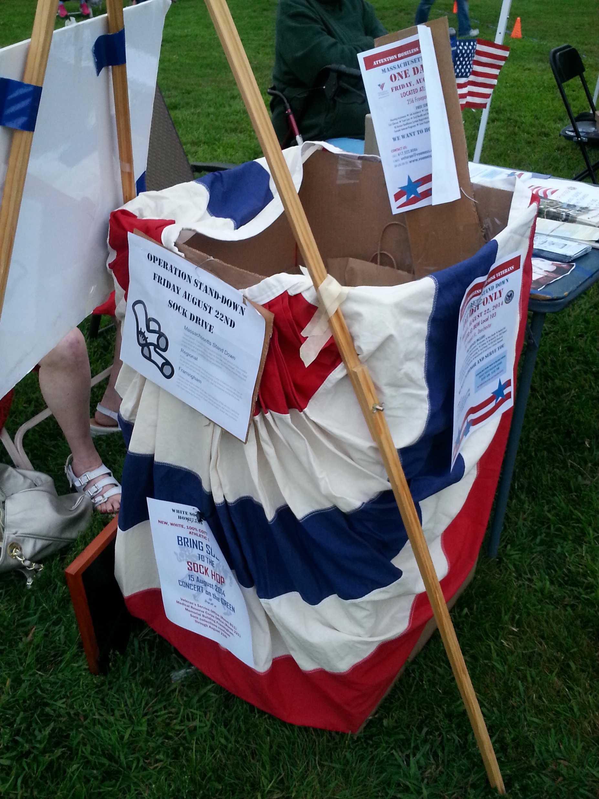
ON THE GREEN………..
Farmers’ Market
Summer Concerts
Earth Day
Sock Hop
Community Events

Slide 22
GREATER BOSTON STAND DOWN
……taking a stand for Veterans
Hosted by the New England Center and Home for Veterans (NECHV)
Annual event at Boston City Hall Plaza at 1 Cambridge Street in Boston
One-day event that brings together service providers and local Veterans
Enable Veterans to receive immediate comprehensive and coordinated
services in one place.
Essential supportive services to Veterans in the Greater Boston area (must bring proof of military service)
Comprised of more than 100 service providers, employers and community
organizations to provide housing services for Veterans who are
experiencing homelessness or who are at risk of becoming homeless,
care and prevention in medical, dental and eyes; legal, and employment
assistance

Slide 23
GREATER BOSTON STAND DOWN
……taking a stand for Veterans
FOOT CARE,
SOCKS,
BOOT & SHOE DISTRIBUTION,
“BLESSING BAGS”

Slide 24
GREATER BOSTON STAND DOWN
……taking a stand for Veterans
STUDENTS FROM THE
MASSACHUSETTS
SCHOOL of PHARMACY
& HEALTH SCIENCE
FREE BLOOD PRESSURE
CHECKS

Slide 25
TRAINING…the process of learning the skills you
need to do a particular job
NARCAN
TRAINING

Slide 26
TRAINING…the process of learning the skills you
need to do a particular job
CARDIOPULMONARY
RESUSITATION (CPR)
CERTIFICATION

Slide 27
TRAINING…the process of learning the skills you
need to do a particular job
FLUZONE TRAINING for local flu
clinics by Sanofi & Framingham
Public Health Department

Slide 28
TRAINING…the process of learning the skills you
need to do a particular job
STOP THE BLEED
Partnered with Tufts Medical Center
and Framingham Fire Department

Slide 29
TRAINING…the process of learning the skills you
need to do a particular job
Incident Command System 100
CPR-Basic Life Support (BSL) and/or Automatic External Defibrillator(AED)
Stop the Bleed
Emergency Dispensing
Basic Sheltering
Pet Sheltering
Senior Emergency Preparedness
Youth/Adult Mental Health
Active Shooter
Nasal Narcan
First Aid
Fire Safety
and community/volunteer requests

Slide 30
THE FOUR C’s
Our local PHN and Volunteers worked together….
COOPERATIVELY Public Health Nurse and MRC Volunteers work together to improve the health, safety, and resiliency of the
community.
COLLABORATIVELY Public Health Nurse and MRC Volunteers join forces to achieve health, safety, and resiliency of the community.
CONCERTEDLY Public Health Nurse and MRC Volunteers are united to attain health, safety, and resiliency of the community.
COLLECTIVELY Public Health Nurse and
MRC Volunteers act as one group to better the
health, safety, and resiliency of the community

Slide 31
In closing, this short video depicts the
importance of the partnership with public
health nurses, MRC volunteers, student nurses, & community.
Our role started with 2 local public health nurses and expanded to many MAPHN members, nursing students and MRC Volunteers.

