Slide 1
Massachusetts Association of Public Health Nurses
21ST ANNUAL MAPHN CONFERENCE
THE MANY FACES OF THE OPIOD EPIDEMIC
(MAY 2017)
Jennifer C. Rowe
Assistant District Attorney
Director, Crime Prevention Unit

Slide 2
Overdose Prevention in Norfolk County
Strategic, Data-Driven Initiatives
172 fatal overdoses in 2016
43 motor vehicle homicide deaths in 2016
Massachusetts Association of Public Health Nurses

Slide 3
NORFOLK COUNTY OVERDOSE DEATH REVIEW
PARTICIPANTS
A detective from each of our 28 local police departments
State Police Homicide and Narcotics assigned to CPAC at NDAO
Boston DEA Diversion
FBI
HHS-OIG
Investigators from:
Board of Medicine
Board of Pharmacy
Board of Nursing
Massachusetts Office of the Attorney General
Massachusetts Association of Public Health Nurses

Slide 4
NORFOLK COUNTY OVERDOSE DEATH REVIEW
Local Police Report
Massachusetts State Police Report
Patient Prescription History
Cell phone data, if available
DATA SOURCES
Massachusetts Association of Public Health Nurses

Slide 5
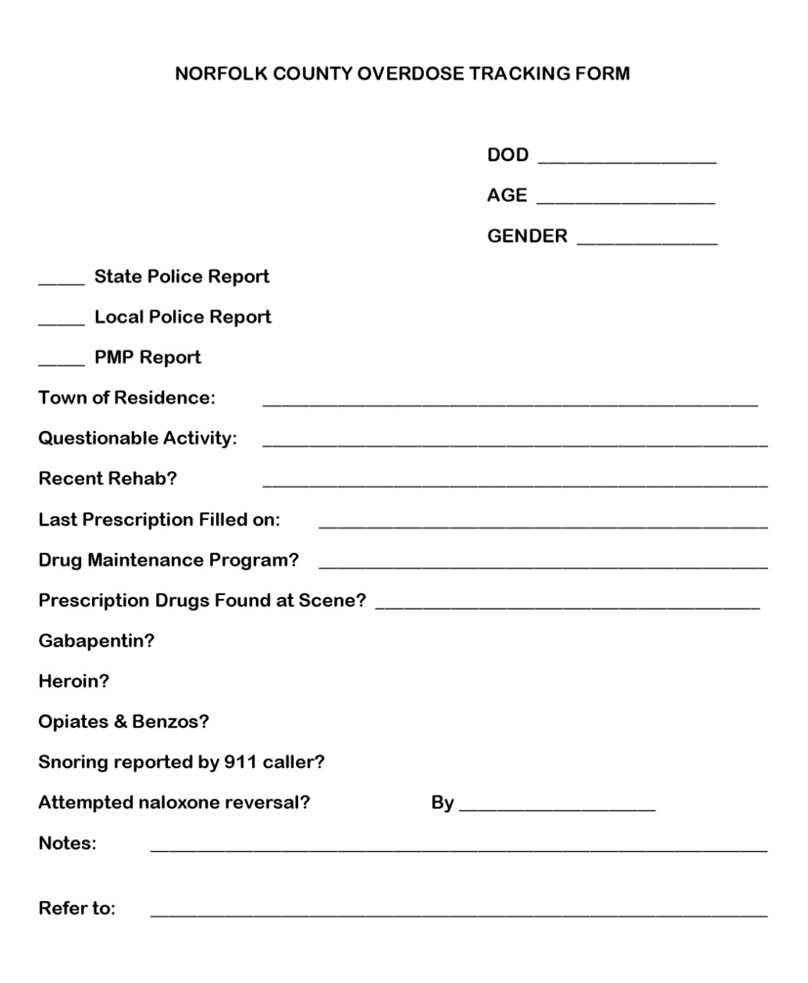
NORFOLK COUNTY OVERDOSE DEATH REVIEW

Slide 6
What gets referred?
Where do we refer cases for review?
What information can we share in referral process?
NORFOLK COUNTY OVERDOSE DEATH REVIEW
Referral Process for review of concerning prescribing and dispensing as seen in the patient prescription history of the decedent
Massachusetts Association of Public Health Nurses

Slide 7
NORFOLK COUNTY OVERDOSE DEATH REVIEW
Norfolk County Overdose Death Review Data
2013: 63 fatal overdoses
2014: 93 fatal overdoses
2015: 150 fatal overdoses
2016: 172 fatal overdoses
2016 Data Summary
133 male decedents
39 female decedents
Youngest: 17 years old
78 were under the age of 35
26 of our 28 communities had at least one fatal overdose

Slide 8
NORFOLK COUNTY OVERDOSE DEATH REVIEW
What have we learned and what are we doing about it?
Massachusetts Association of Public Health Nurses

Slide 9
RISK FACTORS FOR SCHOOL AGED CHILDREN
Prescribing opioid post operatively following orthopedic sports injury during high school
Prescribing opioid following oral surgery during high school years
Lowered tolerance
Unsafe storage and failure to maintain control of medicine

Slide 10
Screening (SBIRT)
Universally screen two grade levels each year
School districts select which grade levels will be screened
School districts select evidence-based screening tool
Train those with a medical role in your school district
School Nurses
Athletic Trainer
Grant: $2,500 to each school district for SBIRT implementation costs

Slide 11
MIAA RULE CHANGE -
“Prior to any chemical health violation, a student’s request for and enrollment in a substance abuse treatment program shall not in and of itself constitute a violation of Rule 62 (MIAA Chemical Health Rule)”

Slide 12
Risk Assessment & Re-Entry of Students following substance use treatment
lowered tolerance

Slide 13
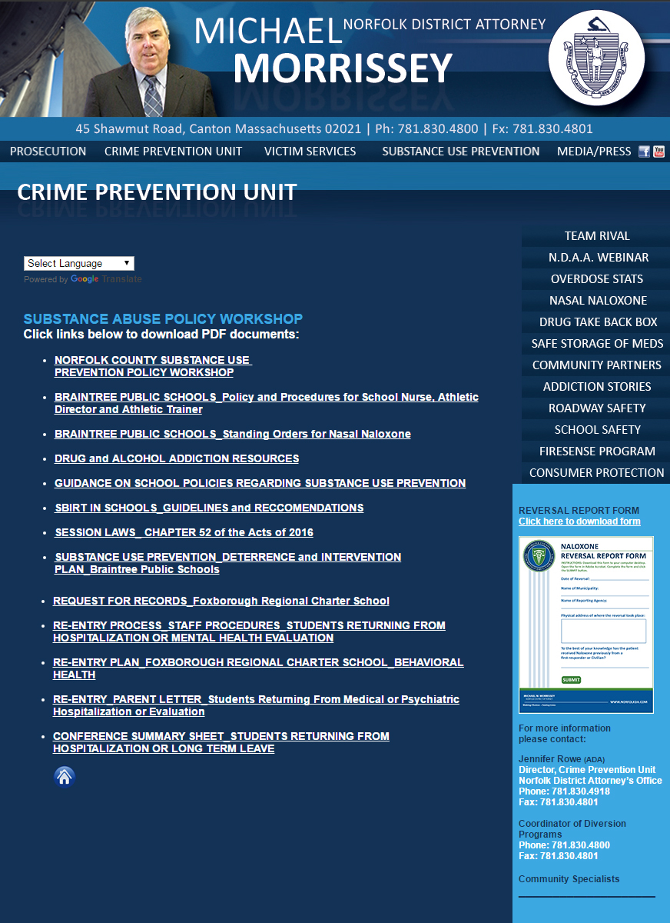

Slide 15
NORFOLK COUNTY OVERDOSE DEATH REVIEW
RISK FACTORS FOR ADULTS
Lowered tolerance
Drug maintenance
and other medications
Prior successful reversal
Benzos + Opioids + drug maintenance
Cash payments and early refills
Poor access to treatment
Massachusetts Association of Public Health Nurses

Slide 16
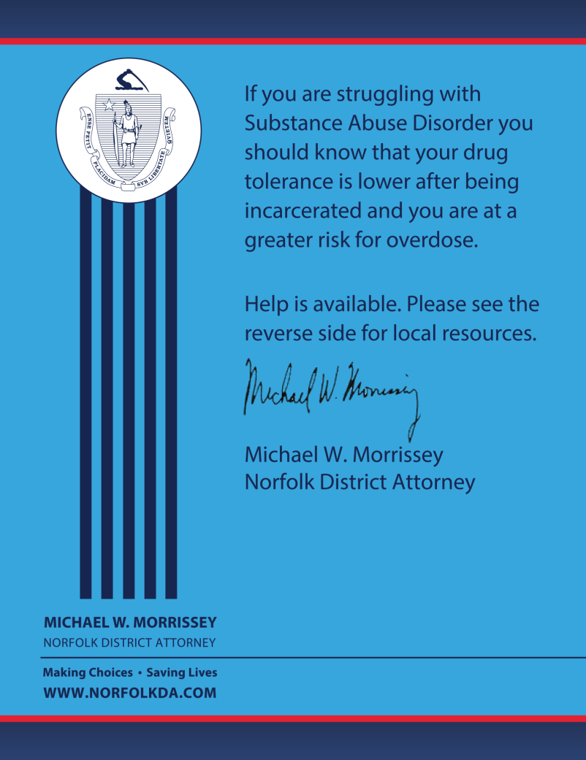
LOWERED TOLERANCE

Slide 17
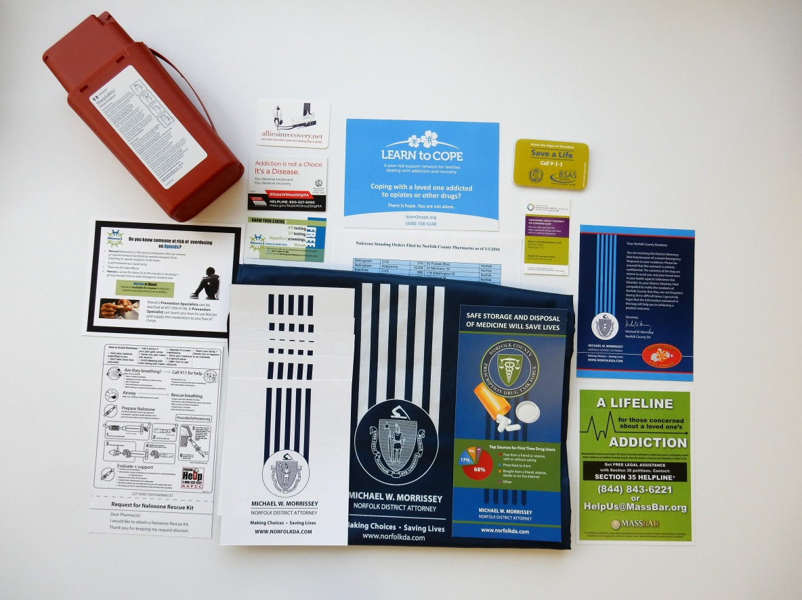
NORFOLK COUNTY OVERDOSE DEATH REVIEW
NORFOLK COUNTY CARES KIT

Slide 18
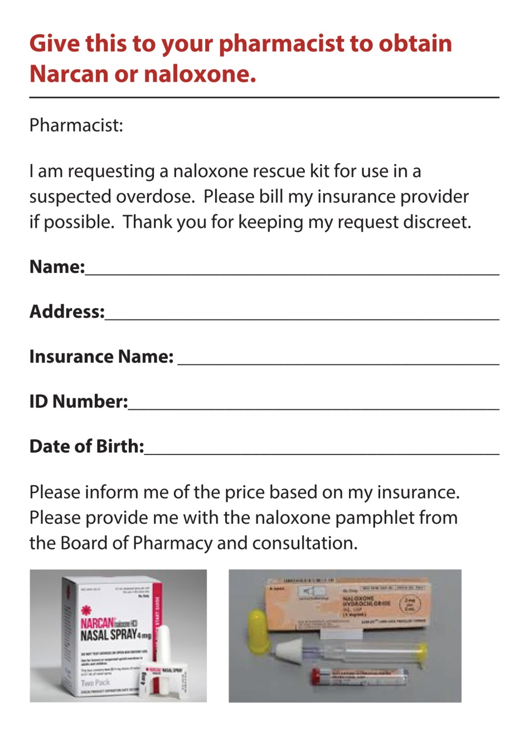
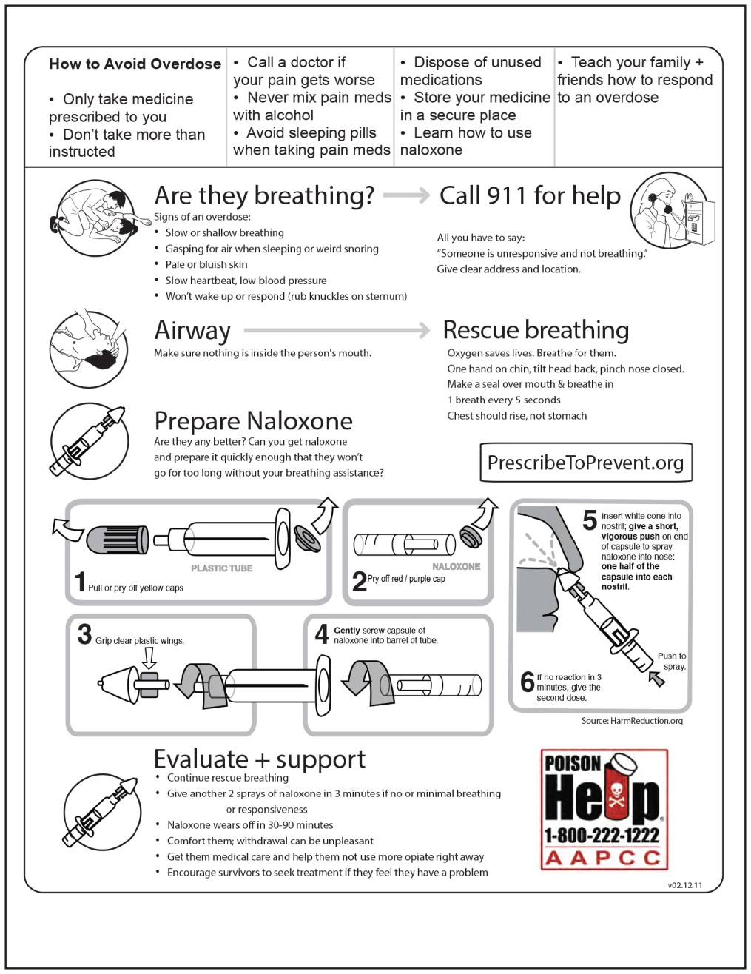
NORFOLK COUNTY OVERDOSE DEATH REVIEW

Slide 19
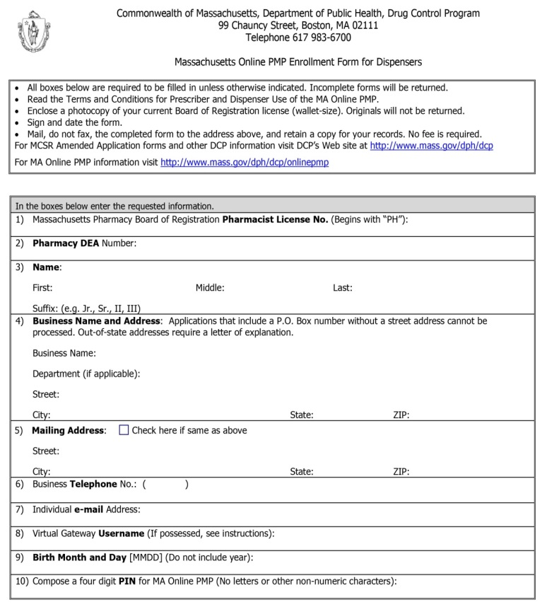
Pharmacy Outreach Program
NORFOLK COUNTY OVERDOSE DEATH REVIEW
GOALS Encourage consistent use of
PMP prior to dispensing
DISPENSERS

Slide 20
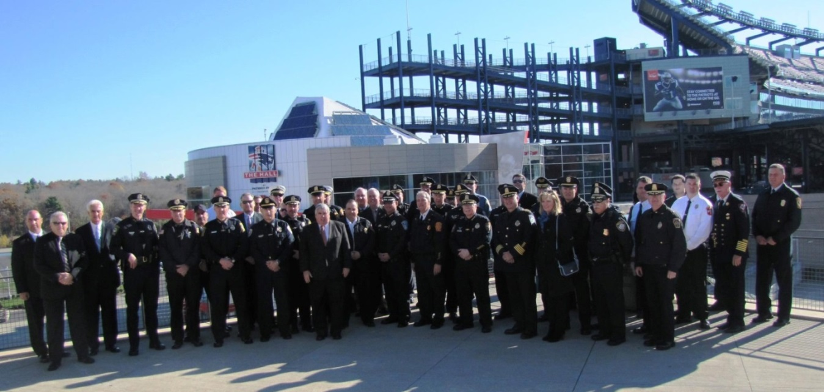
Pharmacy Outreach Program
NORFOLK COUNTY OVERDOSE DEATH REVIEW
GOAL > Building relationships between pharmacists and local police.

Slide 21
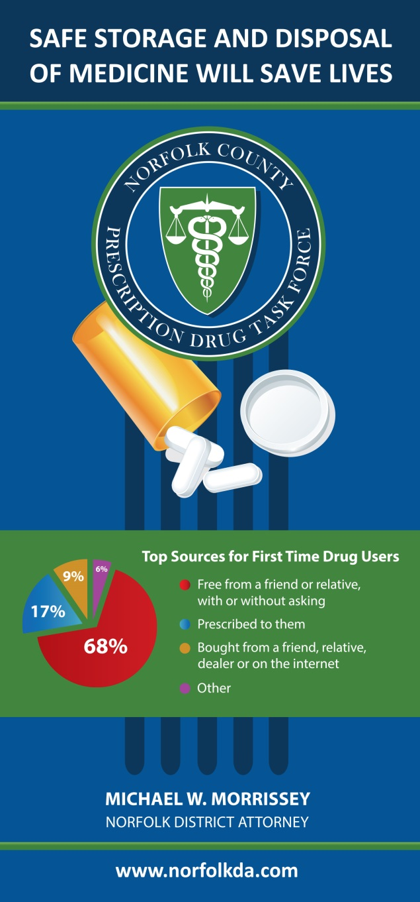
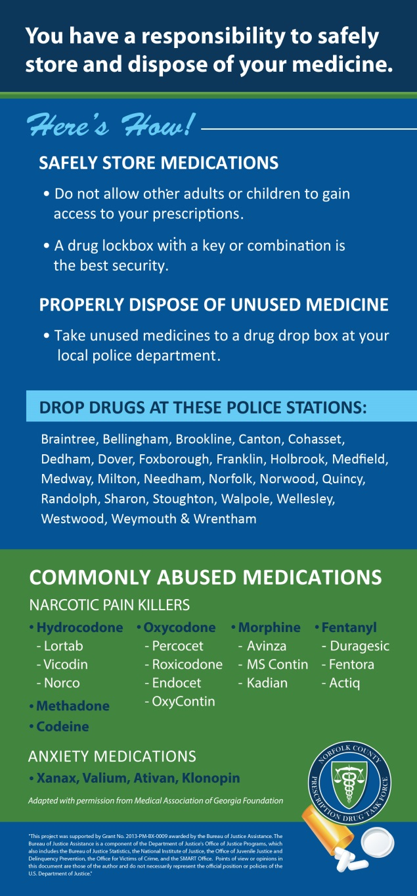

Slide 22
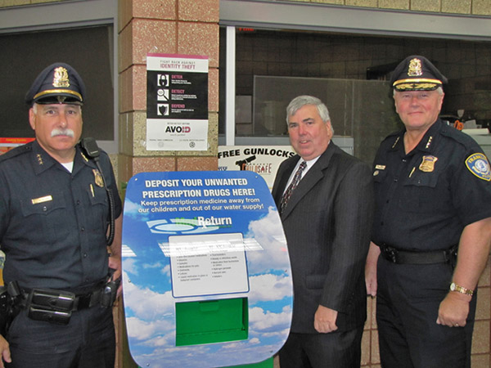
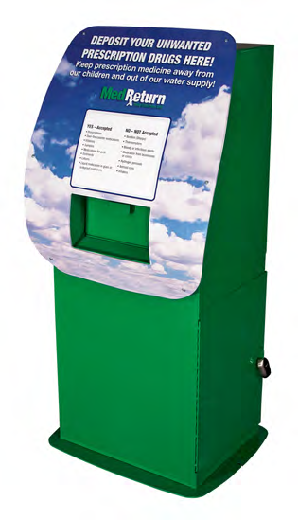
NORFOLK COUNTY OVERDOSE DEATH REVIEW
Medicine Return Boxes

Slide 23
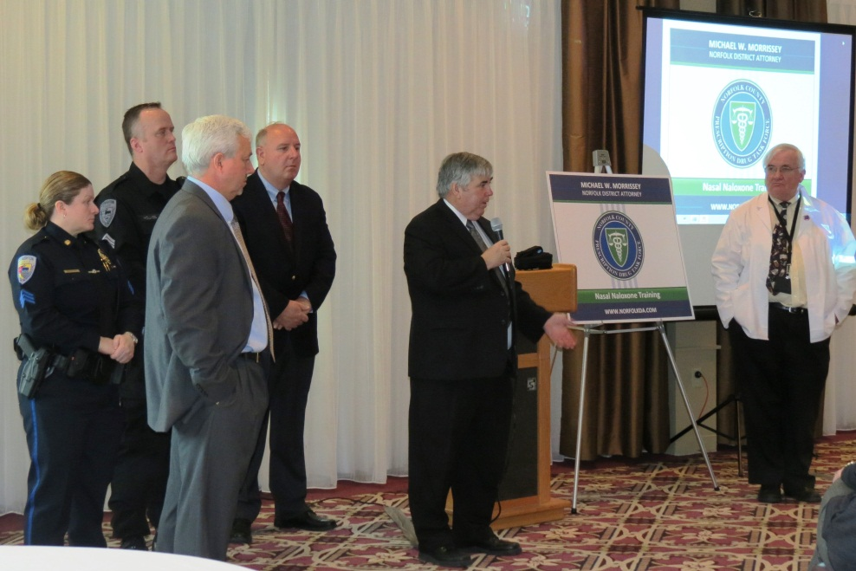
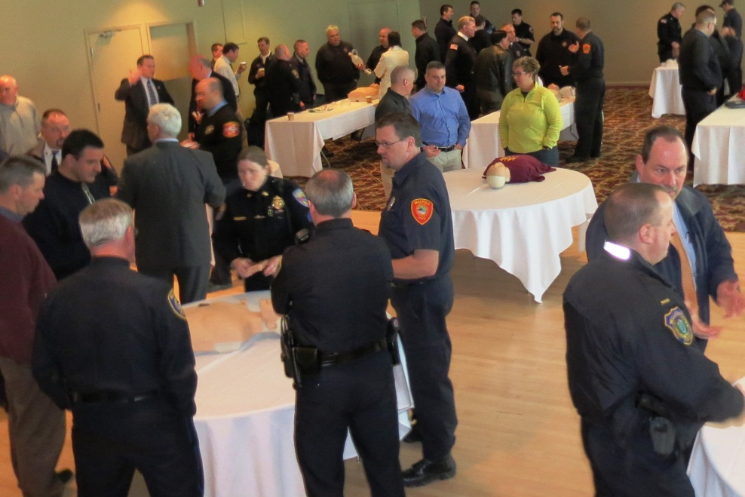
First Responder Nasal Naloxone
NORFOLK COUNTY OVERDOSE DEATH REVIEW

Slide 24
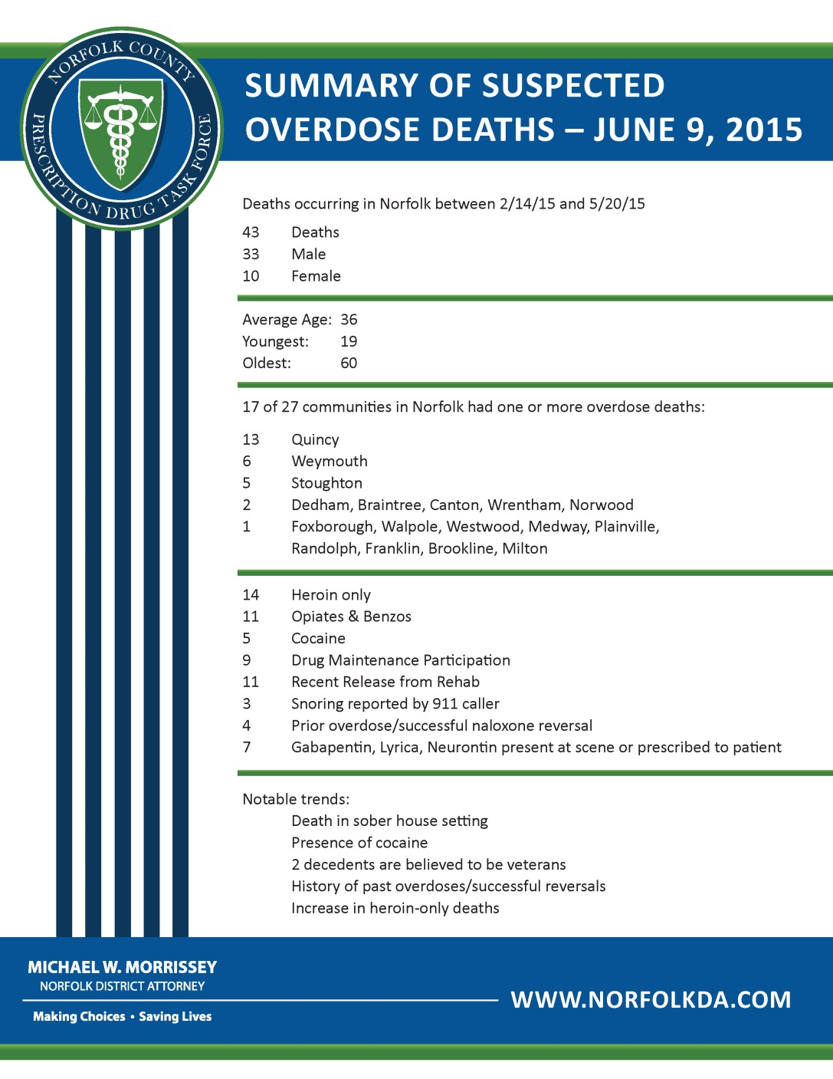
Transparency with aggregate, de-identified data

Slide 25
NORFOLK COUNTY COMMUNITY COALTIONS
Avon Coalition for Every Student (A.C.E.S.)
Braintree Community Partnership on Substance Abuse
Brookline Coalition Against Substance Abuse (B-CASA)
Cohasset Safe Harbor
Dedham Coalition for Drug and Alcohol Awareness
Dover Substance Prevention & Awareness Network (SPAN-DS)
Foxborough – Substance Abuse Free Environment of Foxborough (SAFE)
Franklin S.A.F.E. Coalition
Holbrook Cares
Impact Norwood
Learn to Cope
Medfield Cares About Prevention
Milton Substance Abuse Prevention Coalition
Needham Coalition for Youth Substance Abuse Prevention (NCYSAP)
Stoughton – Organizing Against Substances in Stoughton (OASIS)
Quincy – The Mayor’s Substance Abuse Task Force
Randolph Substance Abuse Prevention Coalition
Walpole Coalition for Alcohol & Drug Awareness
Weymouth Substance Abuse Prevention Team (SAPT)

Slide 26
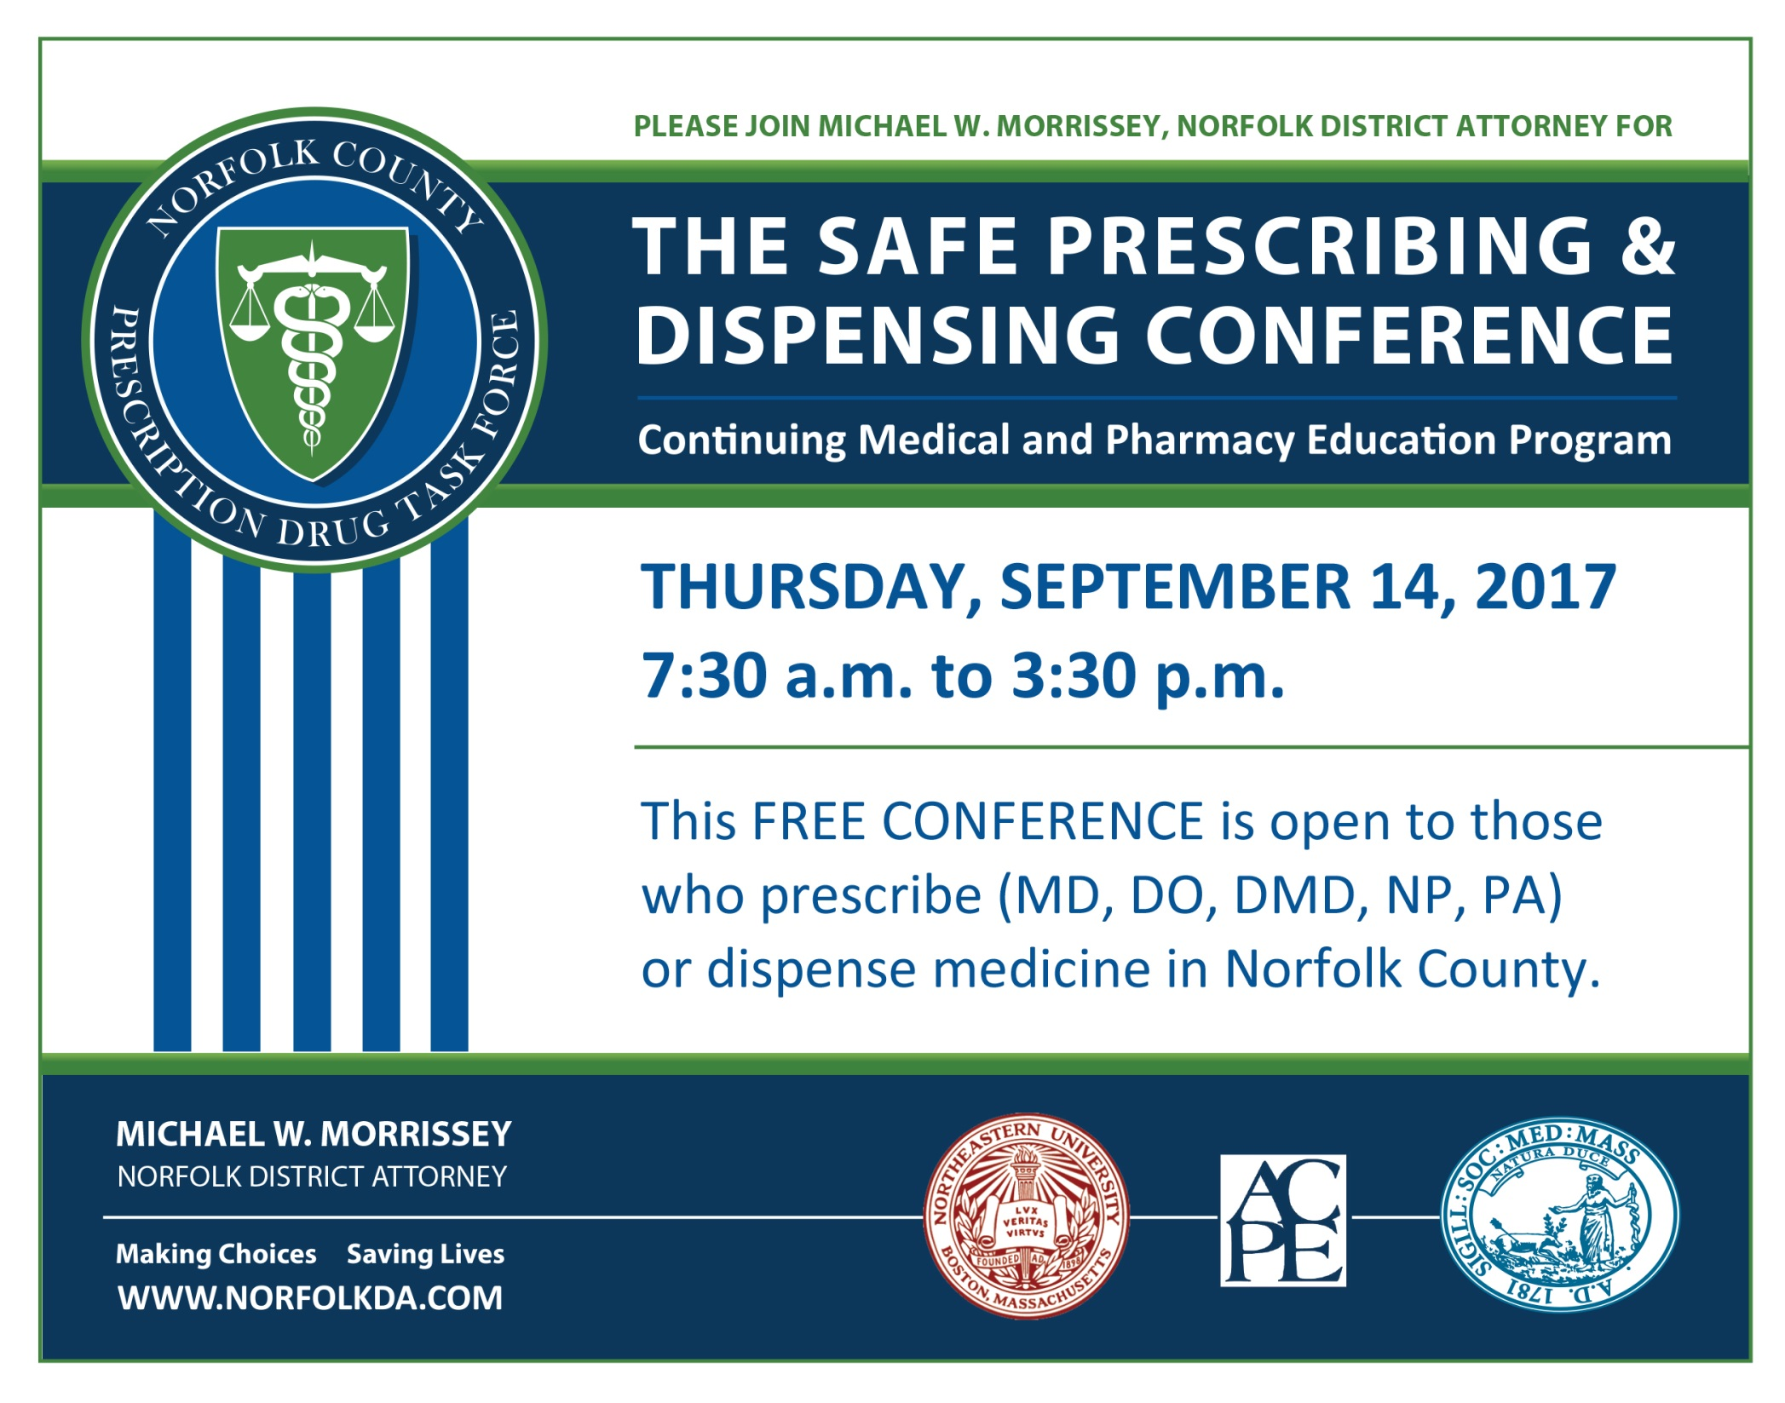

Slide 27
Massachusetts Association of Public Health Nurses
21ST ANNUAL MAPHN CONFERENCE
THE MANY FACES OF THE OPIOD EPIDEMIC
(MAY 2017)
Jennifer C. Rowe
Assistant District Attorney
Director, Crime Prevention Unit

